Slide 1
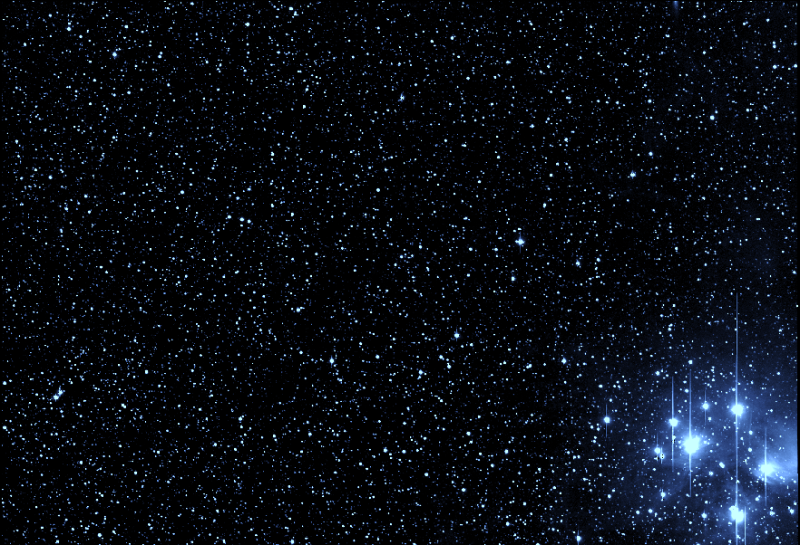













The All-Sky Automated Survey for SuperNovae
C. S. Kochanek (OSU), K. Z. Stanek (OSU), T. Holoien (OSU->Carnegie), B. Shappee (Carnegie->Hawaii), J. L. Prieto (Diego Portales), S. Dong (Kavli Beijing)
Goal: To Find All Bright Transients By Surveying the Entire Visible Sky to ~17 mag on a Nightly Basis
Notes:
background is Pleiades

Slide 2
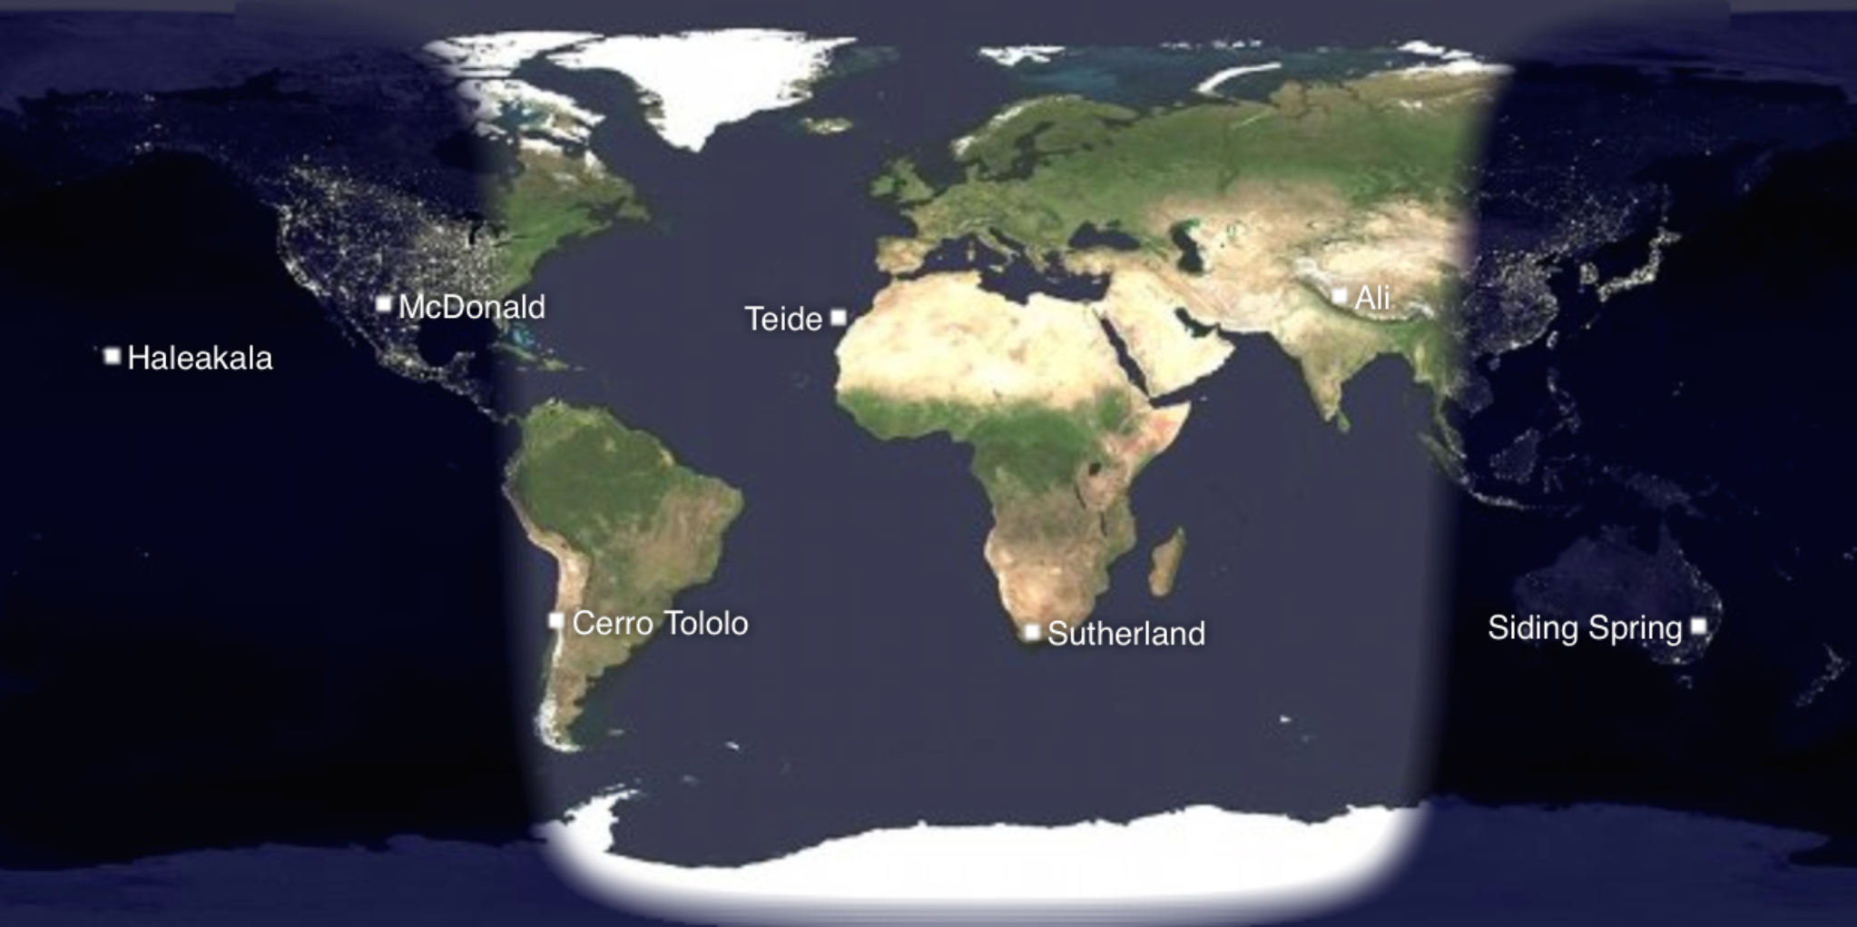

Presently 2 “Mounts” – Haleakala and CTIO
By end of 2017, 3 more – McDonald, Sutherland, second at CTIO
Hosted By……

Slide 3
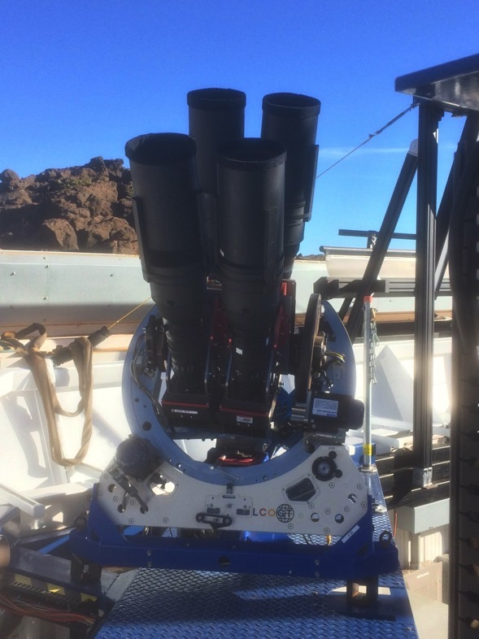
“Mounts”
4 telescopes per mount
14cm lens, 2k × 2k thinned CCDs
4.47 × 4.47 degree field-of-view
7.8" pixel scale
V or g-band filters
limiting magnitude ≈ 17
~1400 images per mount per night
~8000 square degrees per mount per night
With 5 mounts, ~40,000 square degrees per night!
Picture Courtesy of Mark Elphick
Notes:
400 mm NIKKOR
400mm F2.8G ED VR

Slide 4
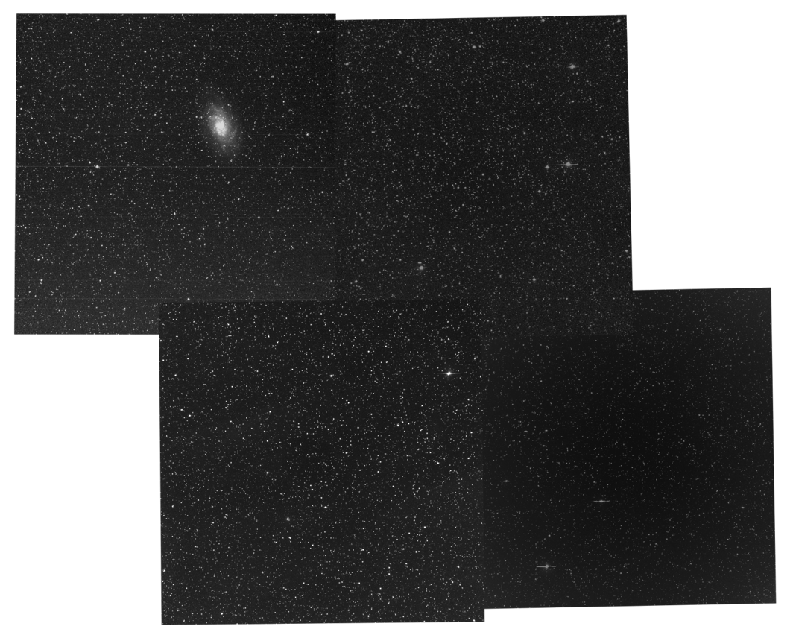
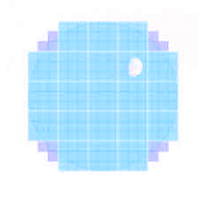
M33: One Image from One Mount
(as compared to a full moon and LSST)
≈4.5°
Notes:
M33

Slide 5

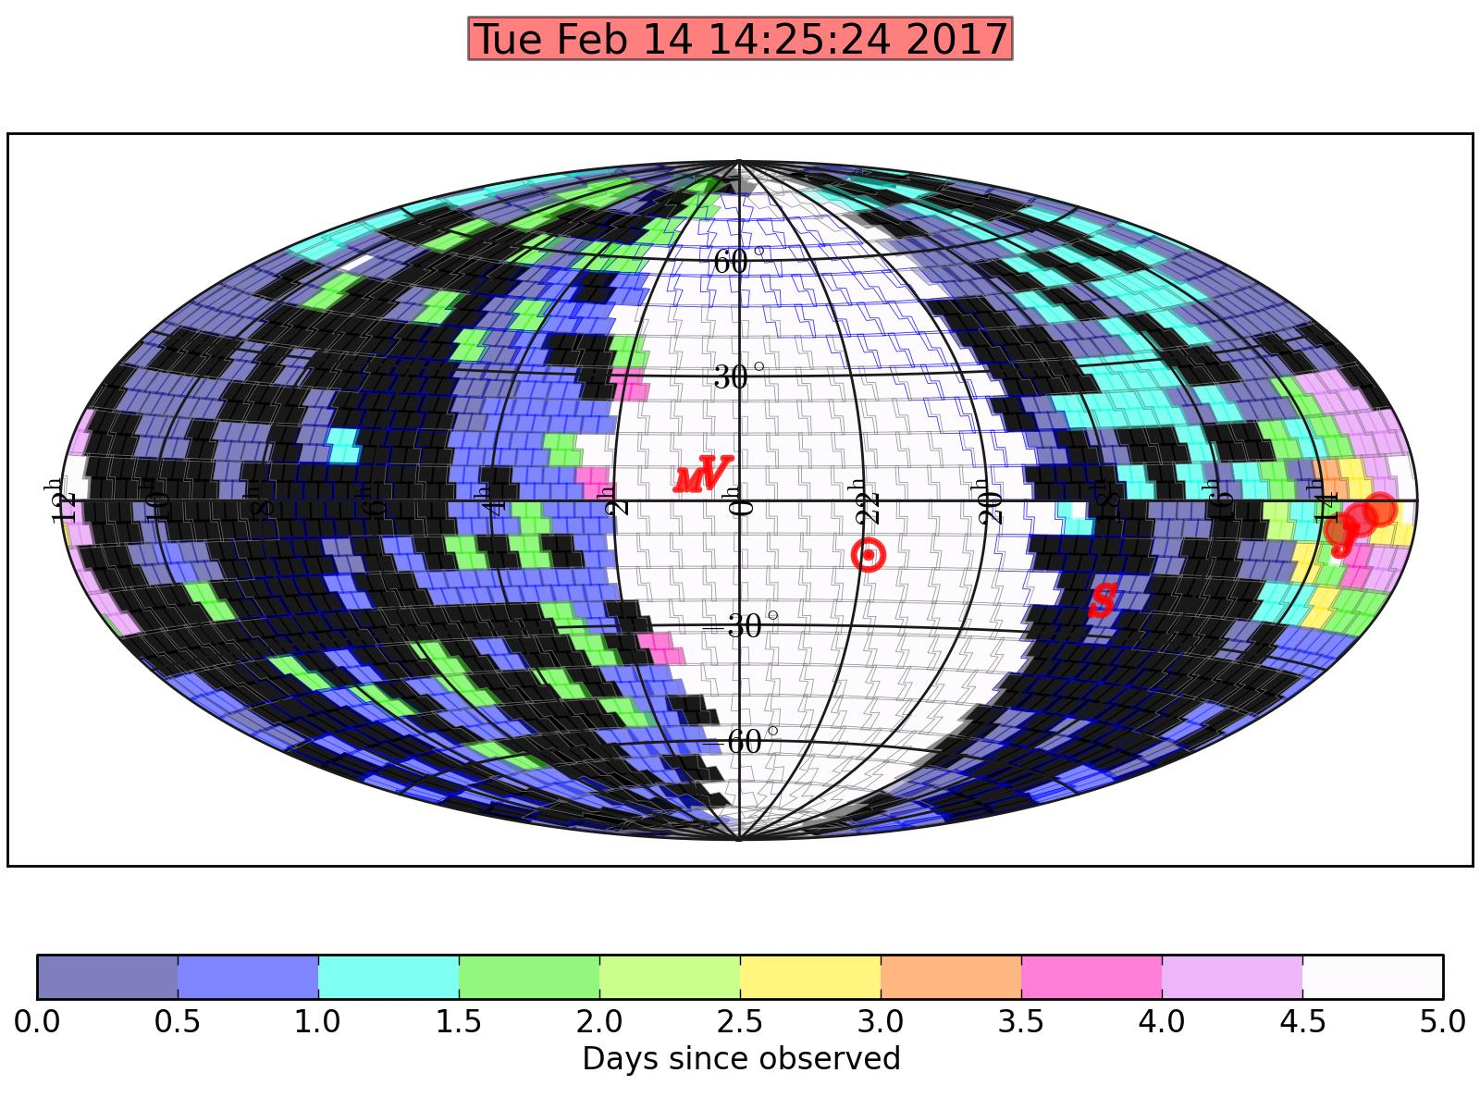
Cadence and Coverage

Slide 6
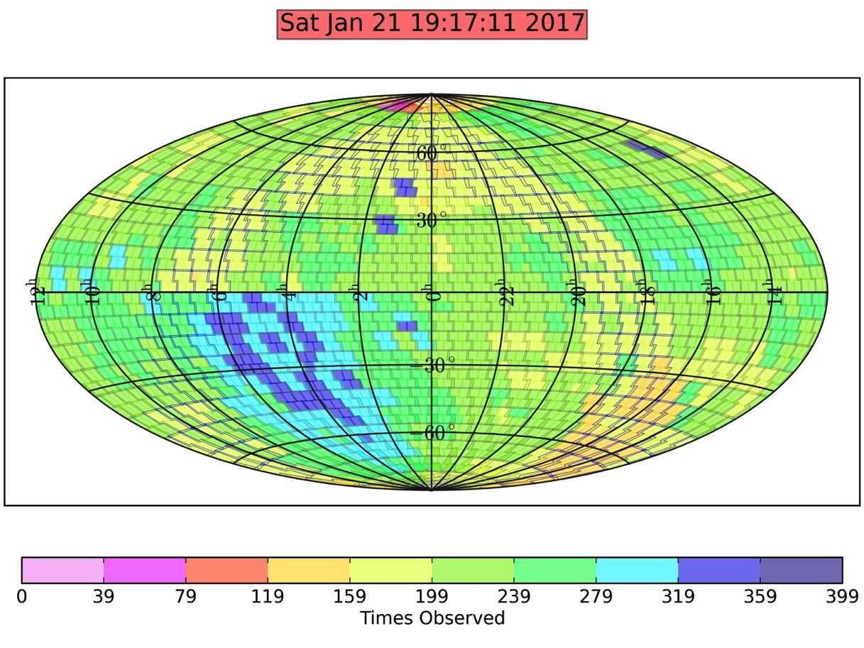
One Year of

Slide 7

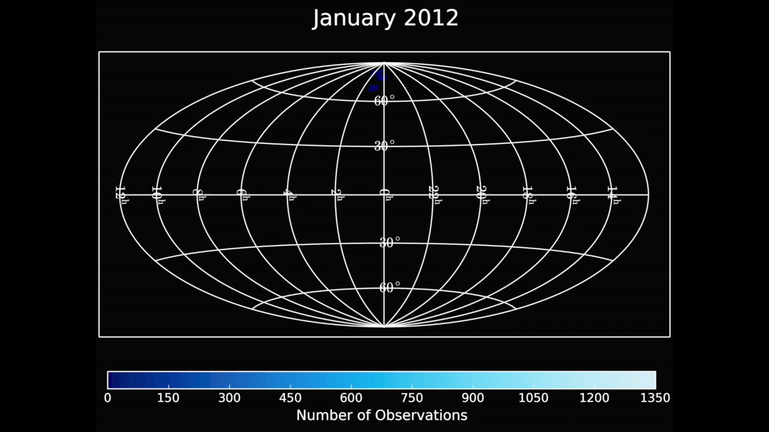
Data
Notes:
M33

Slide 8
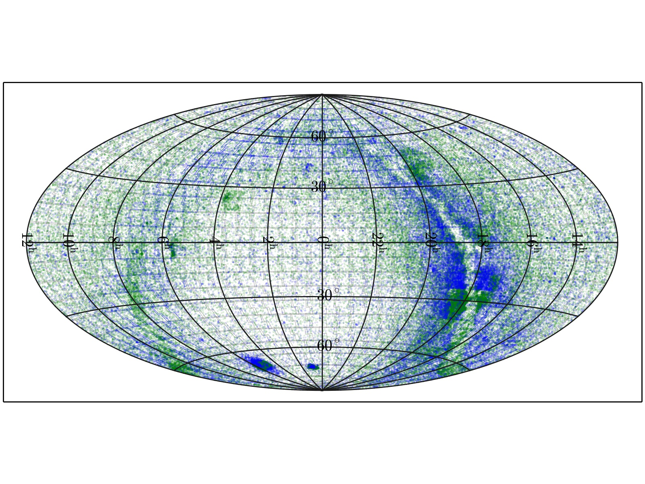
Variables
Notes:
M33

Slide 9
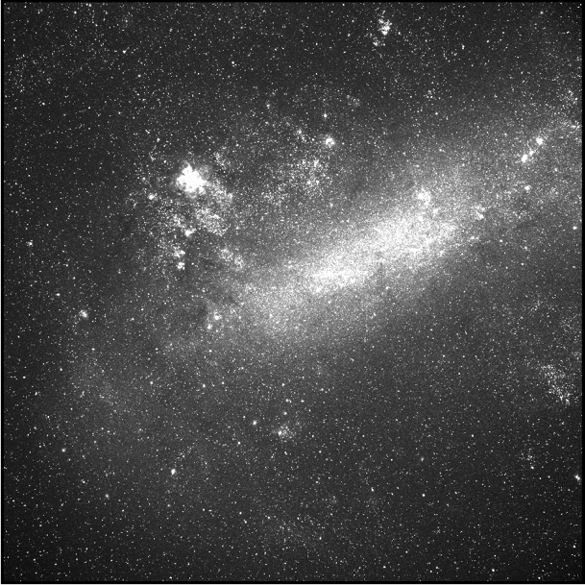
Image Subtraction: Reference Image
Notes:
Because this is such a short talk I can’t go into the details of the pipeline, but if feel free to ask me afterwards.
Automated flux calibration against “The AAVSO Photometric All-Sky Survey”

Slide 10
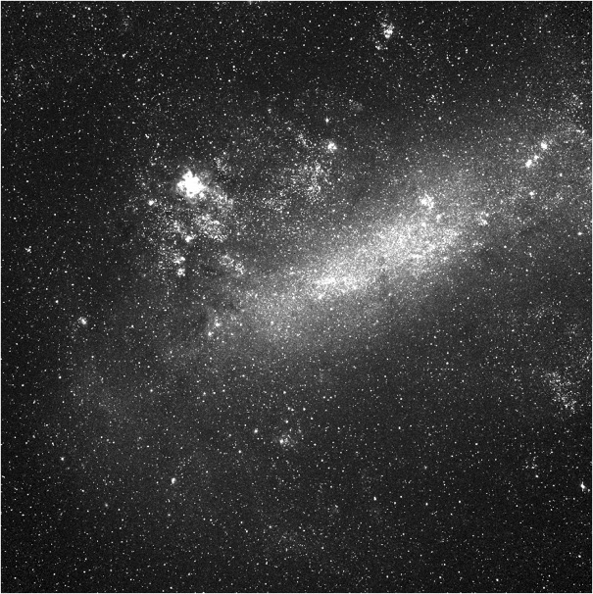
Image Subtraction: New Image
Notes:
Because this is such a short talk I can’t go into the details of the pipeline, but if feel free to ask me afterwards.
Automated flux calibration against “The AAVSO Photometric All-Sky Survey”

Slide 11
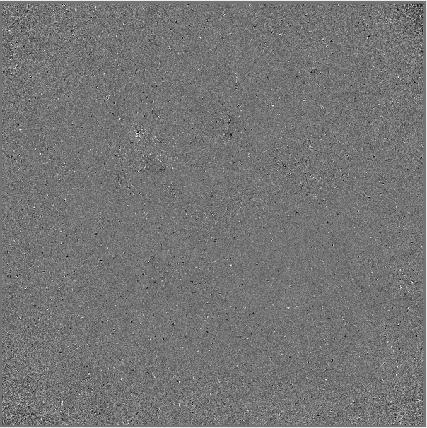
Image Subtraction: Subtracted Image
Notes:
Because this is such a short talk I can’t go into the details of the pipeline, but if feel free to ask me afterwards.
Automated flux calibration against “The AAVSO Photometric All-Sky Survey”

Slide 12
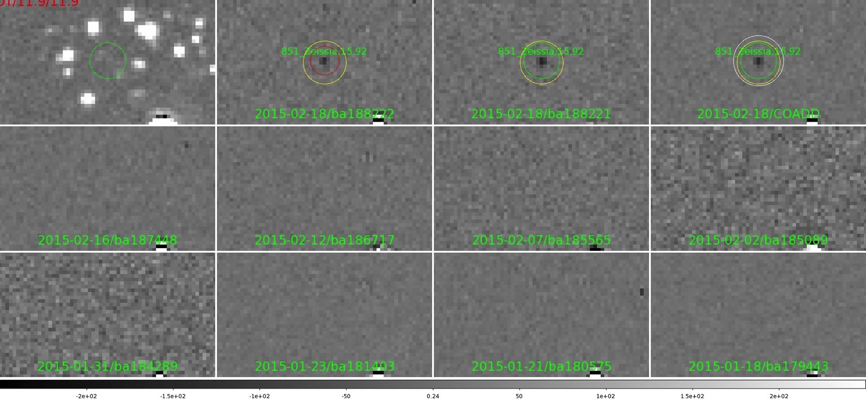
Transient Detection Pipeline
Detections dominated by false positives (5-10 million per night)
Many cuts made including machine learning classifier
300-500 candidates scanned by eye per night
Follow up initiated, new transients announced typically in hours
Notes:
P. R. Wozniak (LANL)
there are some obvious ones like S/N > 5
cuts on ratios of counts in various apertures to weed out things which are not quasi-point sources
cuts on whether the properties in the first image are consistent with those in the 2nd image (e.g.
the two fluxes should be consistent)
then we look at correlations of the source
** between the two images
** rotated by 90 and 180 degrees between the two images
** with the PSF
and toss those with low correlations -- e.g. saturation trails are
very asymmetric etc
and then we have the random forest classifier of these outputs
Machine-learning:
Automated Variability Selection in Time-domain Imaging Surveys Using Sparse Representations with Learned Dictionaries
Authors: Wozniak, Przemyslaw R.; Moody, D. I.; Ji, Z.; Brumby, S. P.; Brink, H.; Richards, J.; Bloom, J. S.
Automated flux calibration against “The AAVSO Photometric All-Sky Survey”

Slide 13
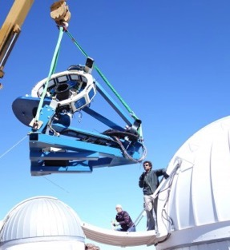
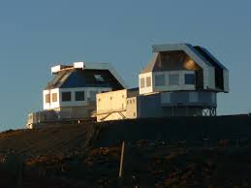
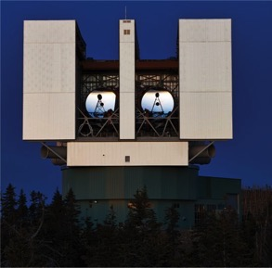
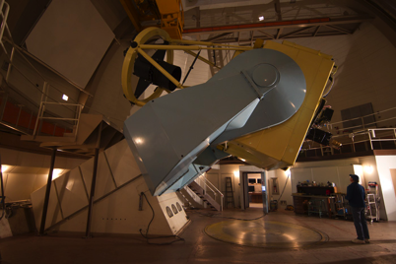
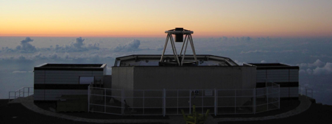
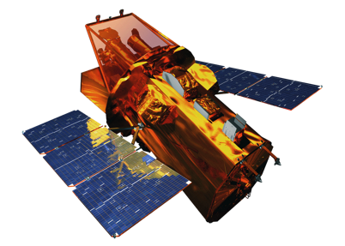
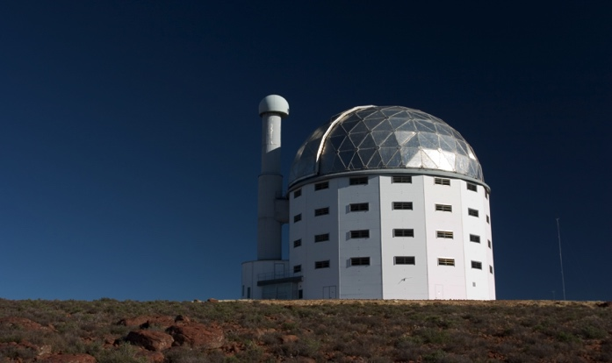
Follow-up Facilities
LCOGT 1 meters
Magellan 2 x 6.5 meter
LBT 2 x 8.4 meter
Du Pont 2.5 meter
MDM 2.4 meter
Liverpool Telescope 2 meter
Swift satellite
many others (SALT, UH 2.2m, FLWO 1.5m, NOT 2.5m, Faulkes, HST, Chandra, VLA …)
Notes:
Ryan Foley and Charlie Kilpatrick
Nickel 1m

Slide 14
Nearby SNe
August 26th, 2014
Notes:
124 total, 79 from ASAS-SN (64%).
Among the 10 brightest SNe of 2015, 6 from ASAS-SN.

Slide 15
We are more complete, unbiased.
Holoien et al. (incl. Shappee) 2017b
Notes:
sne_historgram.pdf shows the SNe counts (with peak < 17.0) per 2
months as a function of time since June 1, 2013.
Red: SNe first announced by ASAS-SN, Green: SNe later shown up in our
search, Blue: others. Grey area: average discovery count per month
with one sigma uncertainty between 2011 and 2013. We have been
discovering consistently above +1 sigma
Note that all SNe counted here have been spectroscopically confirmed.
We are not just "stealing" from amateurs and other surveys but
actually finding more SNe within peak < 17.0. To highlight this plot,
see next plot.

Slide 16
The first unbiased supernova sample
Holoien et al. (incl. Shappee) 2017b
Notes:
5/1/2014 and 12/31/2014
Fig. 2.— This will be offset - host luminosity plot, showing that ASAS-SN is rather unique in
the Local Universe. With the red dotted horizontal line we plot the median offset for supernovae
discovered by ASAS-SN, and with the blue dashed vertical line we plot the median host absolute
magnitude for the same ASAS-SN sample. Among local bright SNe searches, ASAS-SN appears
to be the least biased, discovering supernovae across the entire parameter space (giant and dwarf
galaxies, galaxy cores and outskirts).

Slide 17
Unbiased rate measurement
Basically 100% complete for m<16.5, 70% complete for m<17.0
ALL SUPERNOVA ARE SPECTROSCOPICALLY CLASSIFIED
Notes:
Cumulative distribution of SNe Ia from ASAS-SN as a function of z.
Green dotted line shows N(<z) \prop z^3 to guide the eye for
completeness.
Blue line indicates our "rate" sample (z < 0.034) that we are following up.

Slide 18
Galactic Novae, the new γ-ray sources
Since starting to observe the full Galactic plain, ASAS-SN also dominates the discovery of Galactic novae
Particular focus of Michigan State ASAS-SN members L. Chomiuk and J. Strader
ASASSN-16ma shows correlations between the optical and Fermi γ-ray emission (Li et al. in press)
→ Some of the optical emission in novae is powered by shocks rather than energy released on/near the white dwarf
Notes:
And things I can’t even tell you

Slide 19
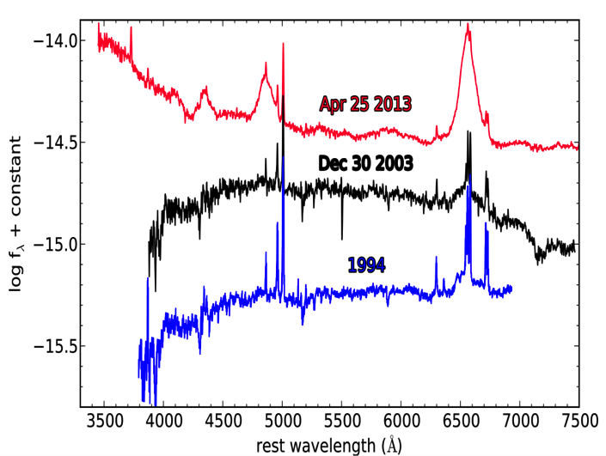
Active Galactic Nuclei – Flares, and not Just Blazars
A “Changing look” AGN: NGC 2617
ASAS-SN triggered on a 10% increase in flux from AGN + host
Follow-up imaging showed AGN continued to brighten by 1.3 mag
Follow-up spectroscopy showed that the AGN changed from a Seyfert type 1.8 to 1.0
Shappee et al. 2014
Notes:
EVN (European VLBI Network)

Slide 20
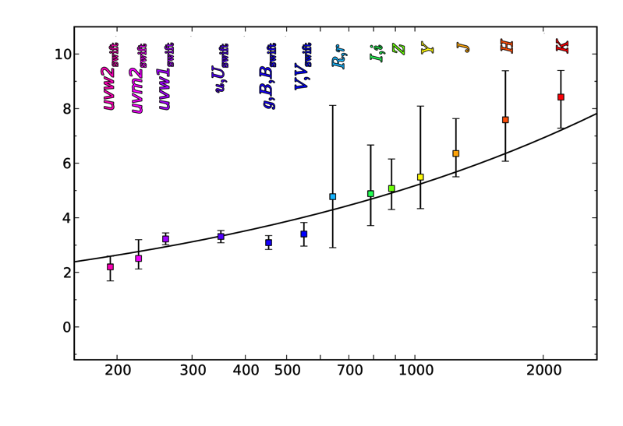
Use It To Measure Size of Disk versus Wavelength=Temperature
Shappee et al. 2014
Notes:
Measuring these inter-band continuum lags is extremely difficult because the predicted size of the accretion disk is only about one light day, and monitoring campaigns require comparable or better cadence to resolve such a short lag. The first suggestive (2–3σ) report was by Collier et al. (1998), who found that the UV variations led the optical variations in NGC 7469. Since then there have been many hints of longer lags at longer wavelengths in other AGN, but most of these measurements are not statistically significant (≤2σ) and rep- resent upper limits (Sergeev et al. 2005; Arévalo et al. 2008; Breedt et al. 2010; Lira et al. 2015; Troyer et al. 2016; Gliozzi et al. 2016; Jiang et al. 2016; Buisson et al. 2017). The rela- tionship between the X-ray and optical emission also appears to be complex and does not necessarily fit into a simple re- processing model. In some cases, there is not enough energy in the X-ray variations to drive the long term trends in the optical light curves (Uttley et al. 2003; Arévalo et al. 2009; Breedt et al. 2009). There are also reports of optical emission leading the X-rays (Marshall et al. 2008), as well as uncorre- lated X-ray/optical emission (Maoz et al. 2002).
The first secure detection (>3σ) of inter-band continuum lags was in NGC 2617 by Shappee et al. (2014), who found
longer lags at longer wavelengths that were consistent with predictions for reprocessing in a standard geometrically thin accretion disk. The only other AGN with significant contin- uum lag detections is NGC 5548. McHardy et al. (2014) re- solved continuum lags in this object using two years of Swift data, while the Space Telescope and Optical Reverberation Mapping project (AGN STORM, De Rosa et al. 2015) ob- tained the most complete RM measurement of the accretion disk to date. The STORM project detected inter-band lags between the X-ray, UV, optical, and near IR wavelengths us- ing four space-based observatories and 25 ground-based tele- scopes (Edelson et al. 2015; Fausnaugh et al. 2016b; Starkey et al. 2017), and the measured lag-wavelength relation is again consistent with predictions for reprocessing in a geo- metrically thin disk. However, the size of the disk indicated by the STORM measurements is larger by a factor of three than the predictions from standard models.
This result is similar to results from gravitational mi- crolensing of strongly lensed quasars. Microlensing is one of the only other ways of investigating physical scales close to the SMBH, and this method also finds disk sizes larger than thin-disk theory by a factor of a few (Morgan et al. 2010; Blackburne et al. 2011; Mosquera et al. 2013; Jiménez- Vicente et al. 2014). However, microlensing can only probe the disks in distant, lensed quasars, while RM provides a means of probing accretion disks in local, low-luminosity AGN. There is therefore an imperative to expand the sample of objects with secure inter-band continuum lags, and several such programs are underway (i.e., NGC 4151, Edelson et al. submitted; NGC 4385, McHardy et al. in prep.).

Slide 21
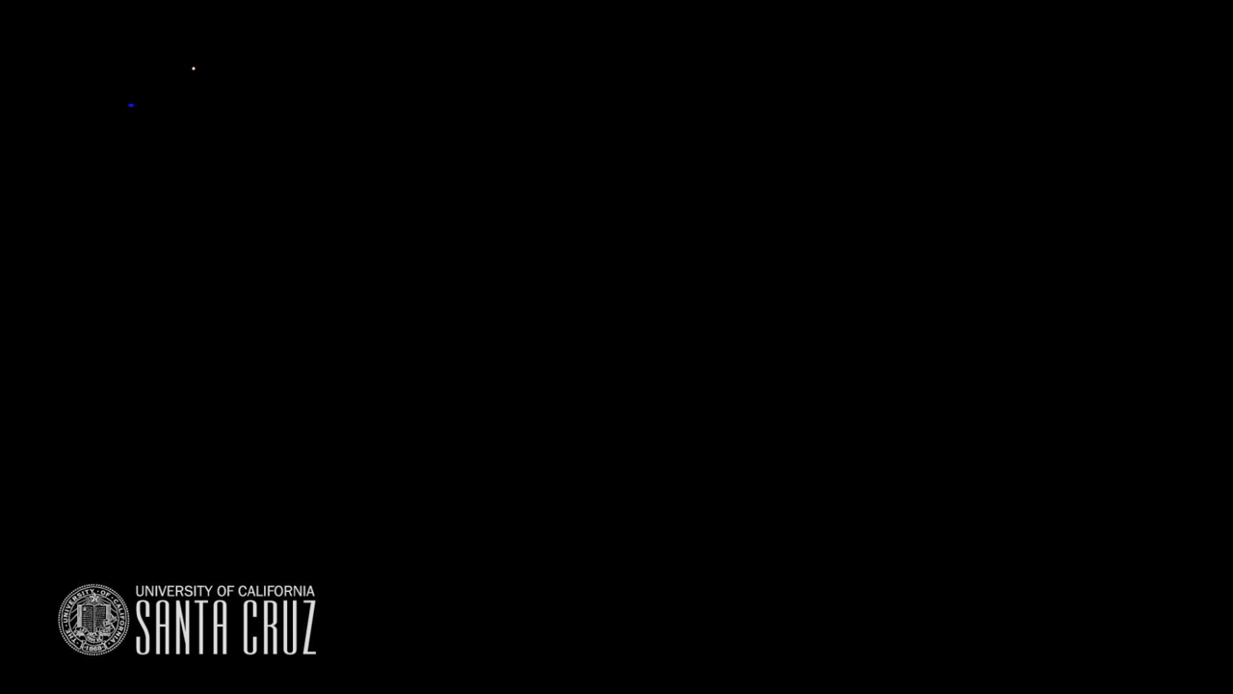
Tidal Disruption Events
Star
Black Hole
Star passes within tidal limit of a supermassive black hole and is destroyed
James Guillochon

Slide 22
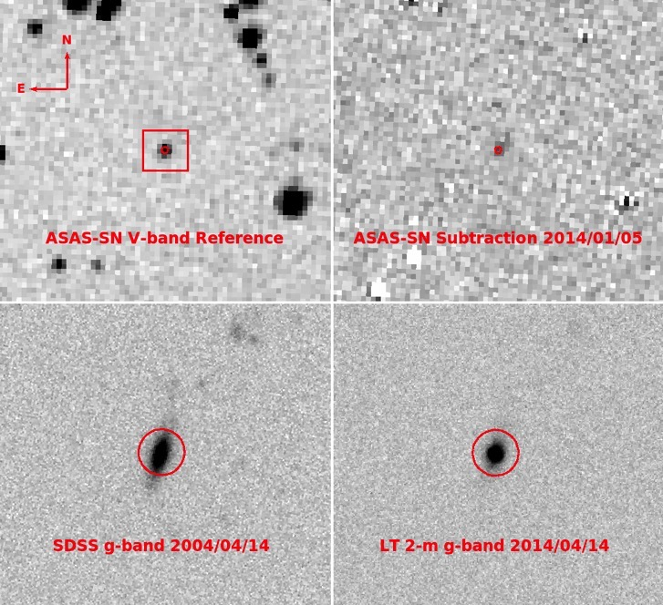
Tidal Disruption Events in
ASASSN-14ae
4 best-studied events
  out of 13-16 discovered in the optical (depending on how you count)
Brightest and best-studied
ASAS-SN is more complete than previous surveys
Rates closer to theoretical rates
Holoien et al. (incl. Shappee) 2014b
Notes:
allowed by the rates of van Velzen & Farrar (2014) who use SDSS Stripe 82 data
Completed surveys:
• ROSAT (3)
• GALEX (3)
• SDSS Stripe 82 (2)
• Ongoing:
• XMM (≈6)
• PTF (3 or 4)
• Pan-STARRS (2)
Discovery image of ASASSN-14ae. The top-left panel
shows the ASAS-SN V -band reference image and the top-right
panel shows the ASAS-SN subtracted image from 2014 January
25. The bottom-left panel shows the archival SDSS g-band image
of the host galaxy and the bottom-right panel shows an LT 2-m g-
band image from 2014 February 08. The dates of the observations
are listed in each panel, and the lower panels show a smaller eld
of view, indicated by the red box in the top-left panel. The red
circles have radii of 5:000 and are centered on the host position.

Slide 23
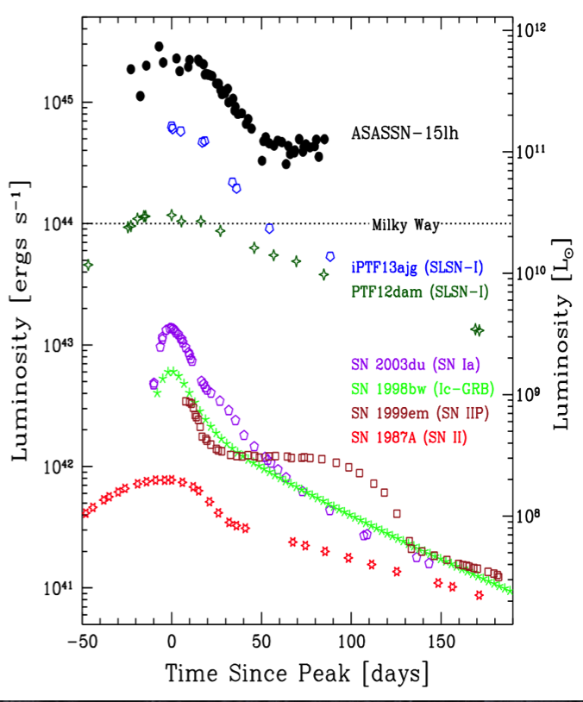
ASASSN15lh - the most luminous supernova?
Nuclear transient, massive host
The most luminous SN ever discovered?
  Dong et al. 2016
Magnetar powered supernova? (most energy possible?)
  Metzger et al. 2015
TDE like no other?
  Leloudas et al. 2016
Extreme events challenge all models, unbiased survey
￼
Dong et al. 2016
Notes:
z=0.2326
M_{u,AB} ~ -23.5
bolometric luminosity L_bol ~ 2.2x10^45 ergs/s, which is >~ 2 times more luminous than any previously known supernova.
hydrogen-poor sub-class of super-luminous supernovae (SLSNe-I)
In contrast to known SLSNe-I, most of which reside in star-forming, dwarf galaxies, its host appears to be a luminous galaxy (M_V ~ -22; M_K ~ -25.1) with little star formation.
In the two months since its first detection, ASASSN-15lh has radiated ~7.5x10^51 ergs, challenging the popular magnetar model for the engine of SLSNe-I.

Slide 24
ASAS-SN and IceCube
(ASAS-SN member A. Franckowiak @ DESY)
Detection of neutrino doublet by IceCube will now automatically trigger a 30 minute ASAS-SN observation of the nominal source location – total delay of ~minutes
ASAS-SN databases will already contain years of variability information for that region of the sky to help identify any newly variable source

Slide 25
ASAS-SN currently dominates bright transient discovery.
First unbiased SN sample, rates, and census.
Many recent other science highlights: early-time LCs for SNe Ia, stellar flares, cataclysmic variables, search for low surface brightness dwarf galaxies, dust echoes from historical supernovae
New science directions such as observations tracking the TESS satellite in real time
Challenges and opportunities for the future: public database, new individual objects, follow up…
Discovery space is open, large, and promising!

Slide 26
Public Science
All SN discoveries are publically announced upon discovery (TNS+ATEL)
Also true of novae (ATEL) and cataclysmic variable outbursts (CV Patrol WWW site)
ASAS-SN Sky Patrol – https://asas-sn.osu.edu/ provides an up to date light curve for any point on the sky
Soon (2018) – light curves of all variables in ASAS-SN including ~50,000 new variables
Soon (2018) – AGN Patrol – monitoring all known AGN for variability

