Slide 1
Evaluating the Gamma-Ray Emission from SN 1987A, the Closest Visible Supernova to us in the last 300 years
Vikram V Dwarkadas
University of Chicago

Slide 2
Simple Analytic Model (Dwarkadas, 2013, MNRAS,434, 3368)
(Drury, Aharonian & Volk 1994)
Use Chevalier (1982) self-similar solution (n>5, s=0 for constant density, s=2 for wind)

Slide 3
Simple Analytic Model (Dwarkadas, 2013, MNRAS,434, 3368)
(Drury, Aharonian & Volk 1994)
Mass = Swept-up mass
Energy in Cosmic Rays = Some fraction of available shock energy at timestep
For s=0 (constant density), Ε_{CR} ~ t^{5m-2} , for m> 2/5, increases with time.
For s=2 (wind), E_{CR} ~ 3m – 2, increases for m>2/3 (Sedov value)
Energy available at shock front equal total SN energy ONLY at Sedov stage.

Slide 4
Simple Analytic Model
Core-collapse SNe, evolve in stellar winds. If steady wind, s=2
Note that, since m < 1, the emission is decreasing with time, after an early approach to maximum energy.

Slide 5
Simple Analytic Model
Constant density medium, s=0 (Type Ia Sne)
If m> 2/5 , which it should be if the remnant has not yet reached the Sedov phase, then the emission is always increasing with time.
Note: Emission proportional to density squared, not simply density, as in older SNRs.

Slide 6
SN 1987A
The closest SN in over 300 years
Hubble images show an interesting structure, with an equatorial ring and two rings at higher latitudes.
The increasing X-ray and radio emission after 3 years indicated the presence of an HII region interior to the ring (Chevalier & Dwarkadas 1995).
We can model the interaction within the equatorial plane and outside the equatorial plane (no ring interaction).

Slide 7
SN 1987A - 3 Ring Circus

Slide 8
Formation of SN 1987A CSM
Interaction of the low density wind from the Blue supergiant progenitor of SN 1987A, with the red supergiant wind from the previous epoch.
Calculated with ionization-gasdynamics code AVATAR
(VVD & Rosenberg 2013).

Slide 9
SN 1987A

Slide 10
SN 1987A

Slide 11
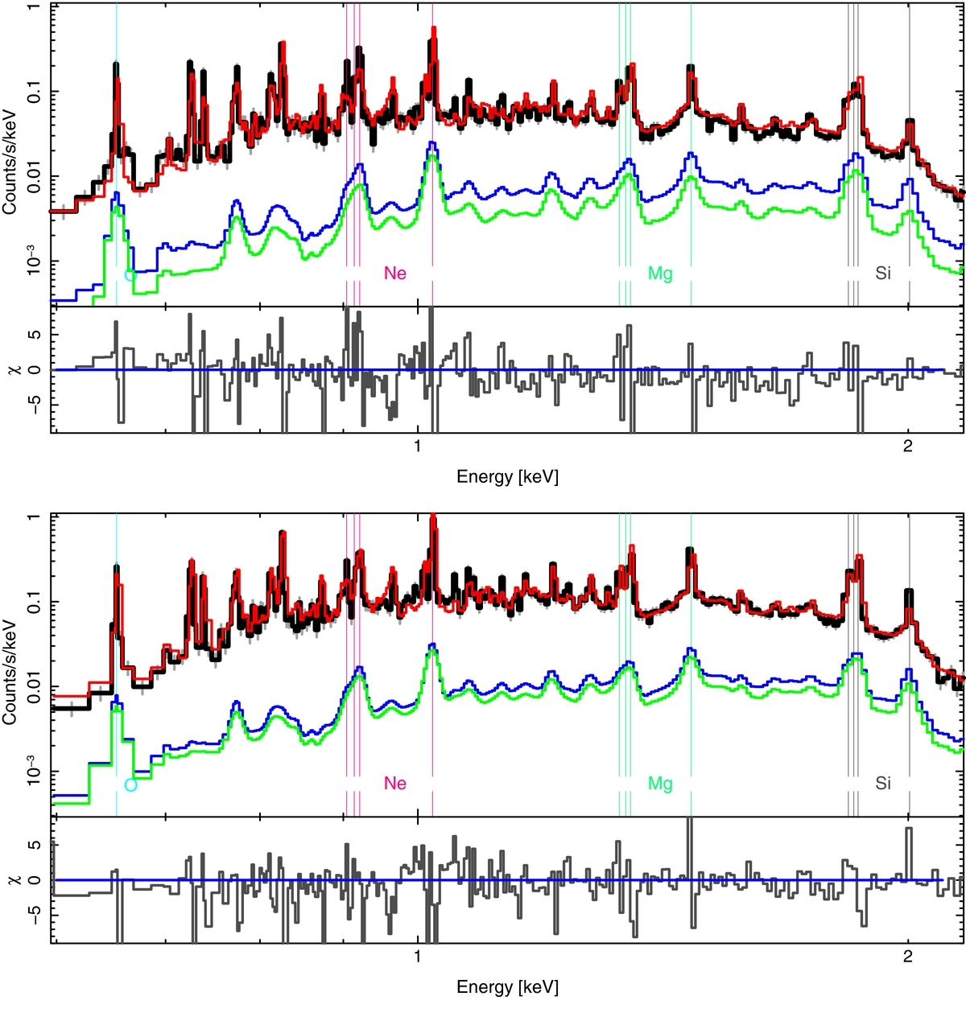
D. Dewey et al. 2012 ApJ 752 103 doi:10.1088/0004-637X/752/2/103
HETG(MEG) spectra and full hydrodynamics-based models. The HETG-07 (top) and HETG-11 (bottom) data (black) are reasonably fit by the total (HII plus nominal clumped-ER) model spectra (red). The HII-shocked-CSM (blue) and the HII-shocked-ejecta (green) components are also shown individually.
(Dewey, Dwarkadas et al. 2012, ApJ, 752, 103)
Progenitor BSG: Wind velocity ~500 km/s, Mass-loss rate < 10⁻⁸ msun/yr.

Slide 12
SN 1987A
Assuming the parameters in Dewey et al (2012), n=9, we get
F_{γ(87A)}(> 100 MeV) = 4.04 x 10⁻¹⁰ cm⁻²s⁻¹
If we assume a spectral index close to the shock of 2, and emissivity q_{γ}=10⁻¹⁷, then the TeV flux is given by:
F_{γ(87A)}(> 1 TeV) = 8.1x 10⁻¹⁴ cm⁻²s⁻¹
This is somewhat larger than the HESS upper limit, but given the approximations (and the approximations in the upper limit) it is not too bad.

Slide 13
SN 1987A recently
Upper panel: HST images of SN 1987A with WFC3 in the F625W filter on days 8717 (2011 January 05), 9480 (2013 February 06), and 9975 (2014 June 15). Middle panels: difference images of 2013–2011, 2014–2013, and 2014–2011, respectively. Blue means fainter and red brighter. Inside the ring the asymmetric ejecta can be seen. Note the gradual appearance of several small spots, as well as diffuse emission, outside the inner ring in the SE. New spots can also be seen in the NE, as well as to the NW. Note that the two new spots in the NW do not coincide with the stars labeled in the upper left image. The residuals in the SE corner of the difference images are due to a saturated star and the radial streak NW of the ring in the two first difference panels is due to a diffraction spike of a star outside the field shown.
Fransson et al, 2015, ApJL, 806, 1

Slide 14
SN 1987A
Recent observations with IR, optical and X-ray show that by day 10,000 the SN shock has exited the equatorial ring, and is now expanding in lower density material.
Since the emission goes as ρ², it will therefore not increase as fast as it was. This complicates calculations of the future gamma-ray flux.
Unfortunately at this point it is not possible to evaluate the density, and density profile, into which the material is expanding. If it is likely a wind then the density would decrease as r⁻².
The forward shock will be expanding in the lower density medium, but the reverse shock will still be in the dense ring. One could imagine particle acceleration at both shocks, which further complicates the matter.
The lower density, and decreasing emission with time if it is in a wind medium, will mean that the overall emission will decrease with time. CTA has a higher sensitivity than HESS , but it still seems possible that CTA will NOT detect SN 1987A.
Note (several approximations made, especially that although shock moving through different density media, self-similar solutions still apply).

Slide 15
Questions and Discussions

Slide 16
Summary & Conclusions
SN Environment is very important!!!!
Young core-collapse SN will typically interact with the freely expanding wind of the progenitor star first, followed by a constant density region.
The density may decrease considerably in Type IIP SNe, or increase some in Type Ic.
A simple estimate can be made of the hadronic flux using DAV 1994, the Chevalier self-similar solutions, and some approximations.
Suggests that Cas A emission is hadronic, and that 87A may be detectable in a few years.

Slide 17
Summary
SNR propagation in the ambient medium depends on the structure of the ambient medium, the structure of the material ejected in the SN explosion, and the energy and mass of the ejected material.
Although SNR evolution is traditionally classified as going through various phases, a SNR could spend most of its time in transition between these phases, and thus may not be adequately described by the self-similar solutions.

Slide 18
Summary (Contd)
The Sedov stage is NOT reached when the swept-up mass equals the ejecta mass, it generally takes a lot longer than that. In some cases it could be truncated or totally bypassed.
SN shocks can become radiative depending on their velocity and the ambient density. This can happen at any time, not necessarily in the radiative stage.

Slide 19
Application to Cas A
A SNR expanding in a dense RSG wind.
Mass-loss rate - 2 * 10⁻⁵ Msun/yr, wind velocity 10 km/s, E_{SN}= 4. * 10⁵¹ ergs, n=10.12 (Chevalier & Oishi)
F_{γ(CasA)}(> 100 MeV) = 5.5 x 10⁻⁸ cm⁻²s⁻¹
Fermi best fit suggests only 2% energy in cosmic rays, explosion energy 2.*10⁵¹ ergs
Then: F_{γ(87A)}(> 100 MeV) = 1.1 x 10⁻⁸ cm⁻²s⁻¹
Comparable to Fermi result. Suggests hadronic emission for Cas A.

