Slide 1
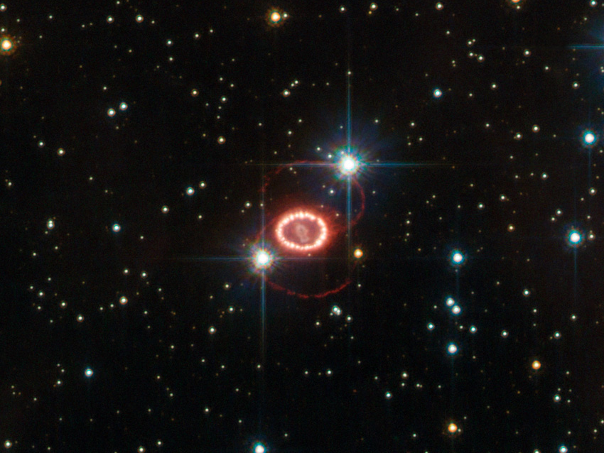


Observing Supernova Neutrinos to Late Times
Shirley Li
The Ohio State University
Collaborators: Luke Roberts, John Beacom
TeVPA, August 2017

Slide 2
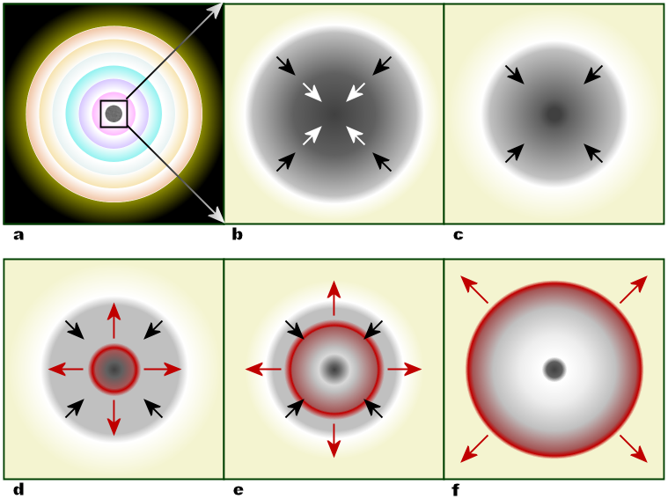
Timescale of a SN
?
Detectable!
Figure credit: R.J. Hall
2/11

Slide 3

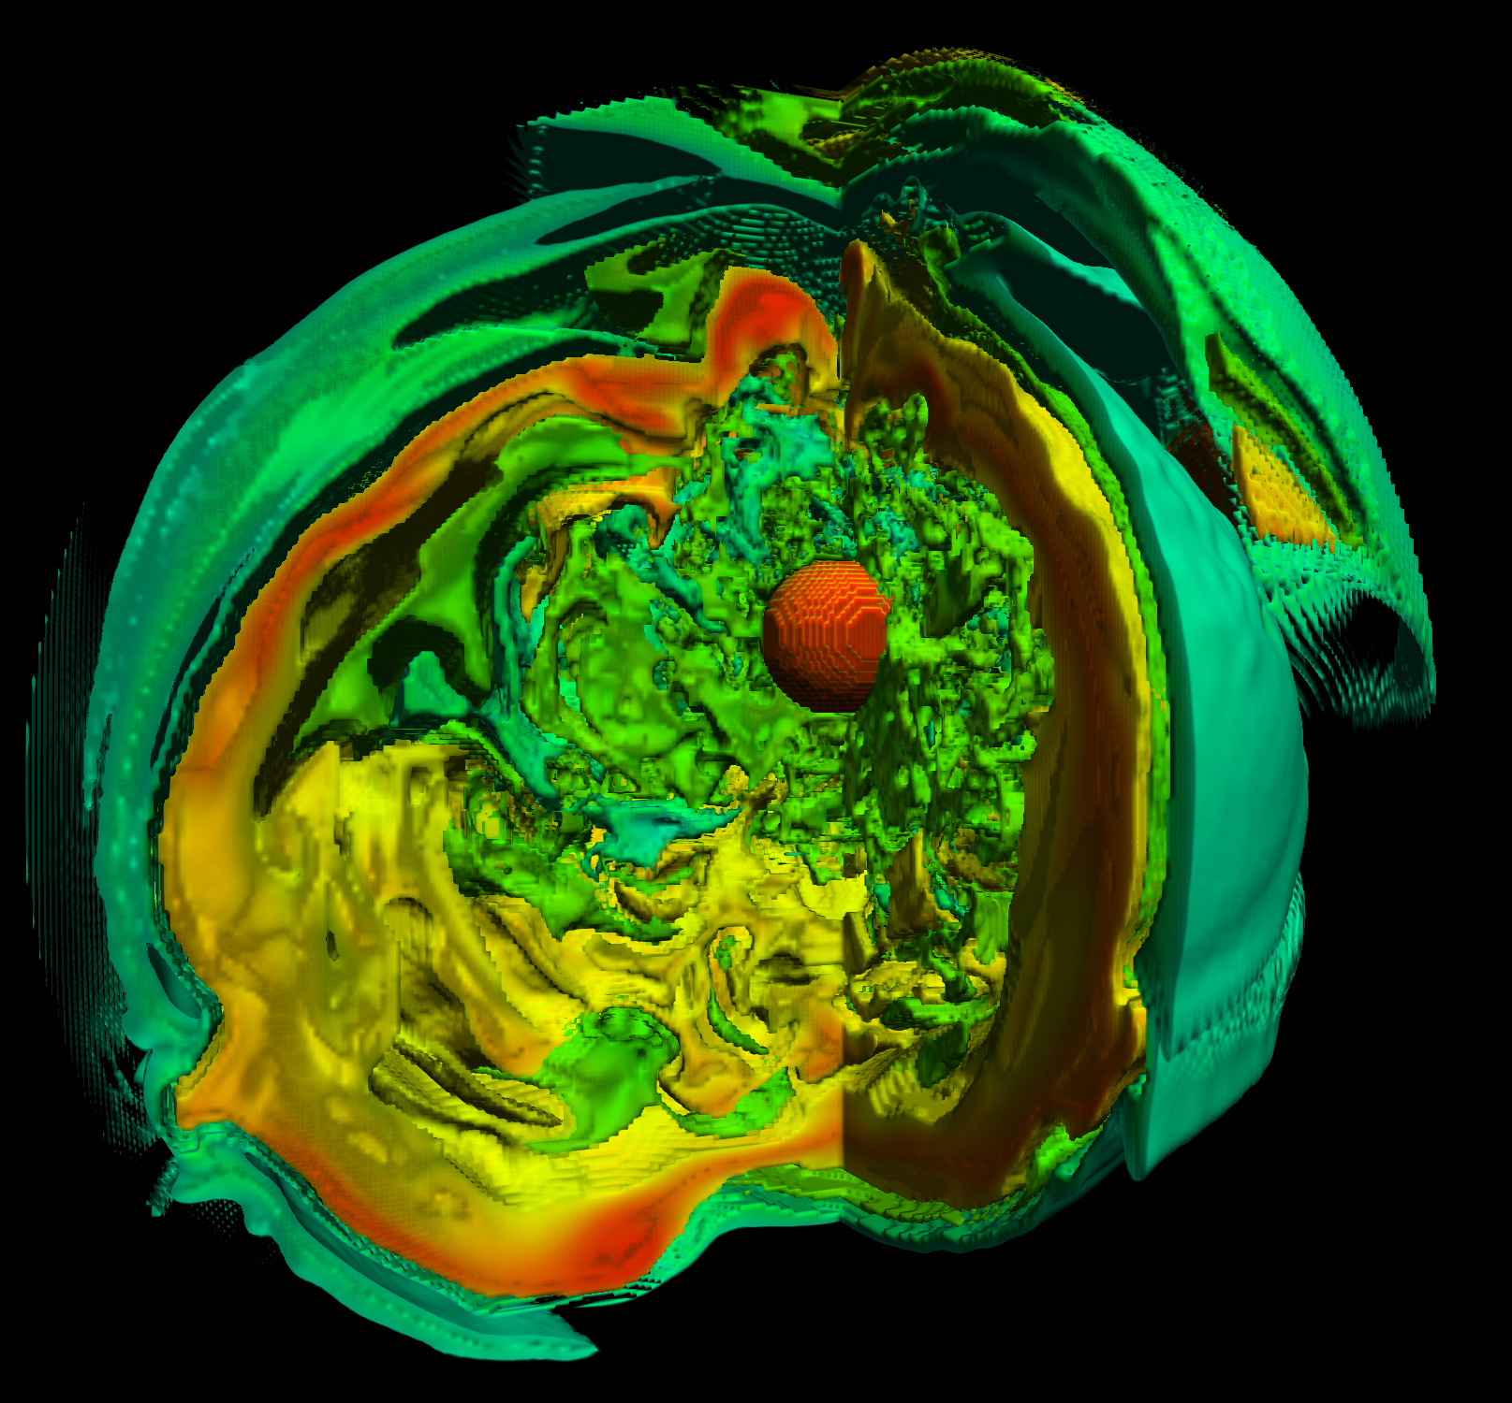
First input -- simulation
Luke Roberts
Blondin et al., 2003
3/11

Slide 4

4/11

Slide 5
Late-time neutrinos
Neutrino luminosity
NS!
1/t behavior
Transparency time
Connects SN and NS
Preliminary
Late-time neutrinos are interesting!
5/11

Slide 6
Late-time neutrinos
Neutrino energy
Moderate mixing effect
Preliminary
Late-time neutrinos are robust!
6/11

Slide 7

${\overline{ν}}_{e}$ signal rate in Super-K
$${\overline{ν}}_{e}+p→e^{+}+n$$
Inputs:
  10 kpc SN
  22.5 kton
  3.5 MeV threshold
Preliminary
Plenty of events in Super-K!
7/11

Slide 8


Other flavors
8/11

Slide 9
Alternative outcome -- BH
Different mechanisms for BH formation
Preliminary
BH may form at late times
9/11

Slide 10
Detecting BH formation
Detection significance of BH formation
Preliminary
We can detect BH formation at late times
10/11

Slide 11
Conclusions
11/11

Slide 12
Thank you!

Slide 13
Back up

Slide 14
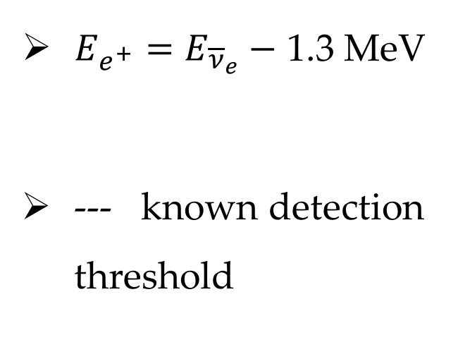

${\overline{ν}}_{e}$ energy spectrum
$${\overline{ν}}_{e}+p→e^{+}+n$$
$E_{e^{+}}=E_{{\overline{ν}}_{e}}−$ 1.3 MeV
--- known detection threshold
Preliminary
Easily reconstruct neutrino spectrum

Slide 15

$ν_{e}$ signal rate in DUNE
$$ν_{e}+40Ar→e^{−}+40K^{∗}$$
Inputs:
  10 kpc SN
  40 kton
  5 MeV threshold
Preliminary
Plenty of events to late time in DUNE!

Slide 16
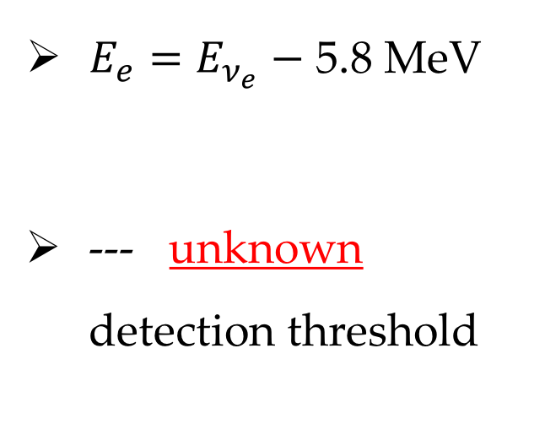

$ν_{e}$ energy spectrum
$$ν_{e}+40Ar→e^{−}+40K^{∗}$$
$E_{e}=E_{ν_{e}}−$ 5.8 MeV
--- unknown detection threshold
Preliminary
Detection threshold needs to reach ~ 5 MeV

Slide 17

$ν_{x}$ signal rate
$$ν_{x}+p→ν_{x}+p$$
Inputs:
  10 kpc SN
  22.5 kton
  0.1, 0.2 MeV threshold
Preliminary
Non-negligible events at late time

Slide 18
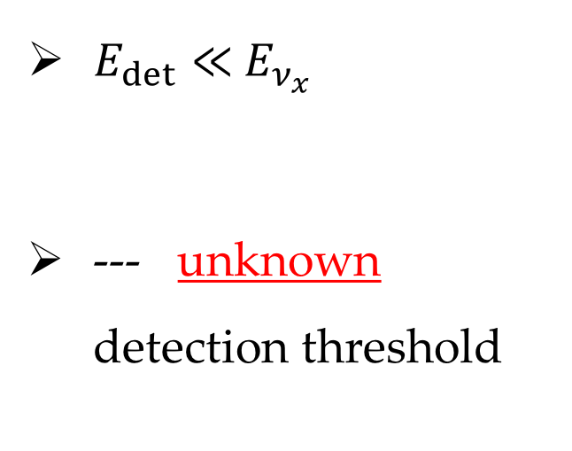

$ν_{x}$ energy spectrum
$$ν_{x}+p→ν_{x}+p$$
$E_{det}≪{ E}_{ν_{x}}$
--- unknown detection threshold
Preliminary
Detection threshold is crucial

