Slide 1
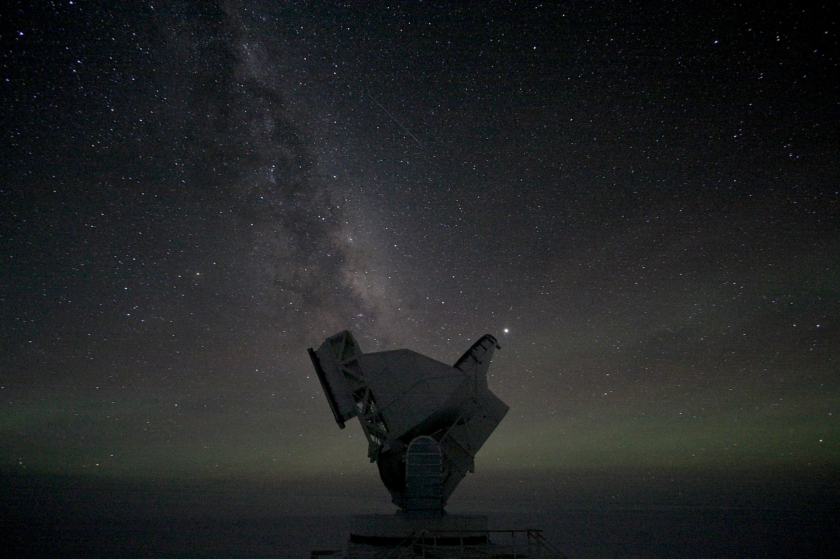
SPT-3G:
A new instrument on the South Pole Telescope
TeVPA
August 7, 2017
Daniel Dutcher
University of Chicago / KICP

Slide 2
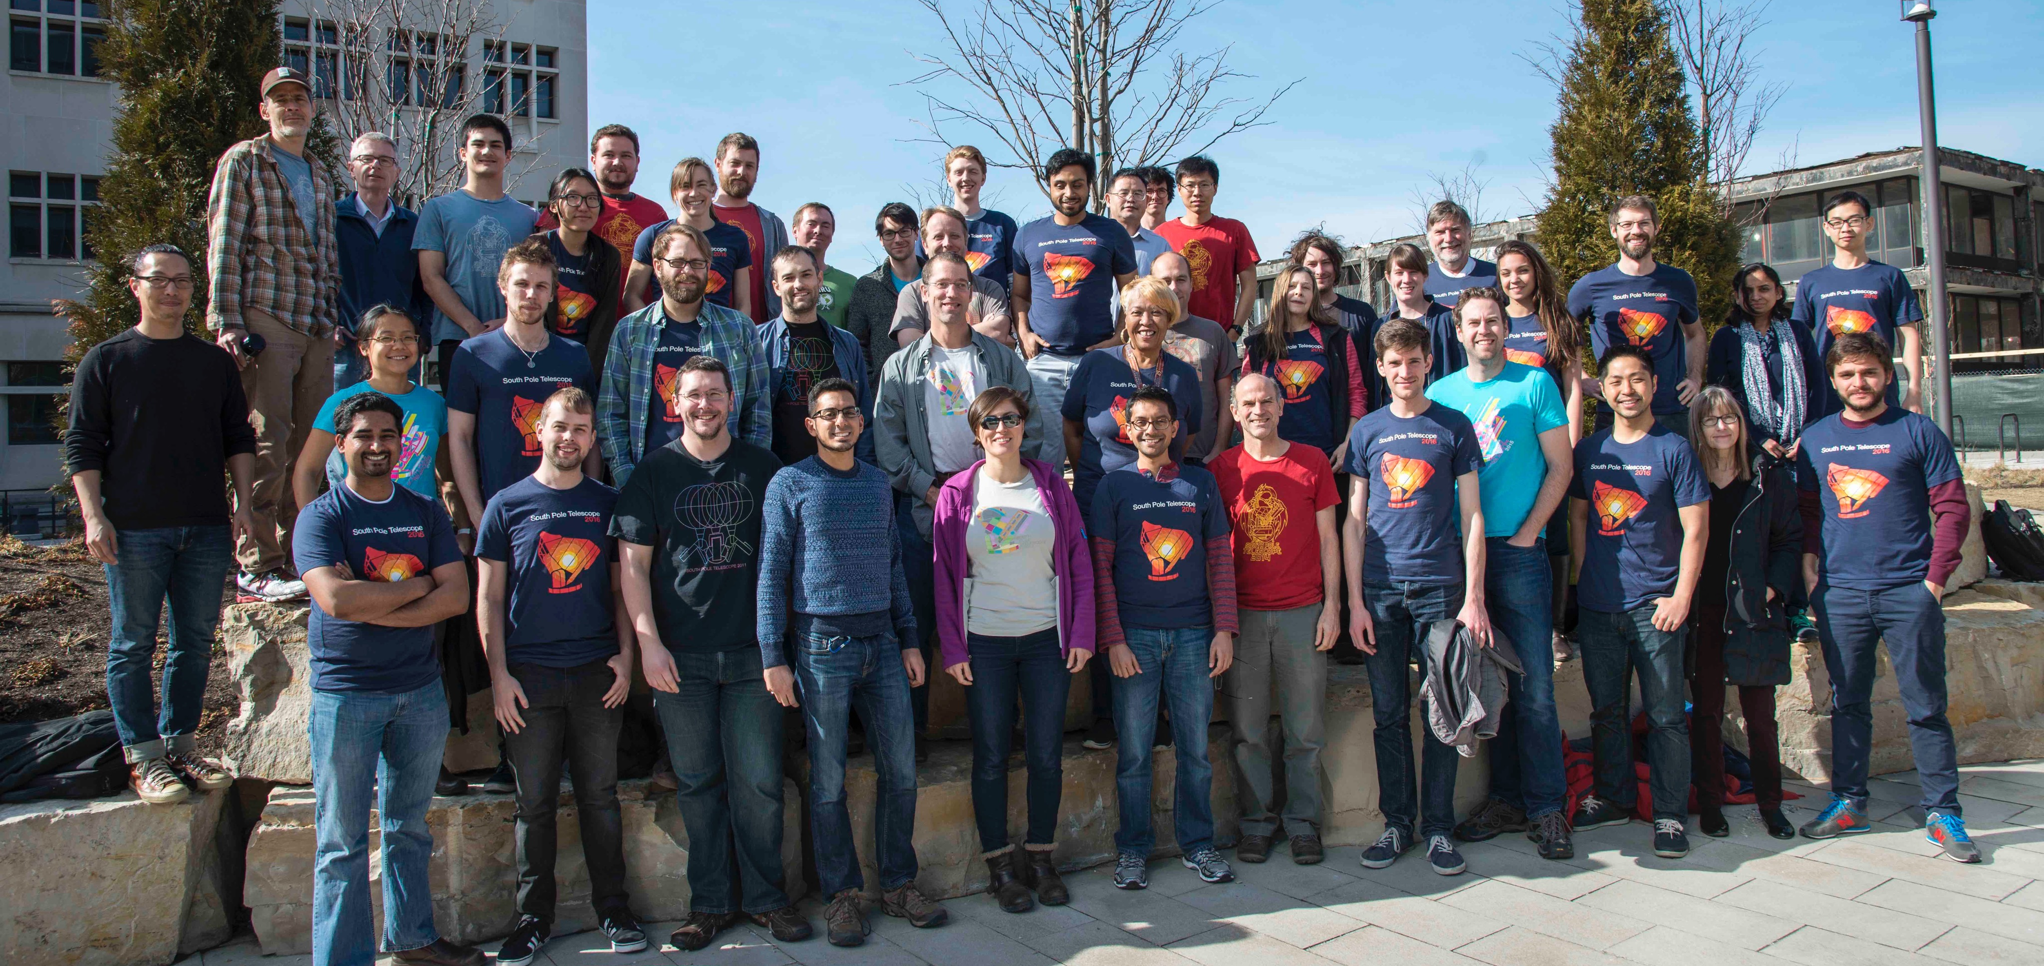





















SPT-3G Collaboration
Funded By:
Notes:
I’ll begin by acknowledging all the hard-working people. . .
~70 scientists, half students/post-docs
~Led by UC, 20 institutions, universitites in US and Canada
- Funded by. . .

Slide 3
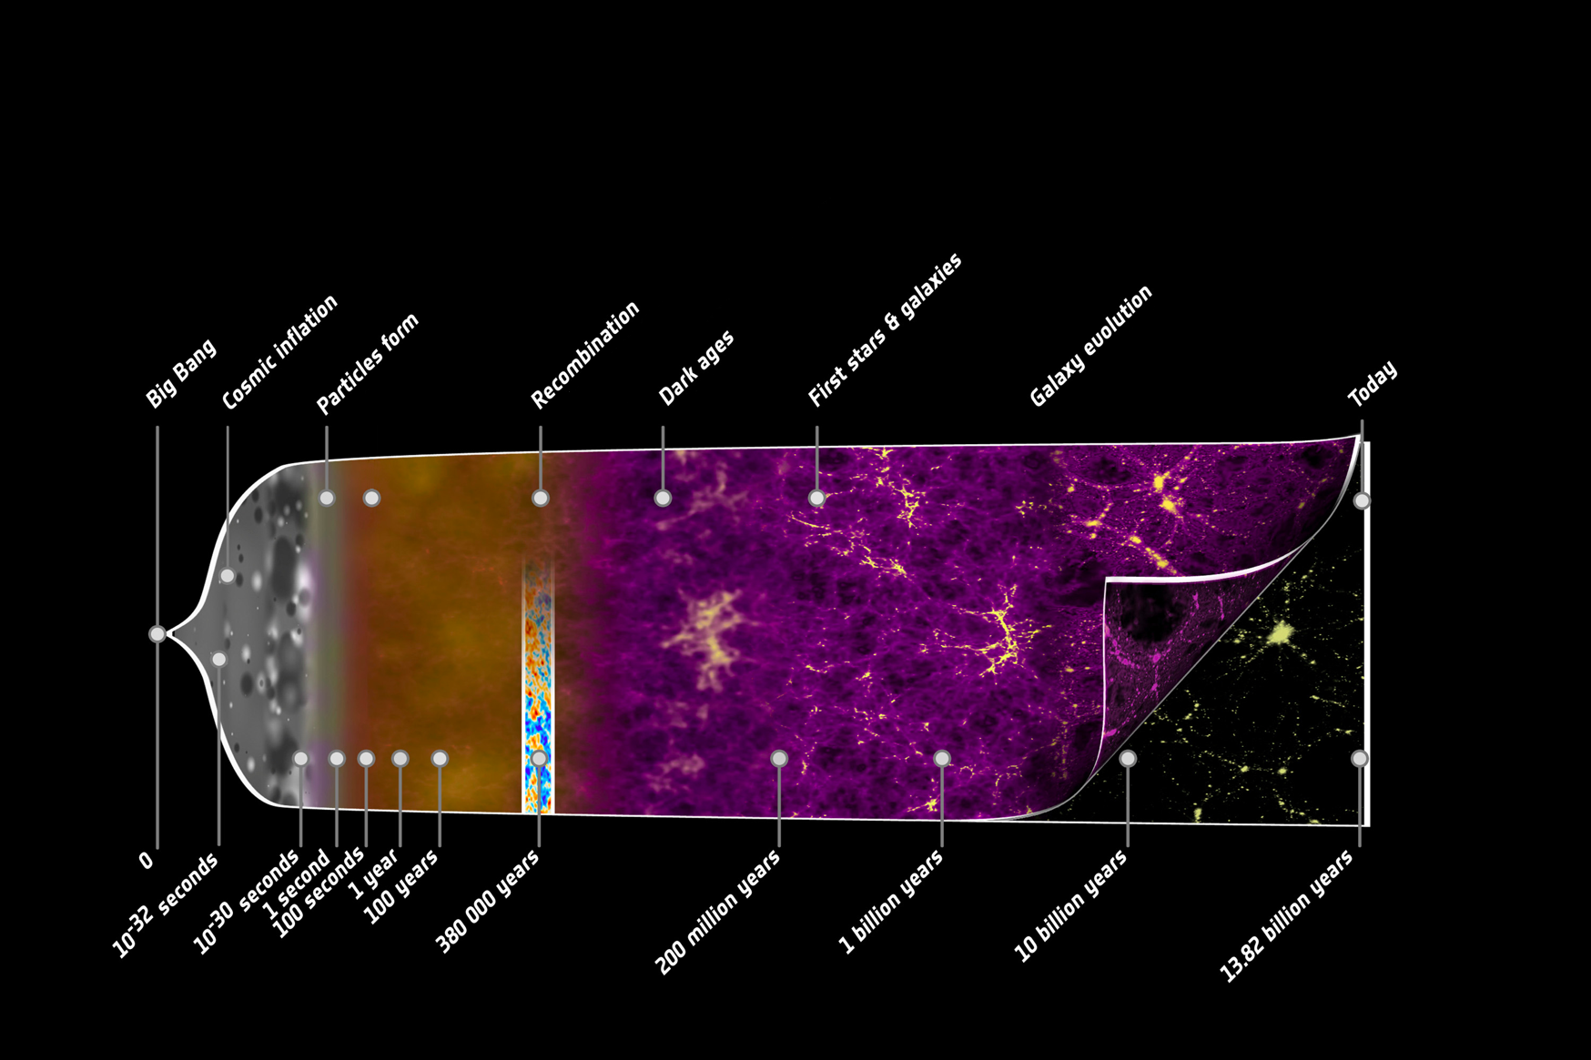
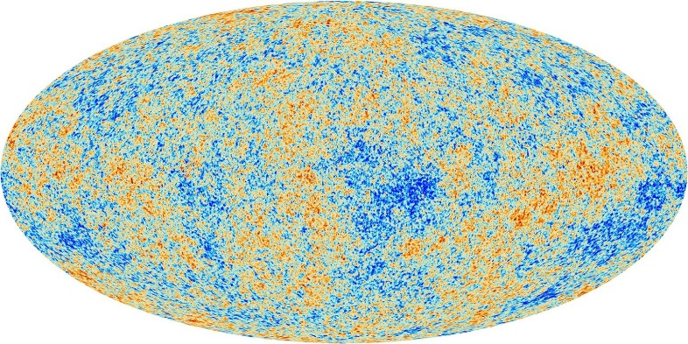
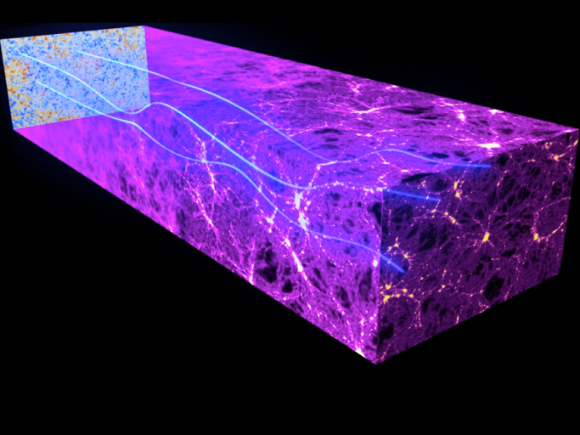
The Universe as a Laboratory
ΛCDM parameters
r : tensor-to-scalar ratio
N_{eff}
Σm_{ν}
Image Credit: Planck/ESA
Notes:
Let’s start at the beginning.
Timeline of the universe: inflation, BBN, neutral atoms, stars, reionization, galaxies
CMB, last surface photons interacted with before us
Imprinted on it, wealth of info on early universe, otherwise wouldn’t have insight into
In addition, On it’s way to us, passed through all space and time.
As for what data looks like,
Fractions of a milliKelvin

Slide 4
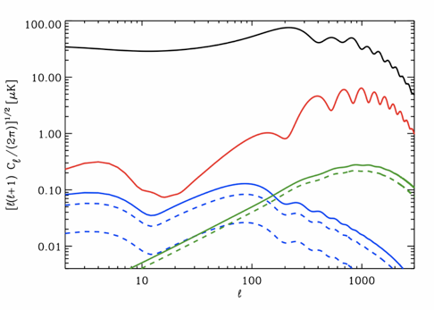
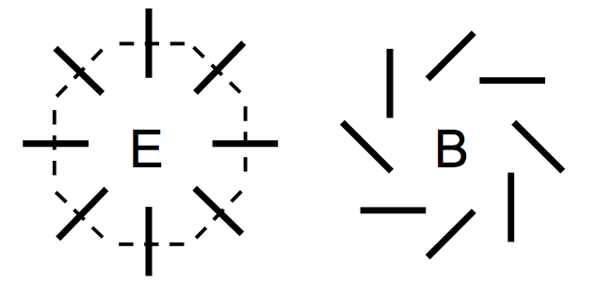
CMB Power Spectra: Intensity and Polarization
TT
EE
lensing of
EE to BB
EInf ~ 10¹⁶GeV
(r = 0.15)
BBInflation
BBlensing
∑mν = 0
∑mν = 1.5 eV
r == Tensor-to-scalar ratio
EInf == Energy scale of Inflation
Notes:
Strength of Fluctuation on y-axis, angular size on x-axis
-Temperature partially polarized, 10% level, E modes
-E-modes get lensed into B-modes, also inflation
-Lensing B-modes depend on amount of matter, growth of structure, etc
-Also important for de-lensing, to get at inflation signal
- That’s theory, let’s look at data ->

Slide 5
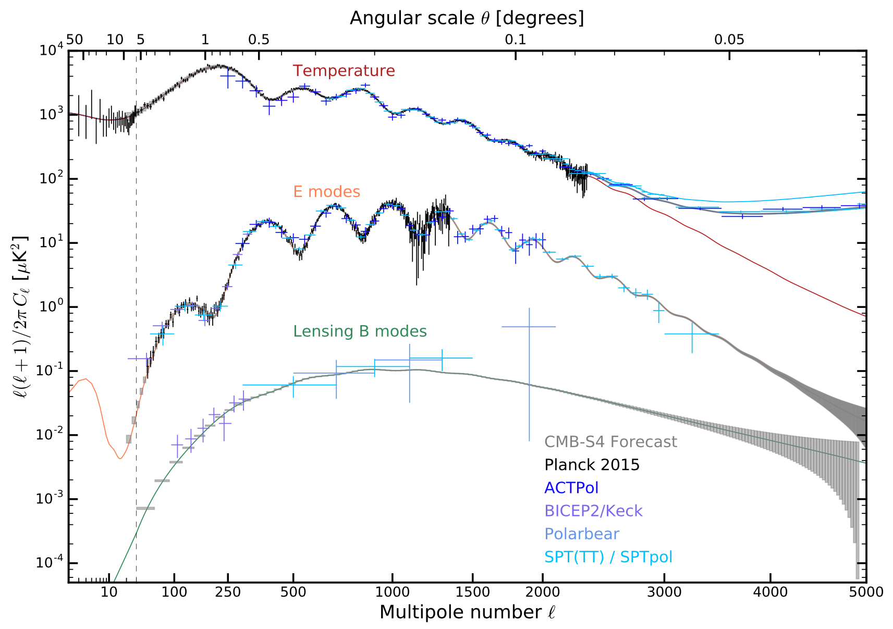
Oct. 2016: CMB Power Spectra
CMB-S4 Science Book: arxiv:1610.02743
To improve measurements, need more detectors
Notes:
Current state of data
-All polarization data from last ~4 years
T very well measured, pol could use improving
Henning et al, EE paper
B especially
To do better, need more detectors
Photon-noise limited

Slide 6
Oct. 2016: CMB Power Spectra
Henning 2017: arXiv1707.09353v1
CMB-S4 Science Book: arxiv:1610.02743
To improve measurements, need more detectors
Notes:
Current state of data
-All polarization data from last ~4 years
T very well measured, pol could use improving
Henning et al, EE paper
B especially
To do better, need more detectors
Photon-noise limited

Slide 7
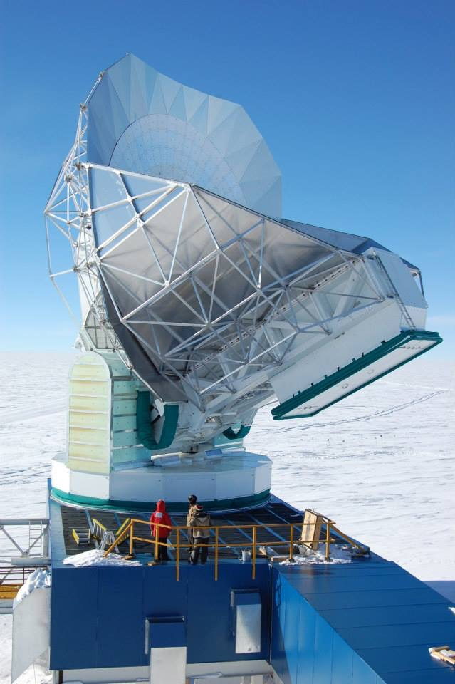
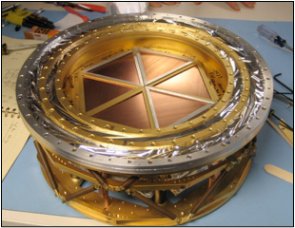
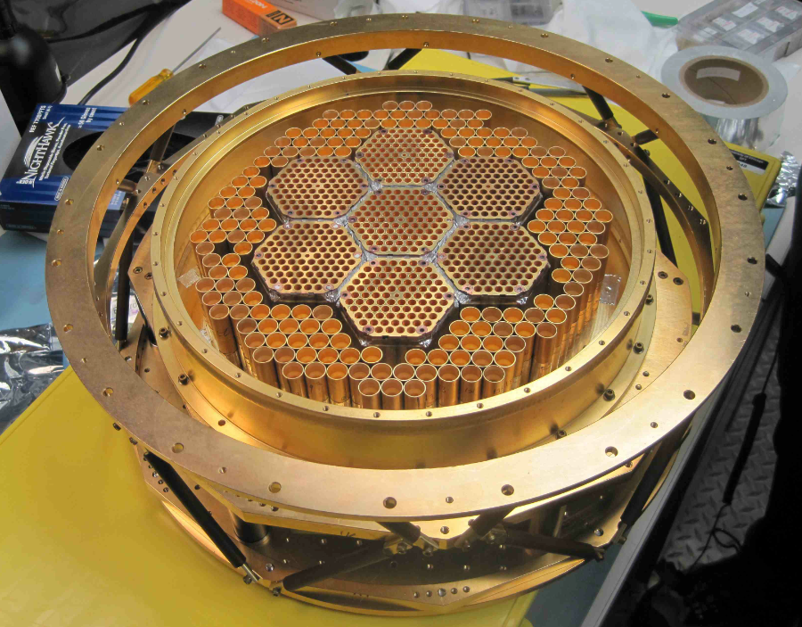
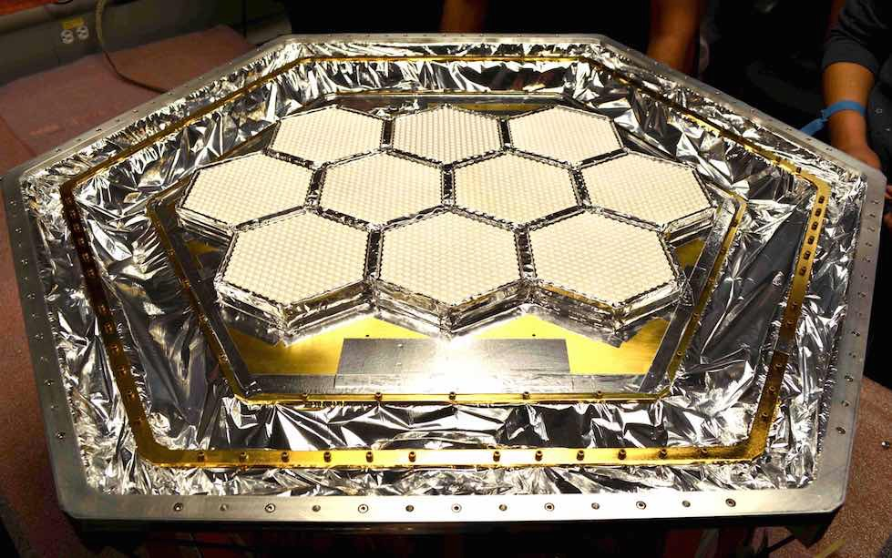
The South Pole Telescope (SPT)
    10-meter sub-mm quality wavelength telescope
    95, 150, 220 GHz and
    1.6, 1.2, 1.0 arcmin resolution
2007: SPT-SZ
960 detectors
95,150,220 GHz
2012: SPTpol
1600 detectors
95,150 GHz
+Polarization
2017: SPT-3G
~16,000 detectors
95,150, 220 GHz
+Polarization
Funded By:
Notes:
That’s where upgrade to SPT-3G comes in
mm-wave ‘scope, 10 meter d primary
High res CMB [Moon=31 arcmin across], high l
(South Pole best in the world: high,dry,stable)
3G , what I’m talking about today, order of mag
A lot went into this

Slide 8
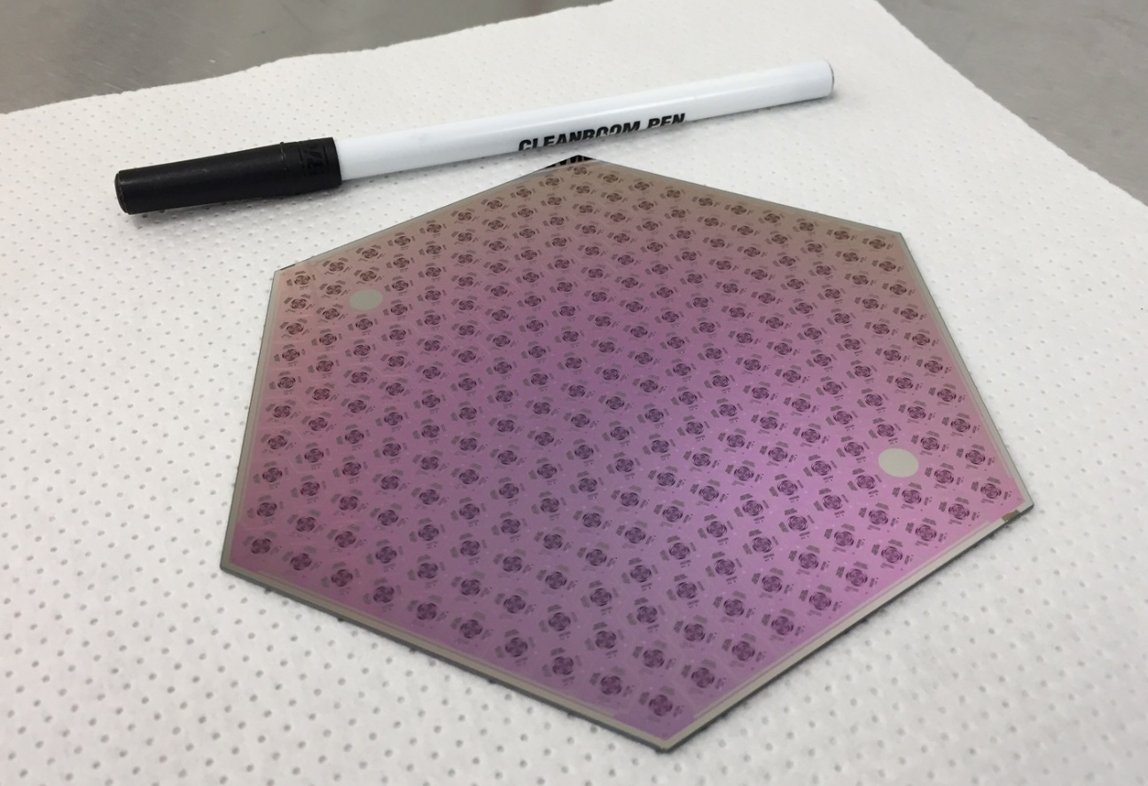
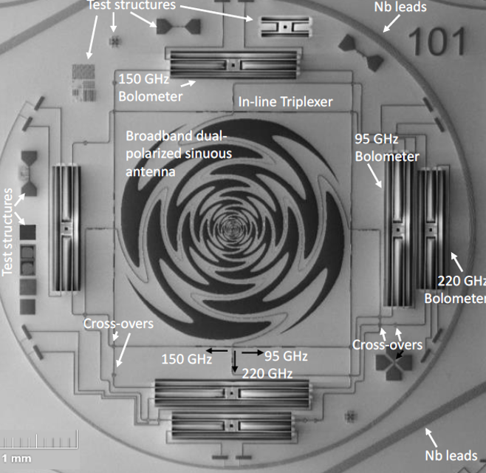
Detectors
Detector wafers fabricated at ANL
271 pixels on each 6” wafer
Ten wafers in SPT-3G focal plane
Broad-band sinuous antenna
coupled to TES bolometers via superconducting microstrip and
in-line filters
Three frequency bands
Two orthogonal linear polarizations
Notes:
Detectors fabricated on Si wafers at ANL
Consist of 271 pixels, each with. . .
Broad-band, dual-pol
Transition-edge sensors
High fab yield, highly uniform
(Psats ~20pW)
To read out each detector ->

Slide 9
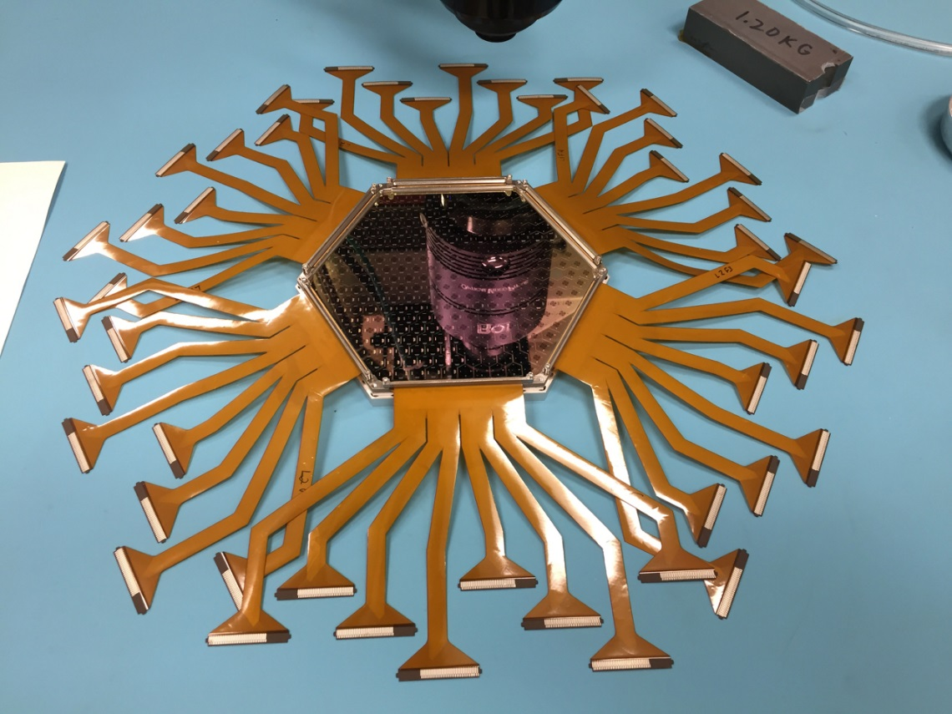
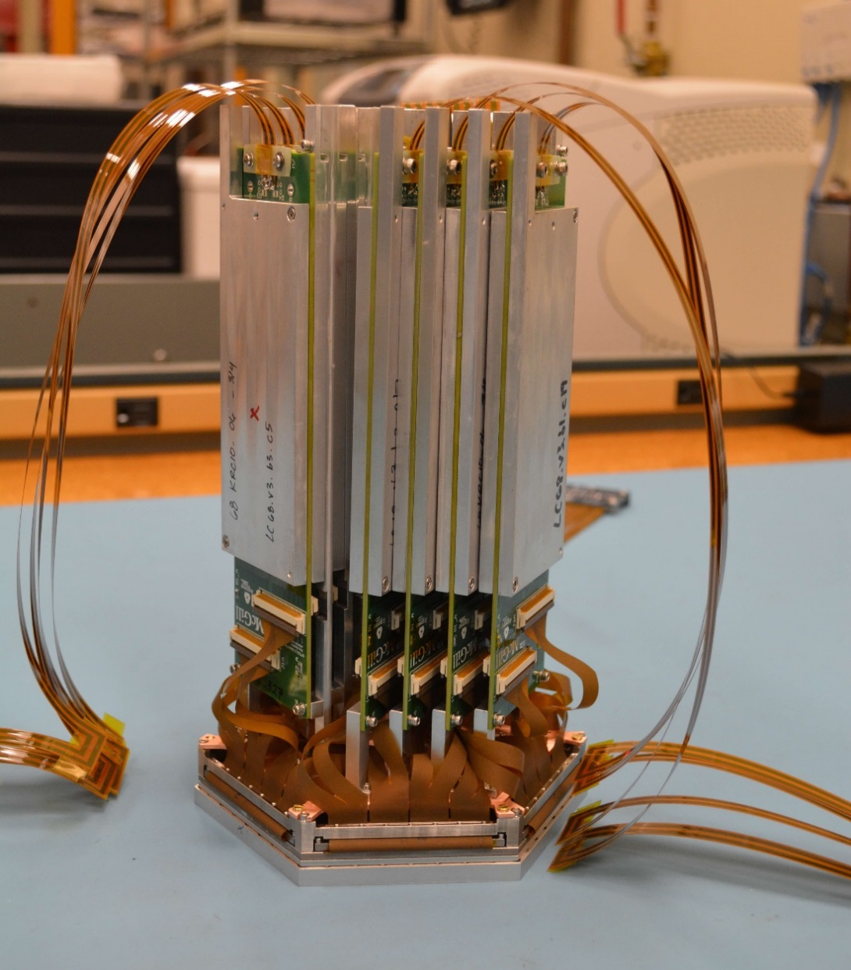
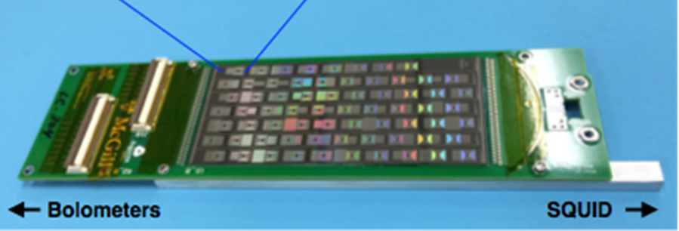
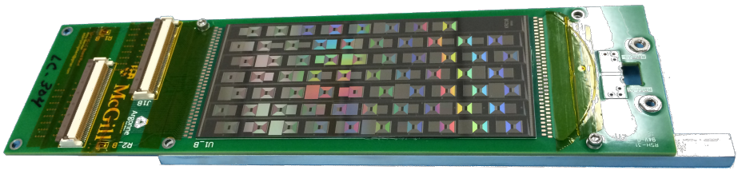
Lithographed inductor-capacitor boards set up 68 resonant frequency channels
Channels summed and read-out through SQUID amplifier
Notes:
-Wirebond each detector (automated)
-cables plugged into LC boards,
Use fmux, each channel gets own frequency -> NEXT SLIDE
LCs set up channels, 68 (pol=15) [LBNL]
264 -> 2
To explain a little bit more ->

Slide 10
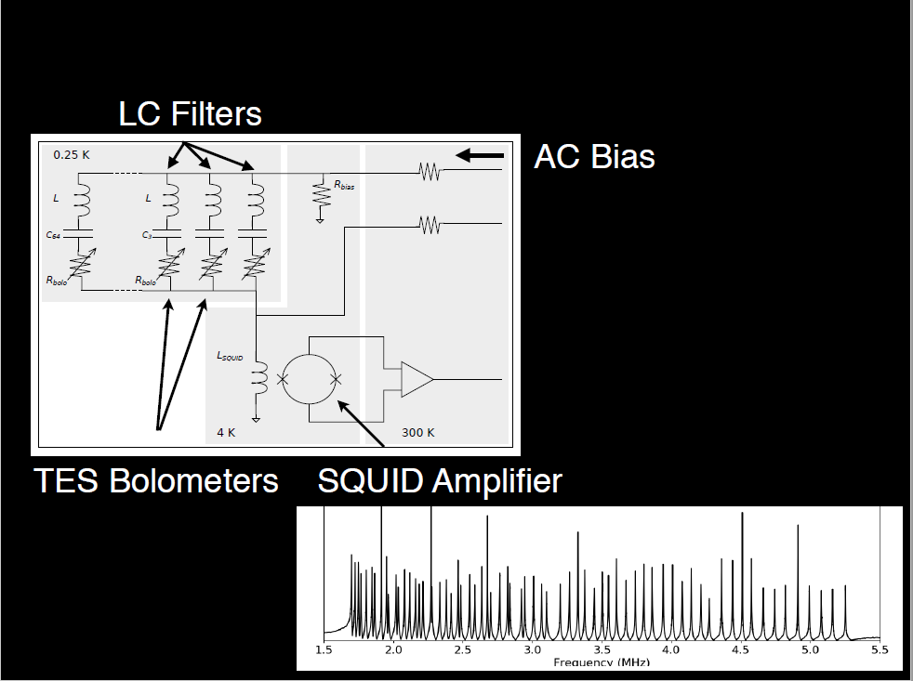
Readout Circuit
Notes:
reduce heat load on cold stage, reduce wiring
98% yield on LCs
Rbolo changes->Ibolo changes
Phi_SQ changes, V_out changes
-SPTpol: 200kHz – 1 MHz, 15 channels

Slide 11
Lithographed inductor-capacitor boards set up 68 resonant frequency channels
Channels summed and read-out through SQUID amplifier
Notes:
Assembled module at right. Repeat 10x ->

Slide 12
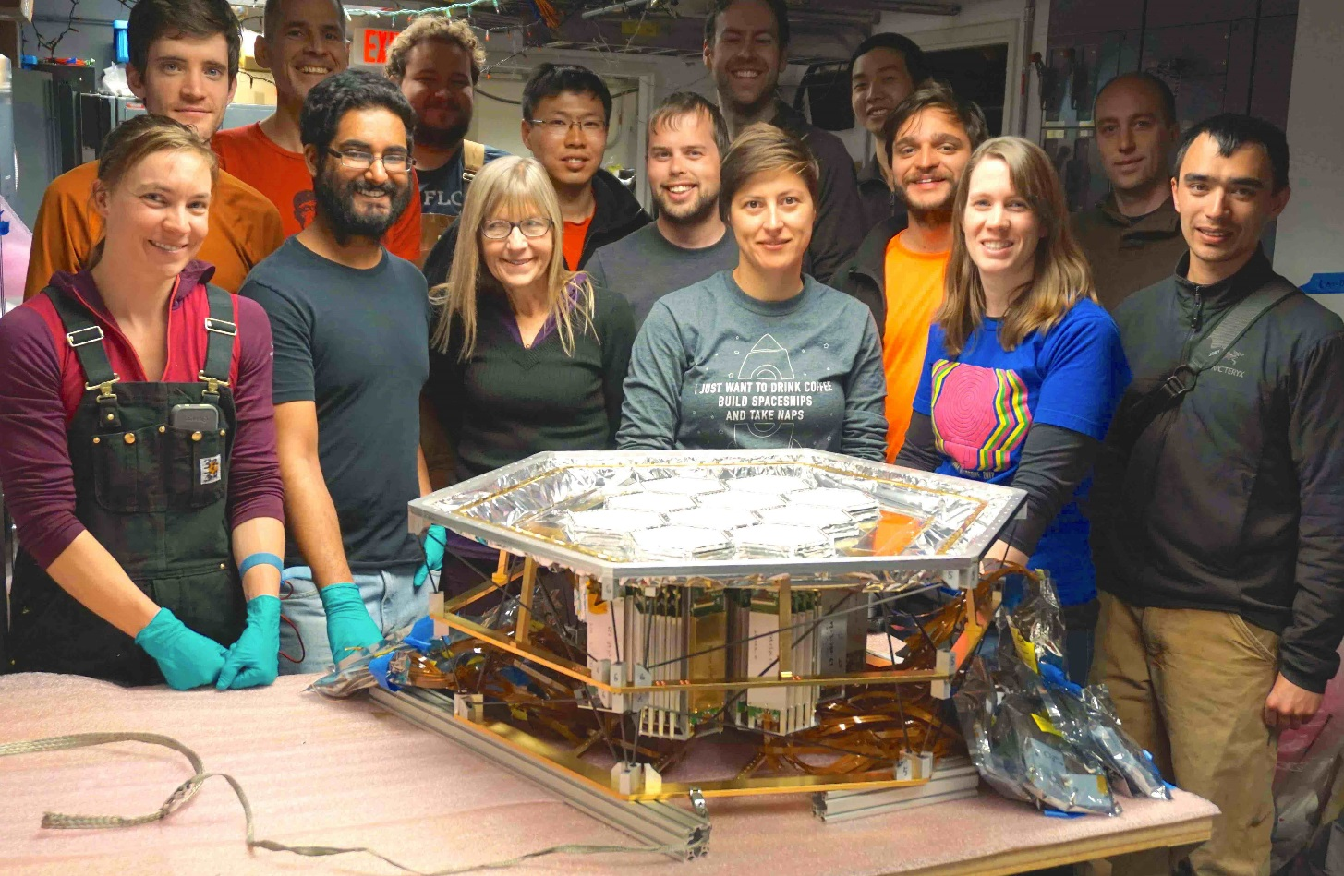
Full Focal Plane Assembled
South Pole January 2017
Notes:
(Alumina lenslets with PTFE AR coating, UIUC)
- Focal plane much larger, need change to telescope optics to illuminate

Slide 13
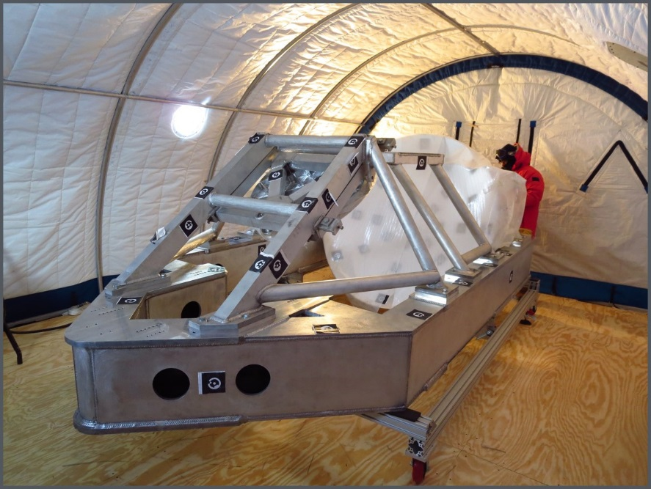
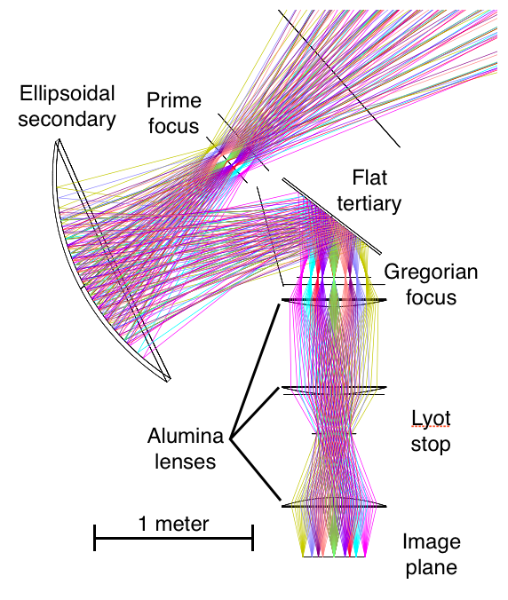
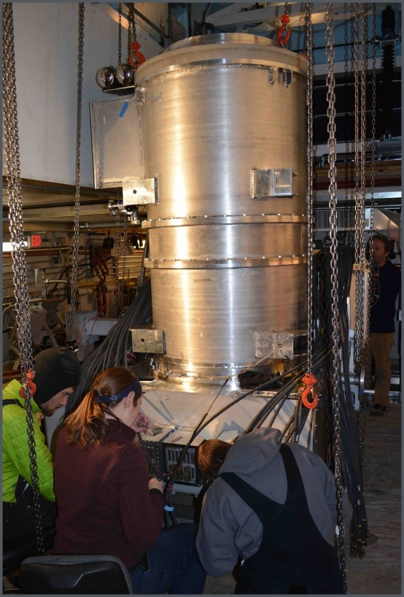
New Optics Design
Optical coupling redesigned to maximize focal plane area
New optics bench, and optics cryostat, and cold alumina lenses
Notes:
- 10m primary to right. Old scheme had cold secondary. . .
-New optics scheme with ellipsoidal. . .
Optics cryo has:
- Window
3 alumina lenses
Lyot stop, LPF

Slide 14
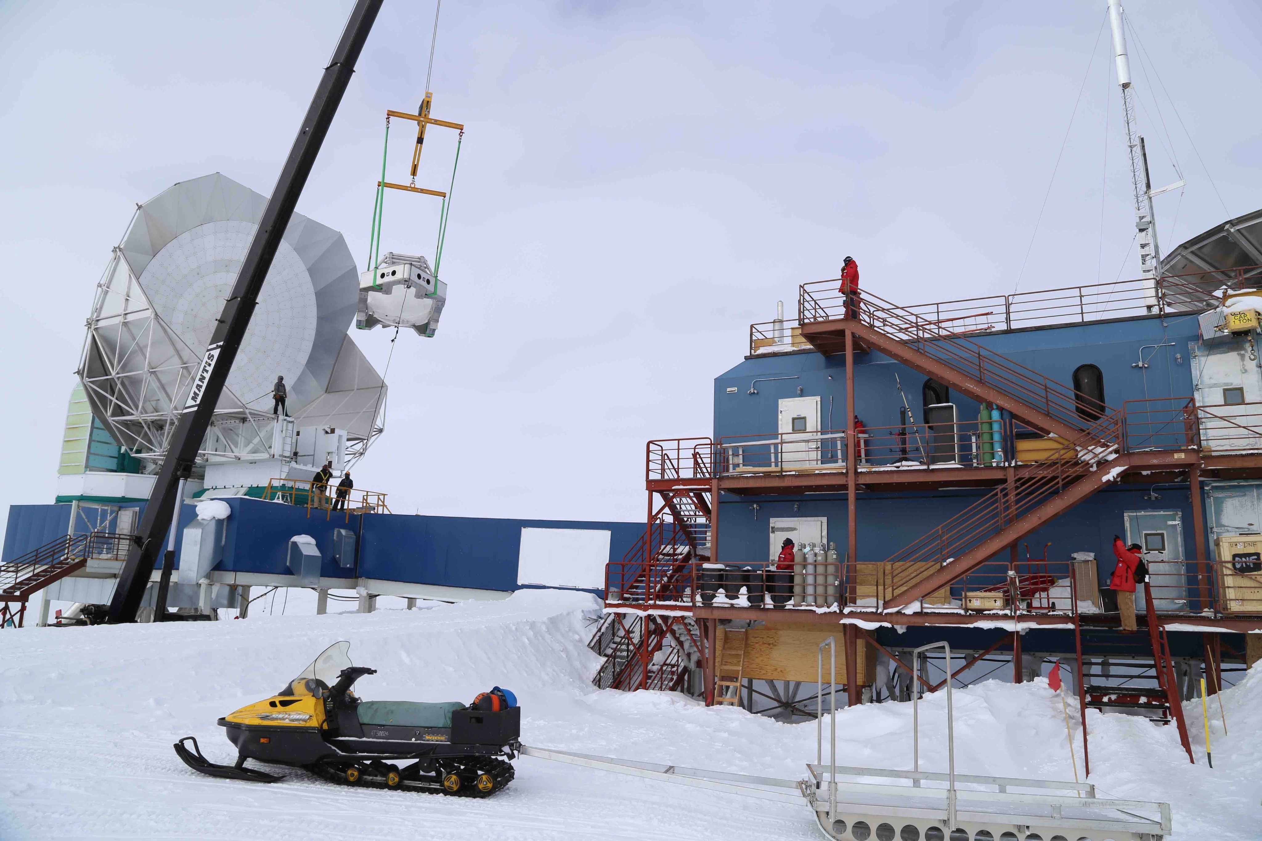
Align and Install Secondary Optics
Notes:
Had to take roof of receiver cabin to get it in.
- Massive operation

Slide 15
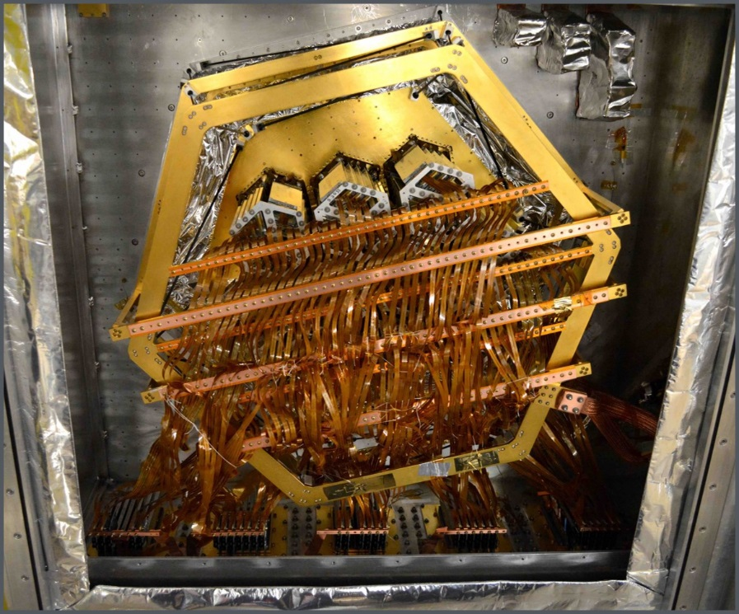
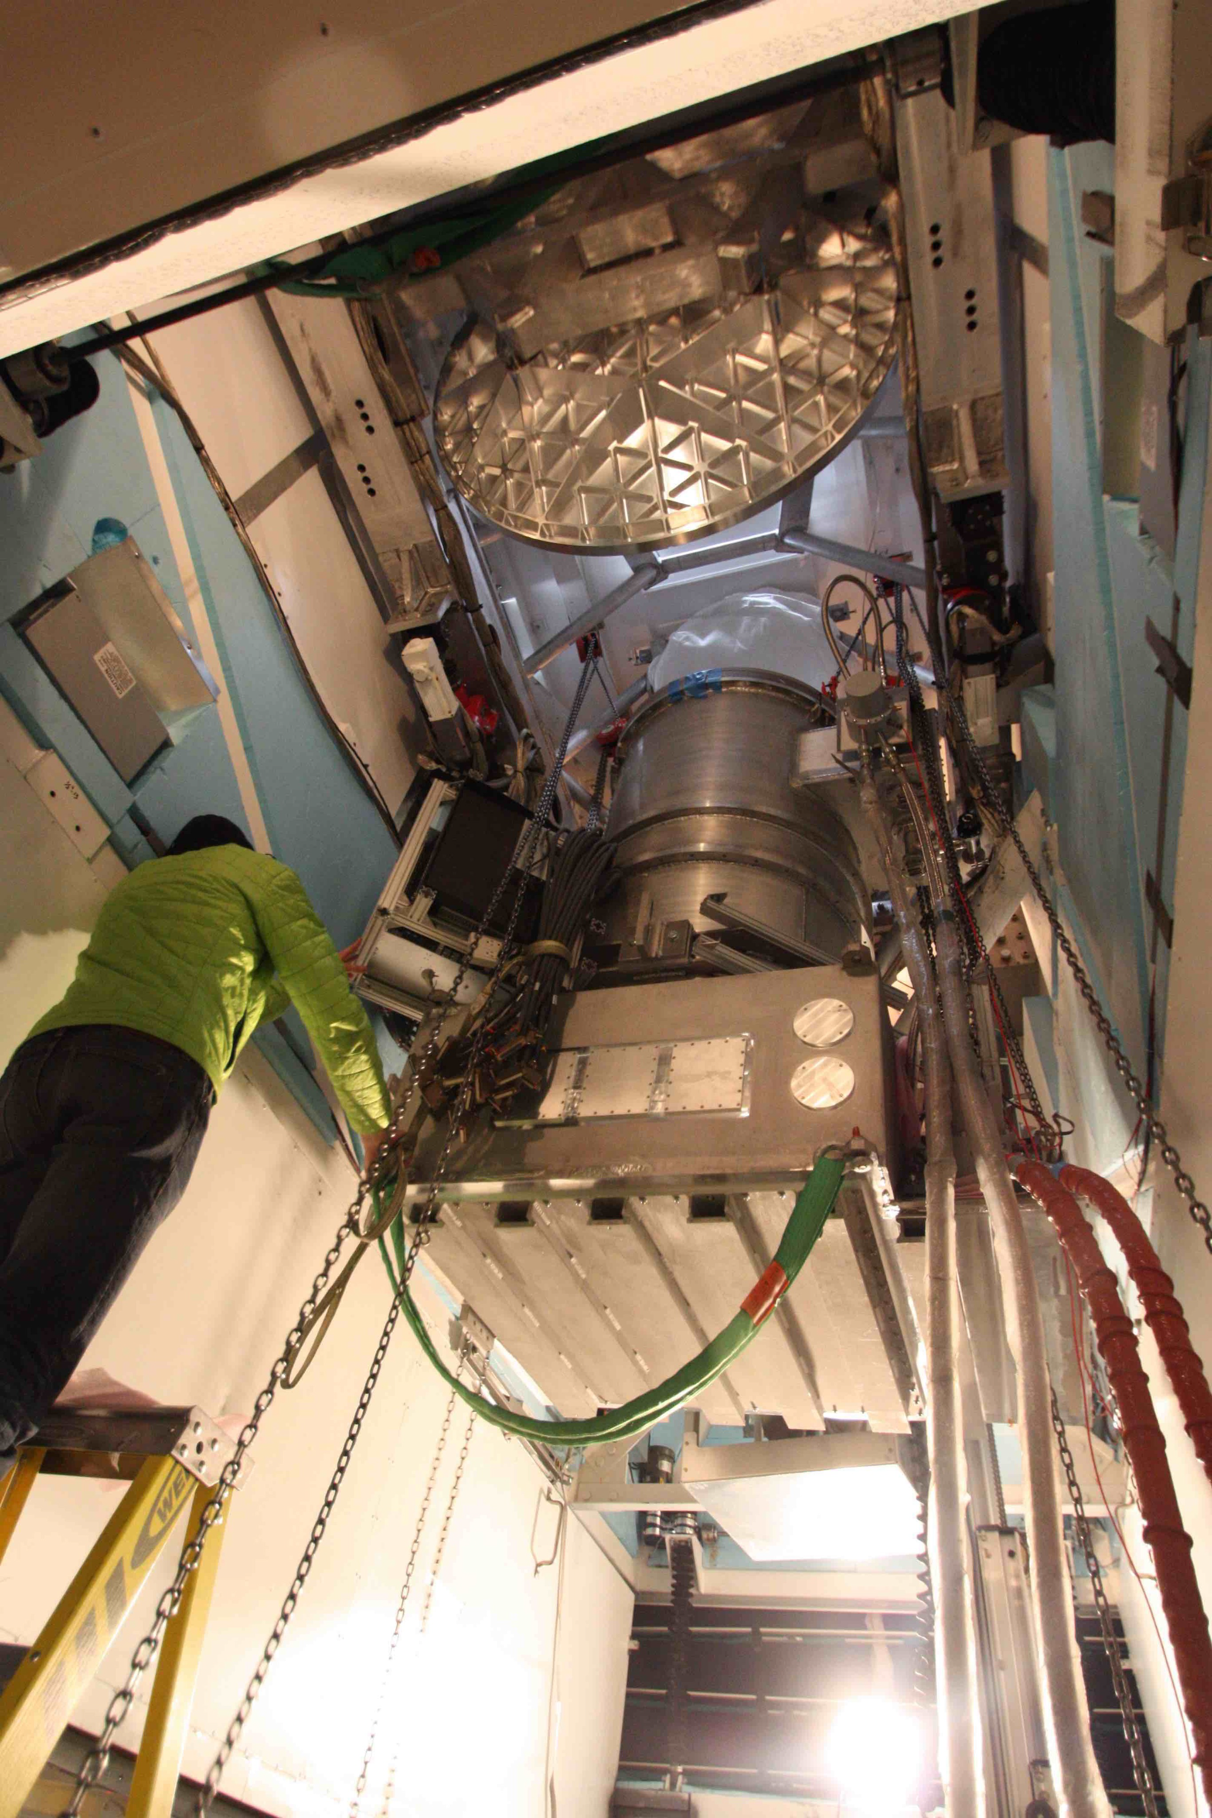
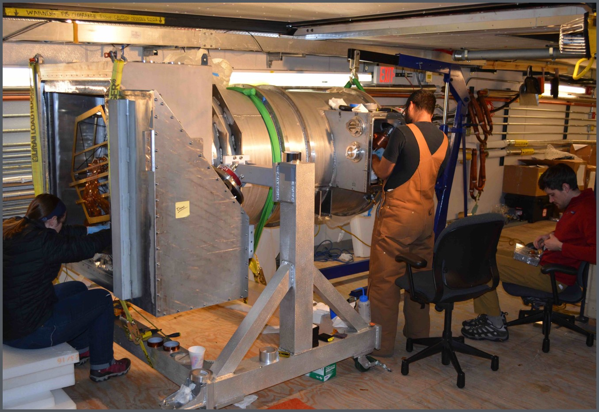
Installation of Focal Plane in Receiver
and
Receiver on Telescope
Notes:
- Describe this slide, then amp for 1st light:
- On January 30th:

Slide 16
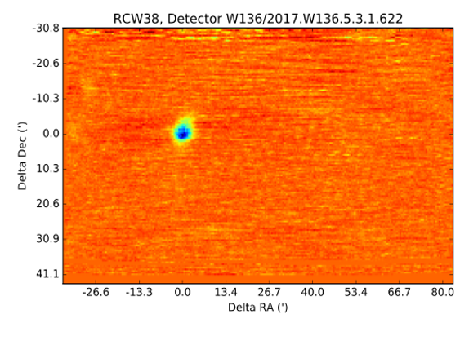
First Light on January 30, 2017
Notes:
Further performance on telescope ->

Slide 17
Source
Observations
RCW38 for pointing, flux calibration
CenA for polarization calibration
RCW38
Centaurus A
Detector band measurements
Good uniformity across wafers
Notes:
New maps of source observations
Use these for calibration
Detector bands (measured on ground)
Uniform, 60-90% bolo optical efficiency

Slide 18
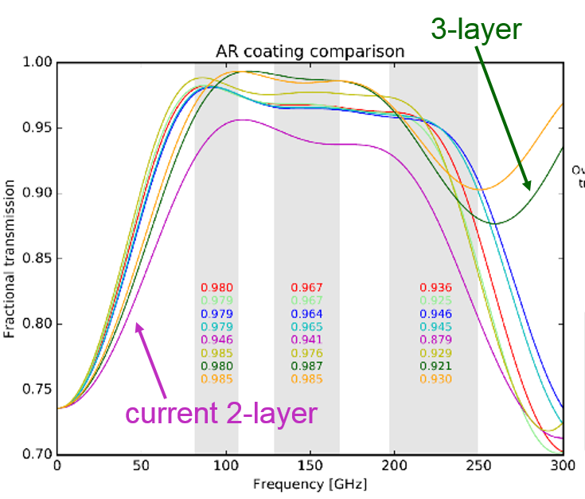
Current Status and
Improvements for Next Season
Operable detector yield ~ 74%
  Replace non-functioning or low yield detectors and readout
Elevated readout noise
  Replace SQUID amplifiers with lower input impedance versions
Two-layer AR coating on alumina lenses has higher loss
  Replace with three-layer coating
Notes:
- Psats?
Noise: SQUIDS, cable grounding fixed in-situ
Lenses: 8 surfaces have AR coating
92% ^8 = 50%
Had been doing thermal spray, might move to PTFE

Slide 19
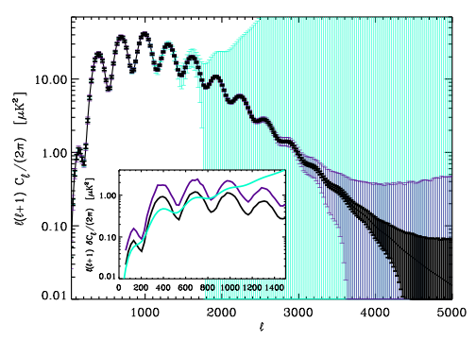
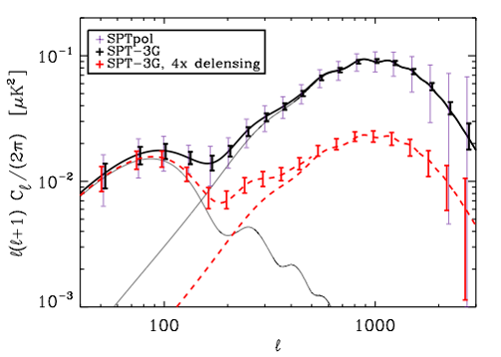
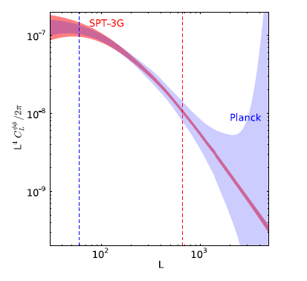
SPT-3G Survey Projections
EE
BB
Lensing
Planck
SPTpol
SPT-3G
Benson 2014
Parameter Constraints
Survey depth
(with Planck, BOSS priors) | SPT-3G (2021)
𝝈(r) | 0.011
𝝈(Neff) | 0.058
𝝈(𝚺m𝝂) | 0.061 eV
2500 sq deg, Four years | 95 GHz | 150 GHz | 220 GHz
T (uK-arcmin) | 3.6 | 3.3 | 8.5
P (uK-arcmin) | 5.1 | 4.7 | 12
Notes:
With nominal noise, should achieve these
Factor of ~5 improvement in noise over SPTpol
17x mapping speed

Slide 20
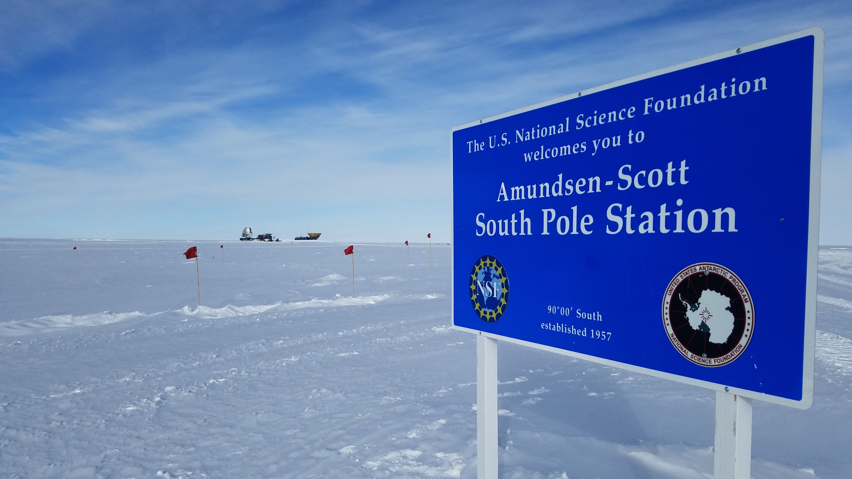
Summary
SPT-3G installed on telescope in early 2017
First-year observations on-going
Improvements to detectors, readout, and optics planned for 2018 observing season
4-year survey will yield high-precision, high-resolution polarization maps of the CMB
Data will probe the neutrino sector, as well as
  Inflation
  Reionization
  Galaxy clusters
  and more

Slide 21
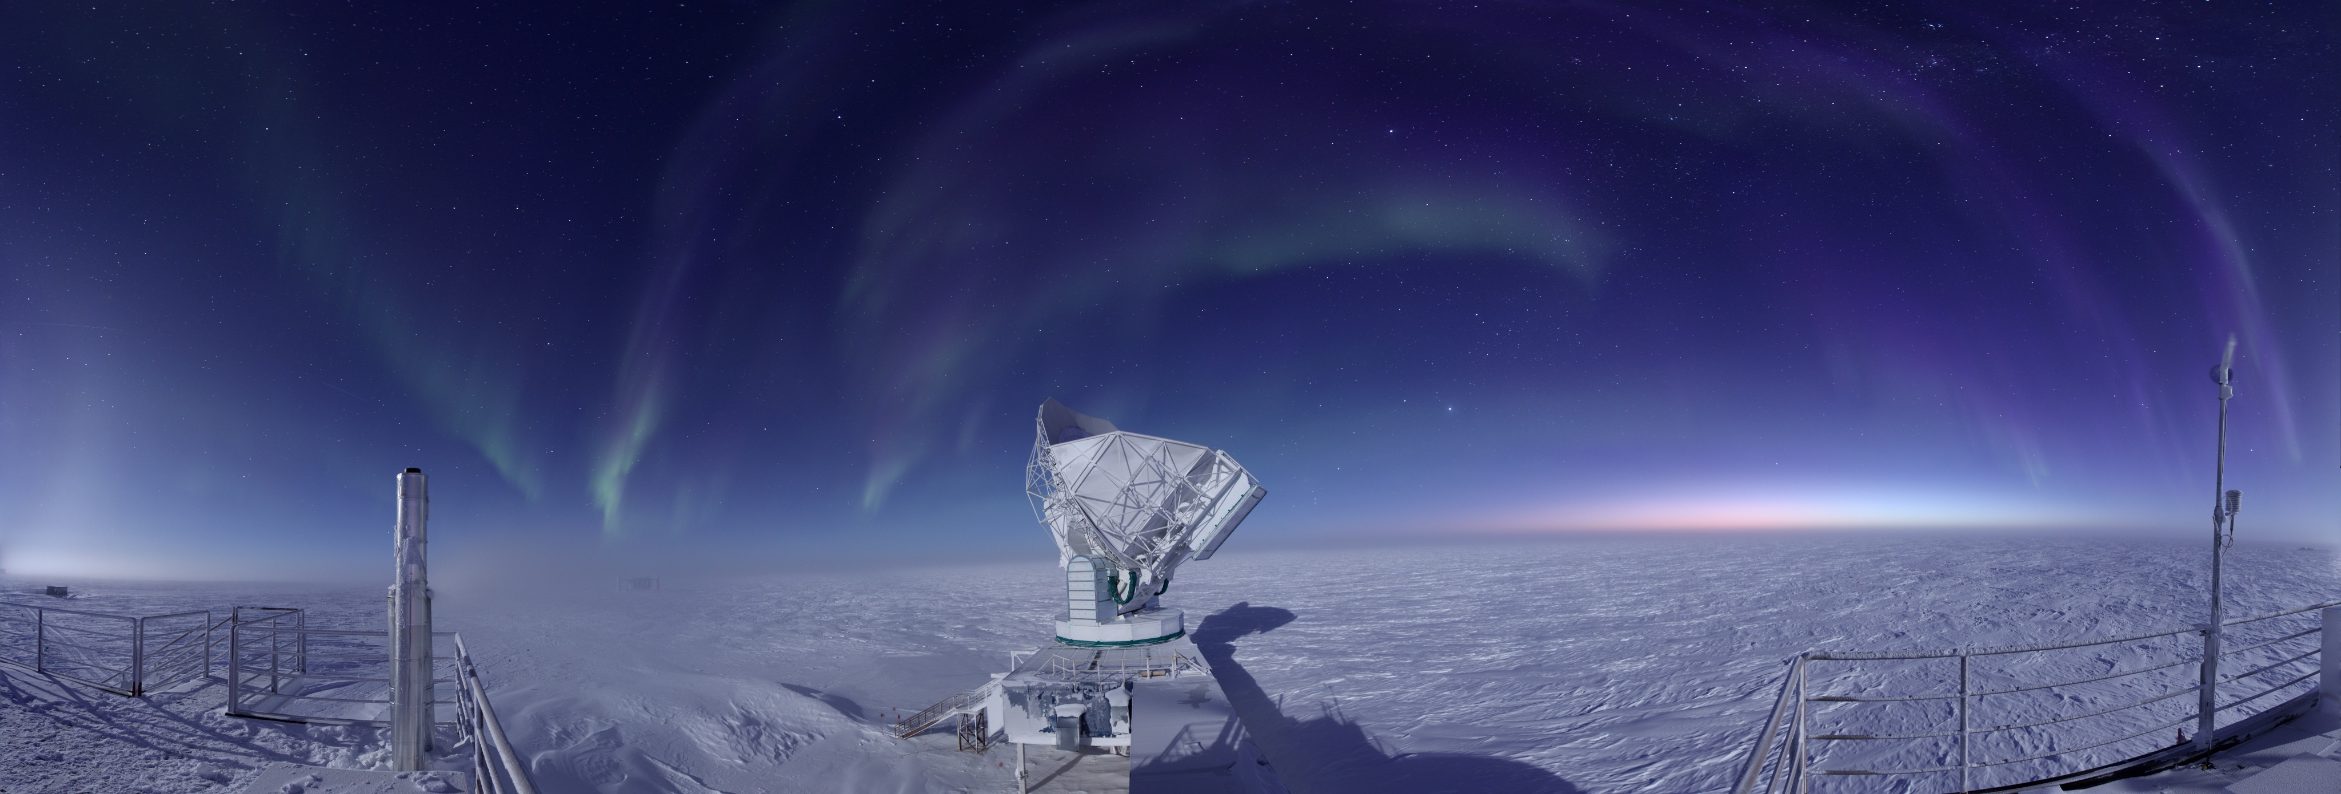
Thank you

Slide 22
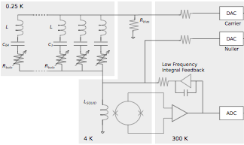

Readout Noise Enhancement
Noise enhancement from current division with SQUID input coil:
  Current at SQUID canceled by “digital active nulling” feedback loop (nuller = science signal)
  BUT nuller current for noise INSIDE LOOP is divided between comb and SQUID coil
  Over 1.8 to 5.2 MHz readout bandwidth, noise internal to ADC chain enhanced by:
leakage
nuller
noise
sources
feedback
 | Linput
current NIST SQUIDs | ~300 nH
NIST, StarCryo SQUIDs under study | 10-50 nH
Want low input coil inductance!
Replacing SQUIDs next season

Slide 23
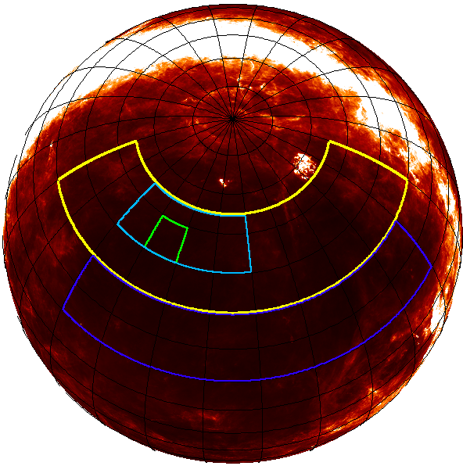
Projected Sensitivity
Significant increase in sensitivity following installation of 3-layer AR coating and low-inductance SQUIDs
2018 season projected
band | NET (bolo) [uK rtsec] | NET (array) [uK rtsec] | mapping speed (x SPTpol)
90 GHz | 509 | 7.4 | 16.4
150 GHz | 460 | 6.5 | 5.3
220 GHz | 1188 | 17 | inf.
SPT-SZ
SPTpol
SPTpol-Deep
SPTpol-Summer
 | Obs. Years | Area (deg2) | 95 GHz (uK-arcmin) | 150 (uK-arcmin) | 220 (uK-arcmin)
SPT-SZ | 2007-11 | 2500 | 40 | 17 | 80
SPTpol-Main | 2012-16 | 500 | 13 | 5 | -
SPTpol-Deep | 2012-16 | 100 | 10 | 3.5 | -
SPTpol-Summer | 2012-16 | 2500 | 47 | 28 | -
SPT-3G (projected) | 2017-21 | 2500 | 3.6 | 3.3 | 8.5
20h
7h
22h
4h
0h
2h
-65
-50
-40
-30
-20

Slide 24
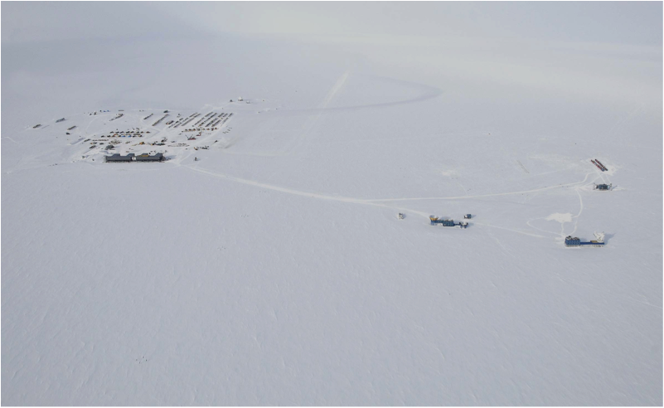
The South Pole is the Best Place in the World to Observe the CMB
The South Pole (and Station)
The “Dark” Sector
~1 km
IceCube
SPT
South Pole Environment
  High Altitude (~10,000 ft)
  Extremely Dry
    Precipitable water vapor in winter is ~4x less than Chile, ~6x less than Hawaii
  Stable Atmosphere
    During 6-month night, the sky is ~30x more stable than ALMA-site in Chile
Keck
BICEP
Slide Credit: Brad Benson

Slide 25
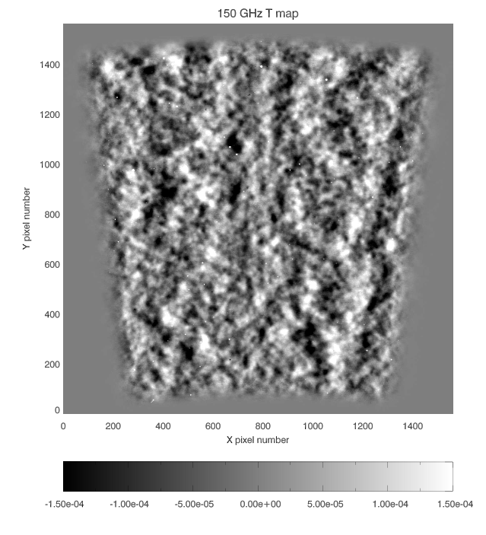

SPT
150 GHz
50 deg²
The moon
(for scale)

Slide 26
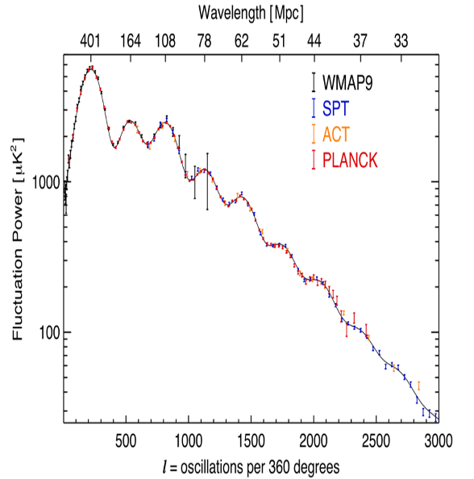
SPT
150 GHz
50 deg²
Primary CMB Anisotropy
Size and scale of temperature fluctuations in early Universe

Slide 27
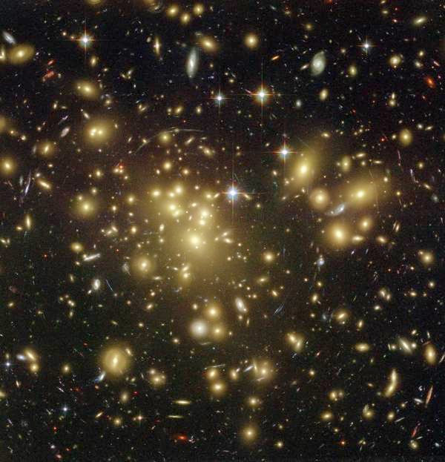
SPT
150 GHz
50 deg²
Cluster of Galaxies
Clusters of Galaxies
“Shadows” in the microwave background from clusters of galaxies.
The Sunyaev-Zel’dovich (SZ) effect

Slide 28
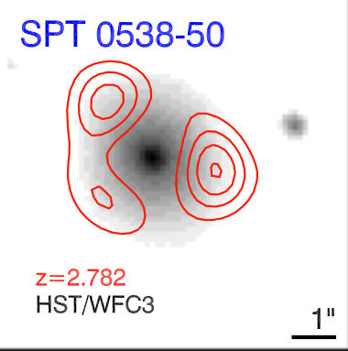
SPT
150 GHz
50 deg²
Point Sources
Active galactic nuclei, and the most
distant, star-forming galaxies
z=2.782
HST-WFC3
ALMA

