Slide 1
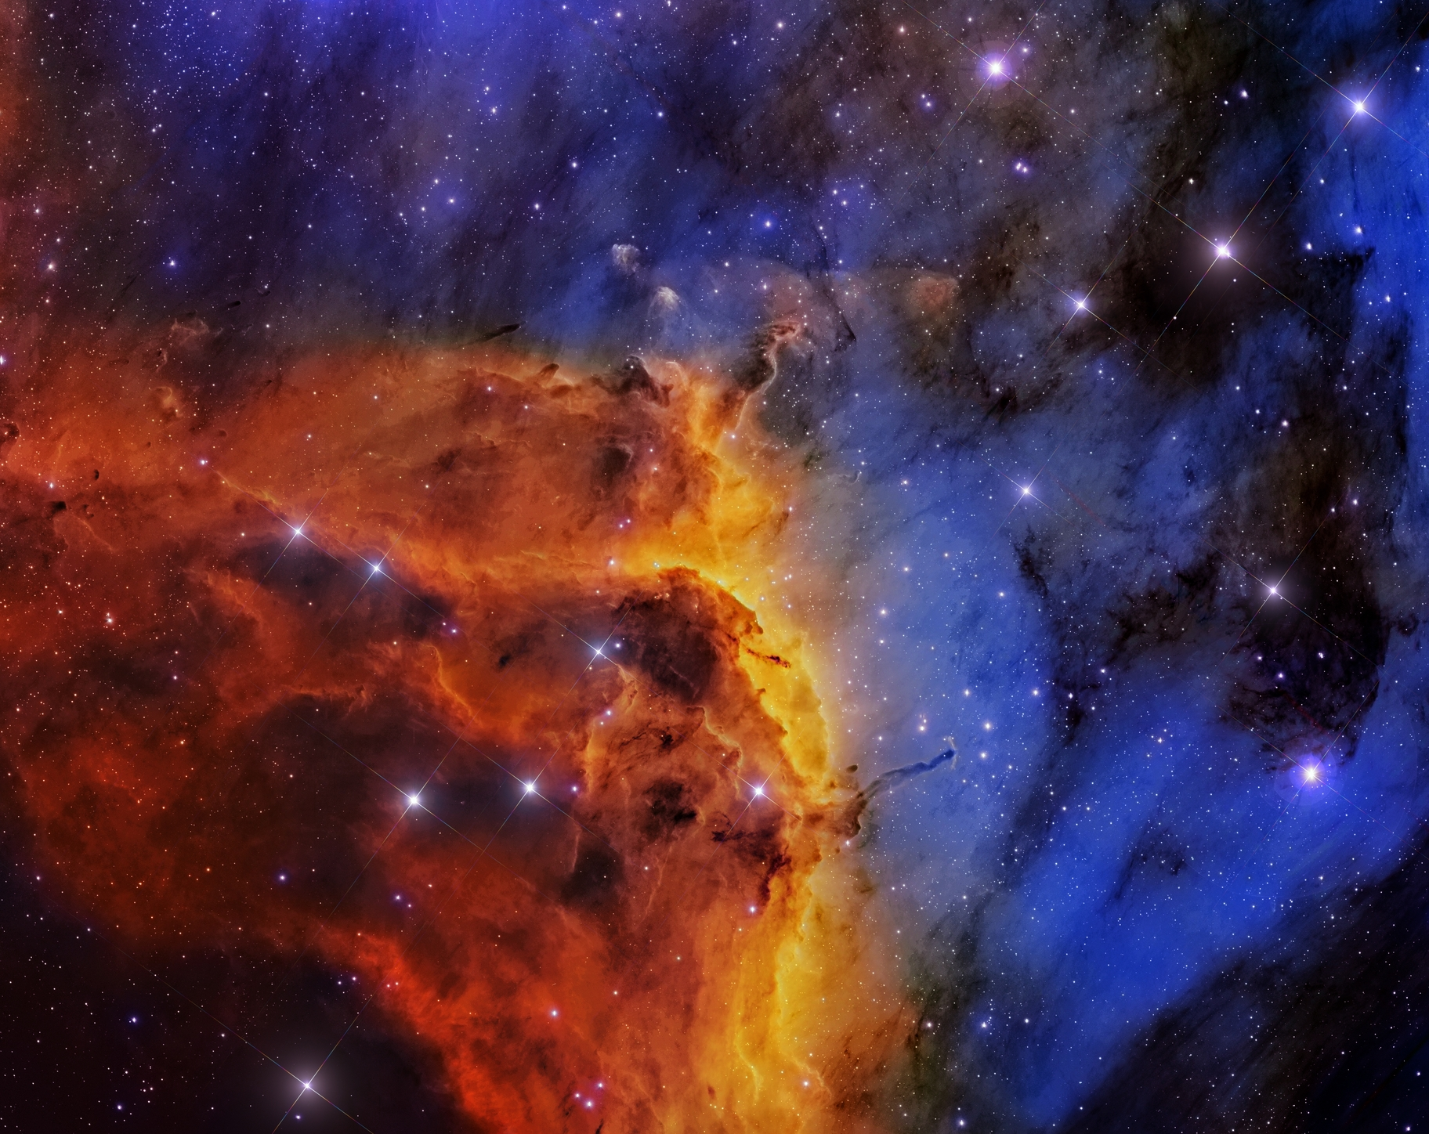
Unexpectedly Bright:
High energy emission from SNRs
Katie Auchettl
The Ohio State University/CCAPP
with Patrick Slane (CfA), Daniel Castro (NASA/GSFC), Laura Lopez (OSU), Nicole Man (UCSC), Stephen Ng (HKU), Joshua Wing (CfA), Jasmina Lazendic-Galloway (Monash) and others…

Slide 2
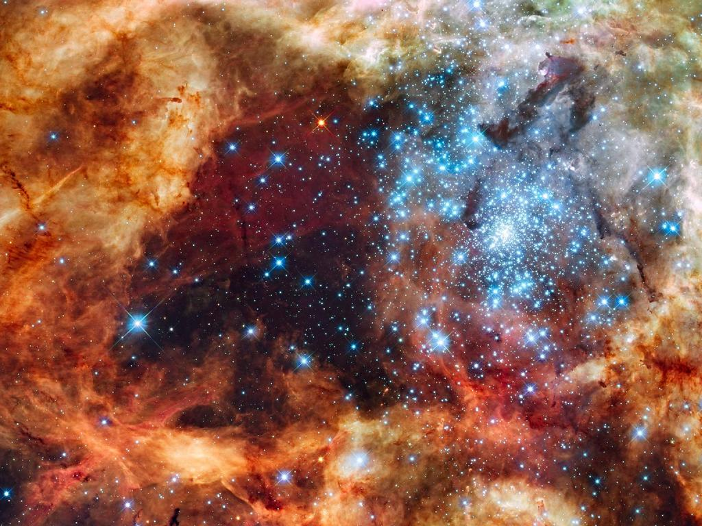
Environment affects the evolution of a star
Notes:
As you all know, the mass and evolution of an individual star will depend highly on the environment in which the star is born. When the massive stars born in these dense environments end their life as a supernova explosion.

Slide 3
Expanding shock-front
The shock-front produced by the SNe expands and heats the stellar ejecta and swept-up ISM to X-ray emitting temperatures.
Contact Discontinuity
ISM/CSM
Forward
Shock
Shocked ISM/CSM
Forward
Shock
Shocked ejecta
Shocked ISM/CSM
Reverse
Shock
Shocked ejecta
Reverse
Shock
Ejecta
Ejecta
Notes:
The energy from this explosion is partially converted into kinetic energy, which forms an expanding shock-wave of ejecta and ISM called the forward shock. As this ejecta driven shock-wave sweeps up mass, it decelerates resulting in a back pressure on the expanding ejecta in the form of a reverse shock. While the forward shock heats up swept-up ISM, the reverse shock heats up the stellar ejecta to X-ray emitting temperatures and ….

Slide 4
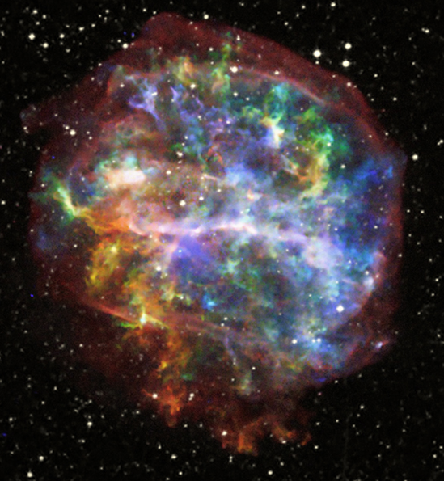
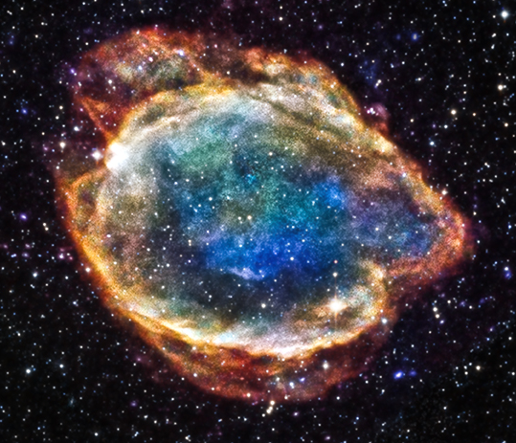
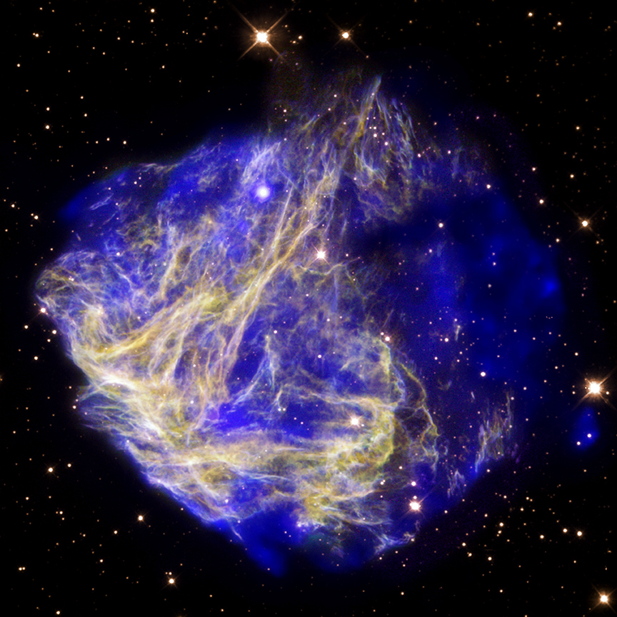
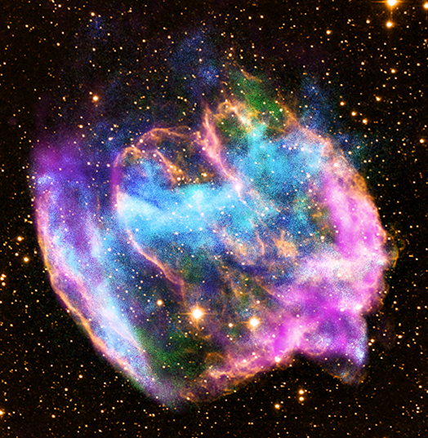
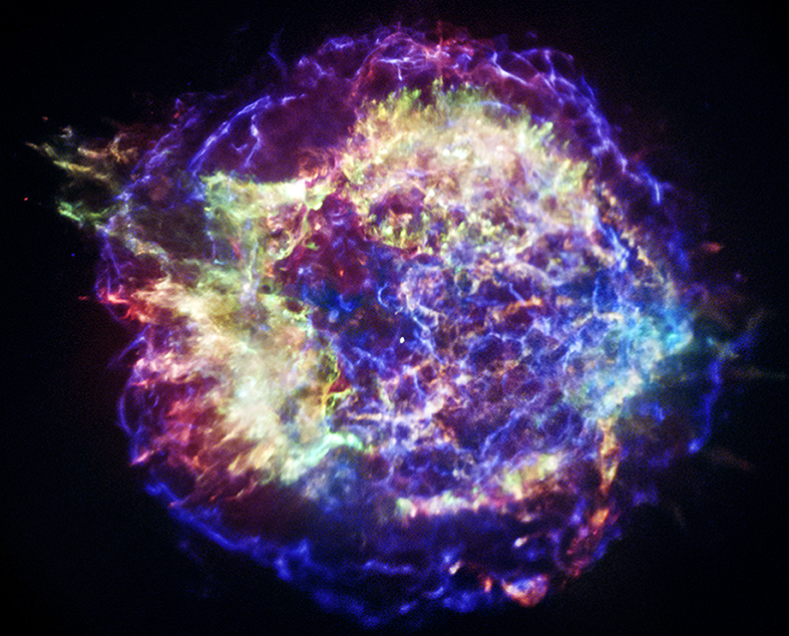
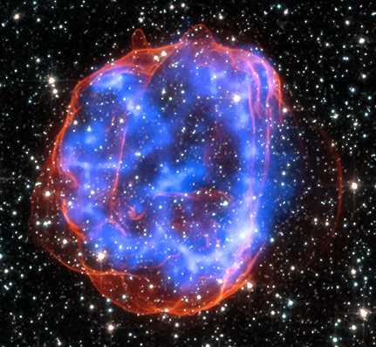
The remnants of a supernova
Notes:
And what we see is the remains of the original star as a supernova remnant. Apart from being beautiful objects, these objects allow us derive information about the original star and itssurrounding environment.

Slide 5
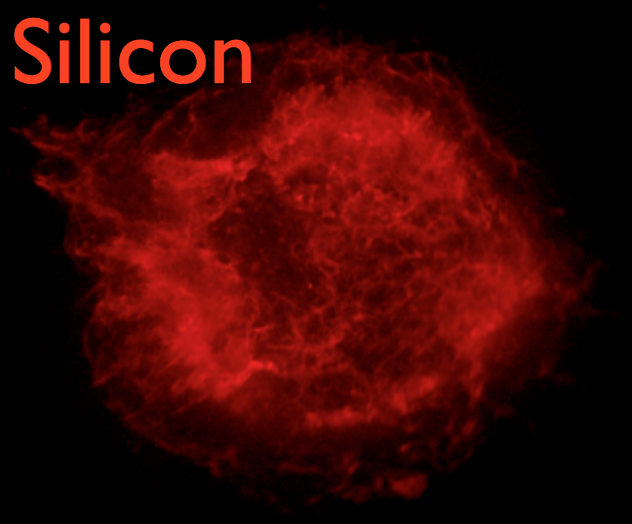
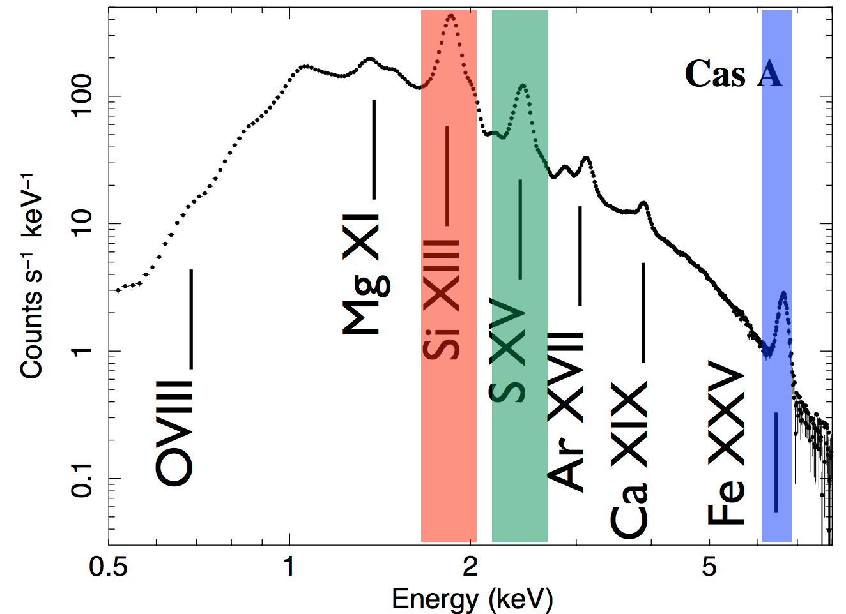
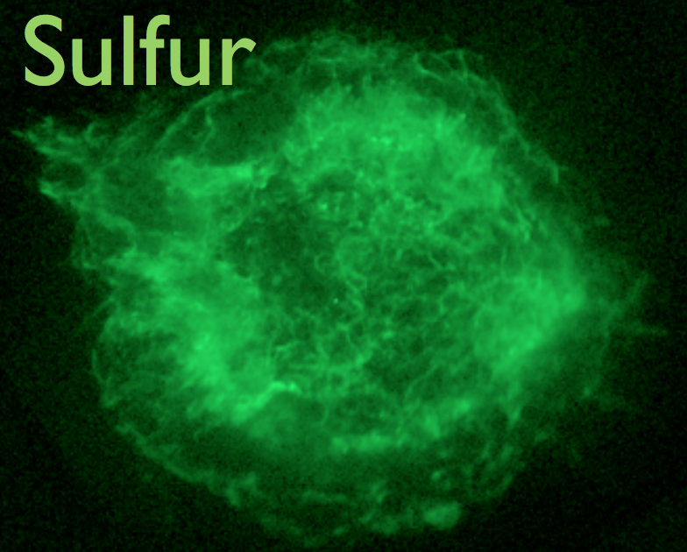
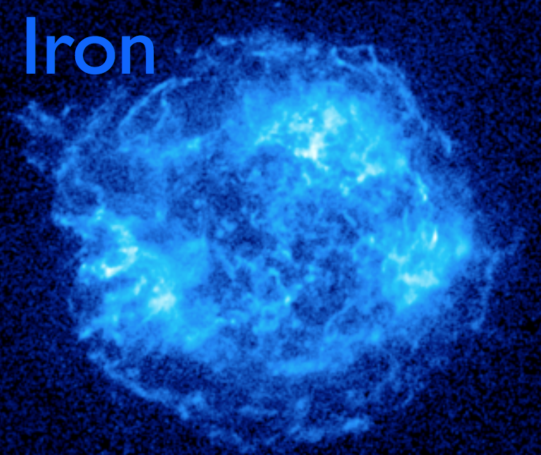
Discover the star we didn’t see
Determine the nucleosynthesis yield of the parent star.
Mass of the progenitor.
Explosion mechanism:
  Type Ia SN have lots of iron
  CC SN have lots of O, Ne, Mg, Si.
Notes:
For example, as the metals synthesizsd by the star and in the explosion are now X-ray bright due to heating by the SNRs reverse shock, we can study the X-ray emission of these objects to determine the nucleosynthesis yeilds of the parent star. From this, we can estimate the mass of the progenitor needed to produce these yields, while studying the spatial and velocity distributions of these elements can reveal inherent asymmetries of the original explosion. And if we are lucky, we can also determine the type of explosion that occurred either from chemical abundances derived from spectra, or from the detection of a compact object.

Slide 6
The remnants of a supernova
A dense environment has a profound effect on the morphology and properties of SNRs.
Notes:
However, as the massive stars that produce supernova remnants do not travel far from their original birth place, they are usually expected to die in the same dense environment in which their progenitor was born. As a consequence, the interaction between the SNR with its dense environment has a profound effect on the morphology and emission properties of these objects.

Slide 7
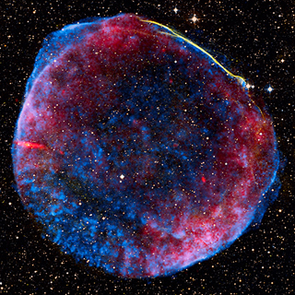
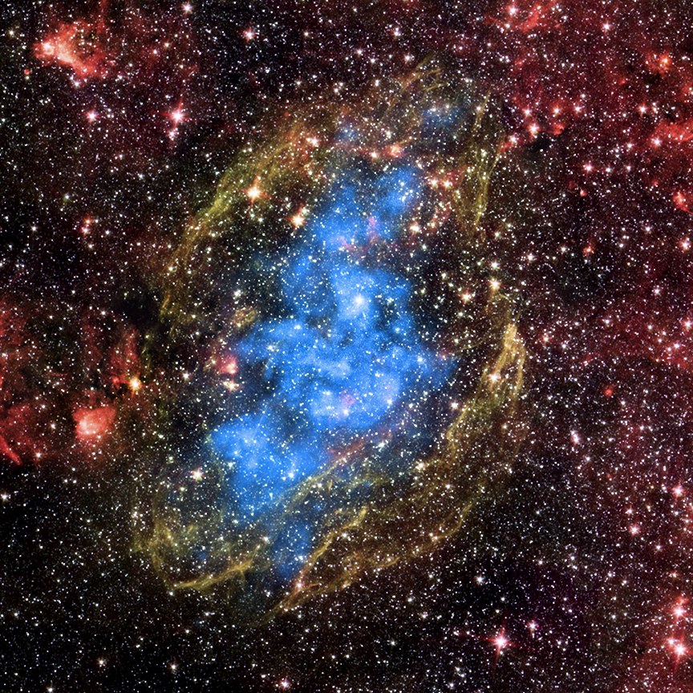
Centrally peaked X-ray morphology
Shell type-SNR:
SN1006
Mixed Morphology SNR:
W44
Centrally peaked X-ray morphology which arises from a collisional hot plasma (Lazendic et al. 2006).
These mixed-morphology SNRs are middle aged.
Notes:
The best way to see how the properties of SNRs are affected by the presence and interaction with a molecular cloud is by comparing to approximately 80% of the known Galactic SNRs which are classified as shell-type. For Shell-type SNRs their emission usually resembles a ring-like structure in which its X-ray and radio emission is spatially correlated. However for mixed morphology SNRs which are usually known to be interacting with dense material, their properties are quite different. The X-ray and radio emission from these remnants are not spatially correlated, with X-rays being found in the center of the remnant, while the radio emission forms a shell.

Slide 8
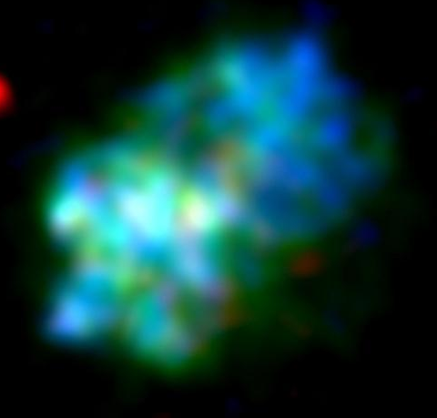
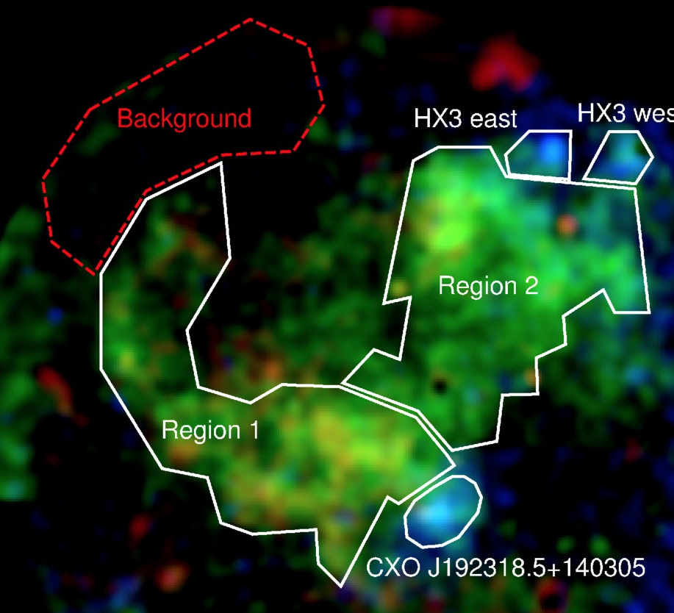
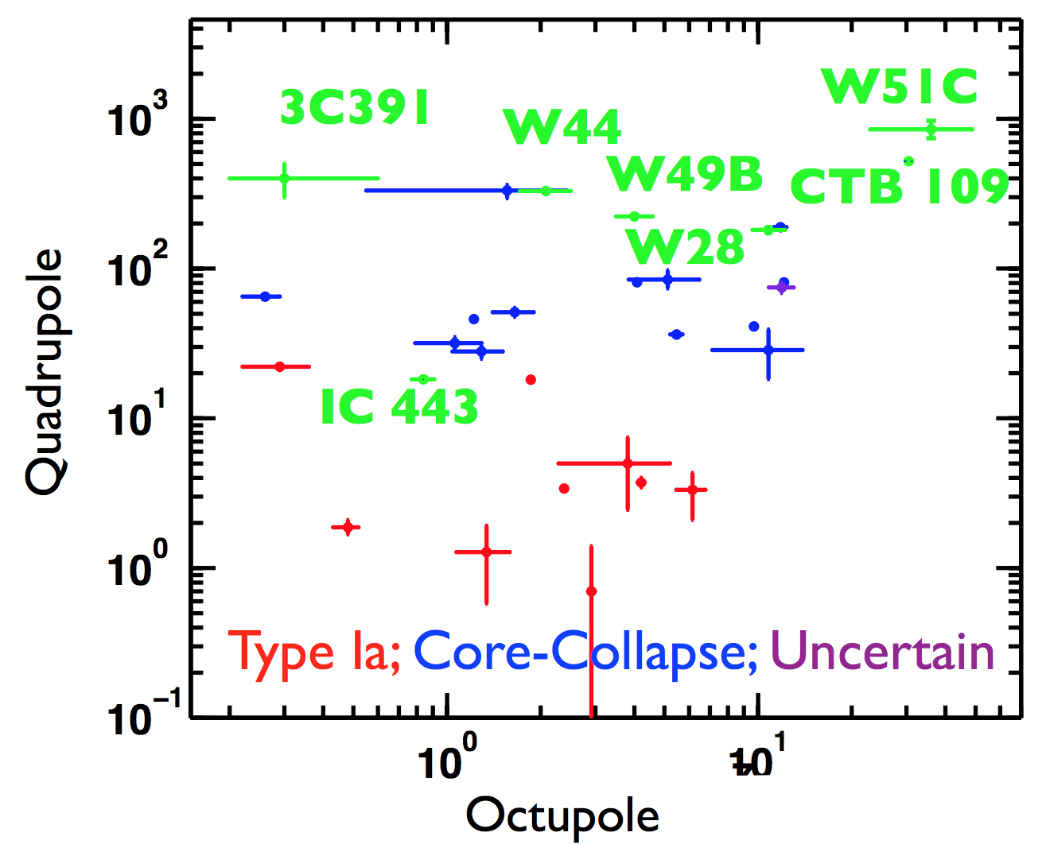
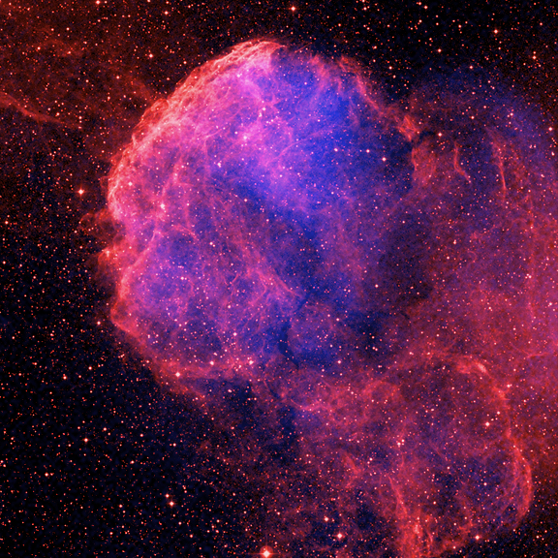
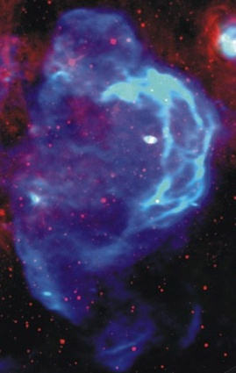
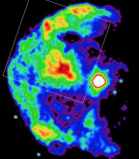
Highly asymmetric
SNRs known to be
interacting with
molecular clouds are less spherical and are more asymmetric than shell type SNRs.
Ellipticity ---------------->
Shell Type
Asymmetry ----------------->
Lopez et al. 2013
Notes:
But apart from this centre filled X-ray morphology, the interaction of a SNR with a nearby molecular cloud will dramatically affect the overall shape of a SNR as well with these objects usually being more asymmetric and less spherical compared to shell type SNRs.

Slide 9
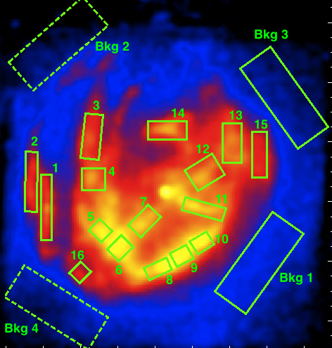
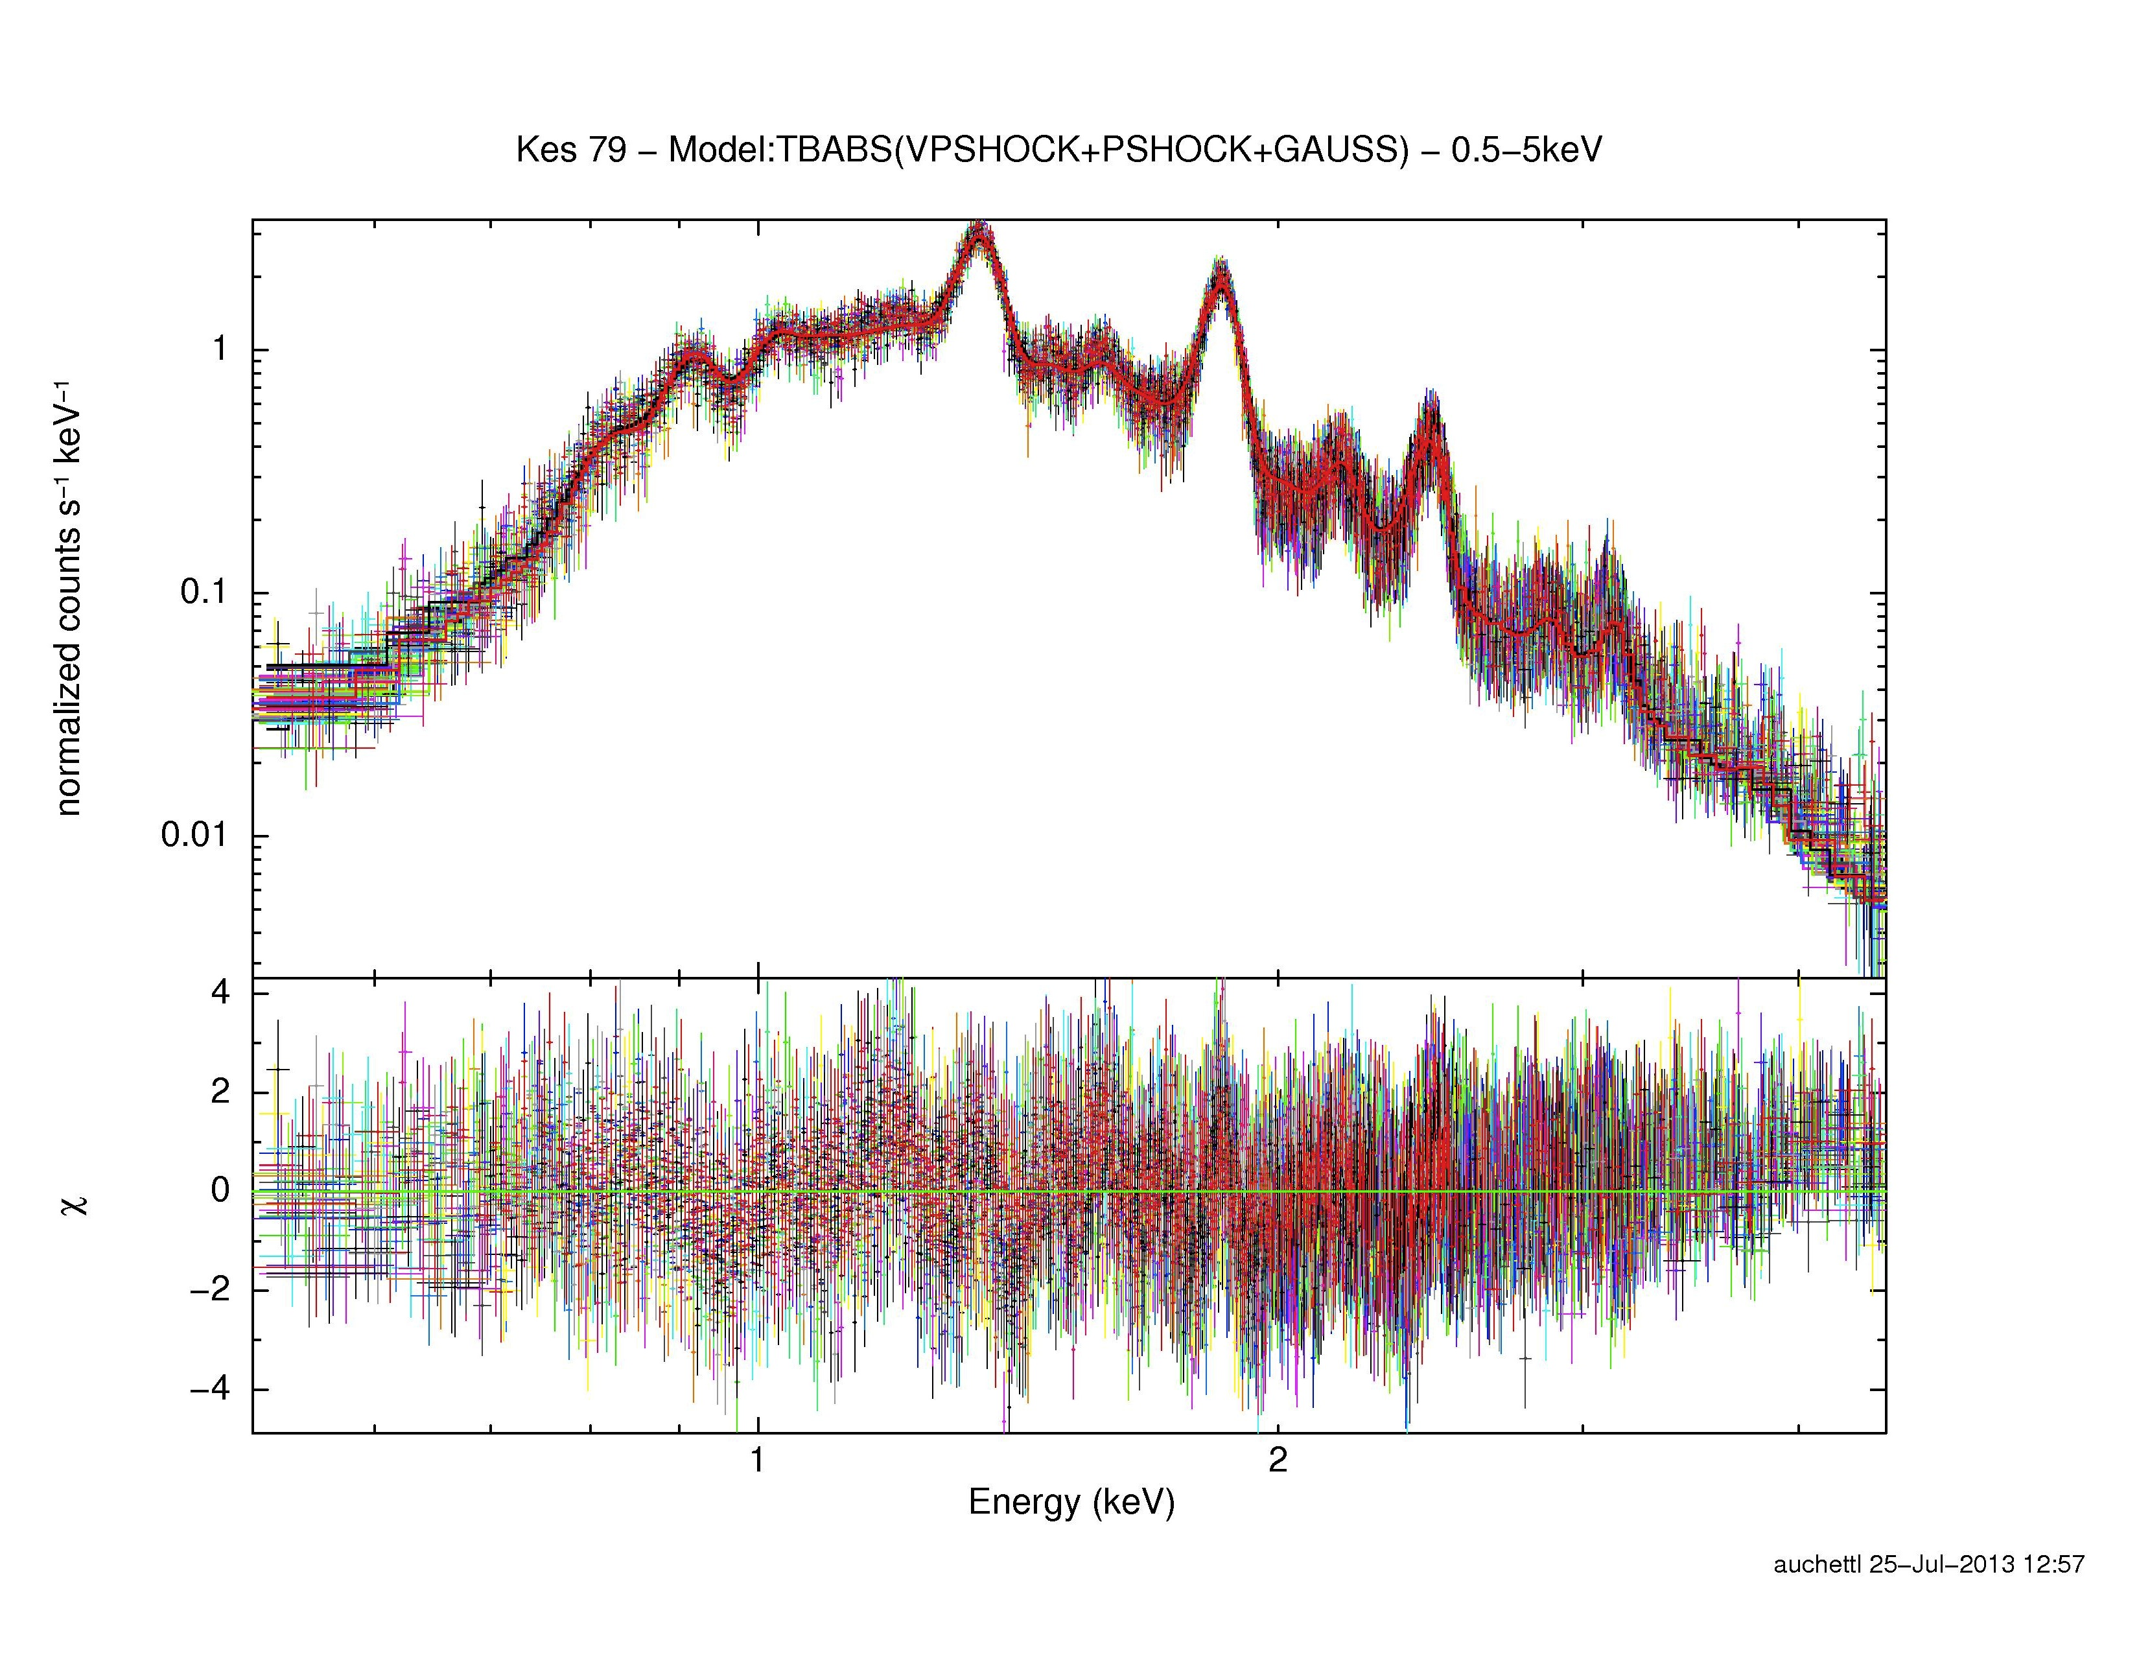
Enhancement & Rapid cooling.
Strong X-ray lines imply super solar abundances of stellar ejecta.
  Expect to see ejecta only in young SNRs, not middle aged SNRs.
Rapid cooling in the form of radiative recombination features.
  Only see in SNRs interacting with MCs.
S
Mg
Kes 79 - Auchettl et al. 2014
Si
Notes:
Apart from the morphological differences of these objects when compared to other classes of SNRs, one also find significant differences in the plasma properties of these objects.
For shell type SNRs their X-ray spectra usually show solar abundances of elements indicating that the ejecta from the original supernova explosion is very well mixed with the swept up ISM. But for MM their X-ray spectra show evidence of ejecta in the form of strong emission lines. When one measures these lines one find that we detect super solar abundances of these elements or more than two times that seen in our sun. This is very unexpected, as one would only expect to see ejecta emission linesthis strong arising from young SNRs, not MM SNRs which are usually middle aged.

Slide 10
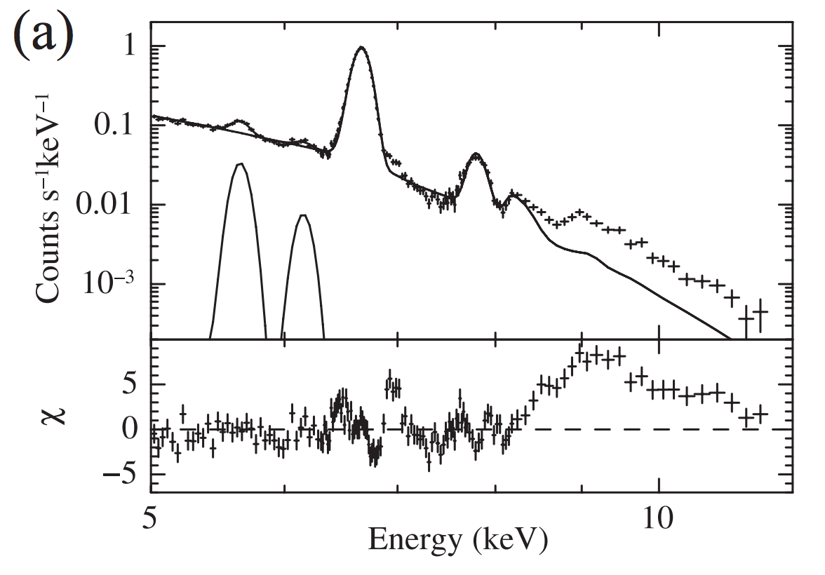
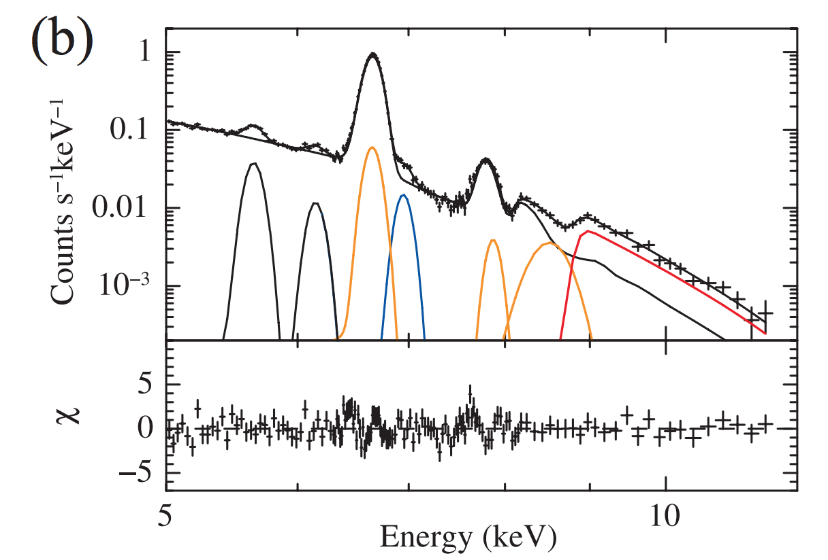
Enhancement & Rapid cooling.
Strong X-ray lines imply super solar abundances of stellar ejecta.
  Expect to see ejecta only in young SNRs, not middle aged SNRs.
Rapid cooling in the form of radiative recombination features.
  Only see in SNRs interacting with MCs.
Ozawa et al. 2009
S
Mg
Si
Fitting X-ray spectrum of W49B
without recombination
RRC seen in red + recombination lines seen in orange and blue added to fit.
Notes:
In addition, the plasma of a MM SNR exhibits rapid electron cooling. This rapid cooling has not been detected in any other type of SNRs. Usually you do not expect to see rapid cooling of electrons. You expect the temperature of the electrons to always be higher than the temperature of the ions in the plasma, while in SNRs interacting with molecular clouds the temperature of the electrons is lower than the ion temperature, and it was not until the advent of Suzaku did we even know that this type of cooling could occur in SNRs, even though there was prior hints to this unique plasma property. The effect of this cooling on the X-ray spectrum can be quite dramatic, as seen here. Here, the authors attempted to the fit the spectrum of this SNR with a plasma that does not shown rapid electron cooling and one can see it fails quite significantly.

Slide 11
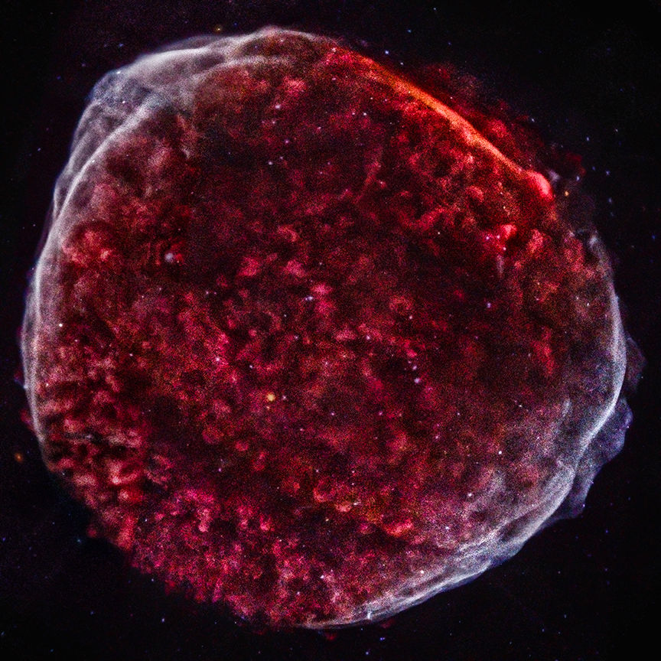
SNRs accelerate particles
Forward shock ➔
synchrotron emission from multi-TeV e⁻
Forward shock (& reverse shock??) of a SNR can accelerate particles
  e.g., SN1006
Lagage & Cesarsky (1983)
applied diffusive shock acceleration to shell-type SNRs and concluded that:
  Particles in SNRs can be
  accelerated up to 10 -100TeV.
SNRs can accelerate cosmic rays!
Chandra X-ray image(NASA/CXC/Middlebury College/F.Winkler)
Notes:
Apart from heating ejecta and swept-up ISM to X-ray emitting temperatures, the shock front of a SNR are sites in which populations of particles can be accelerated efficiently. As the shock-front of a SNR propagates, particles in the vicinity of the shock front will scatter back and forth off turbulence that has formed on either side of the shock. These particles will experience a gain of energy every time they cross the shock until their energy is large enough that they can escape the acceleration region. Assuming very basic acceleration parameters for a SNR, it was determined theoretically in the early 80s that SNRs can accelerate particles up to energies of 10-100 TeV, and since the advent of high resolution X-ray satellites such as the Chandra-X-ray satellite it has been confirmed that SNRs accelerate particles up to these high energies, with Chandra detected X-ray synchrotron emission arising from multi TeV electrons in SNR SN1006. So naturally the question that arises is how are the particle acceleration properties of these SNRs affected by the with a dense environment.

Slide 12
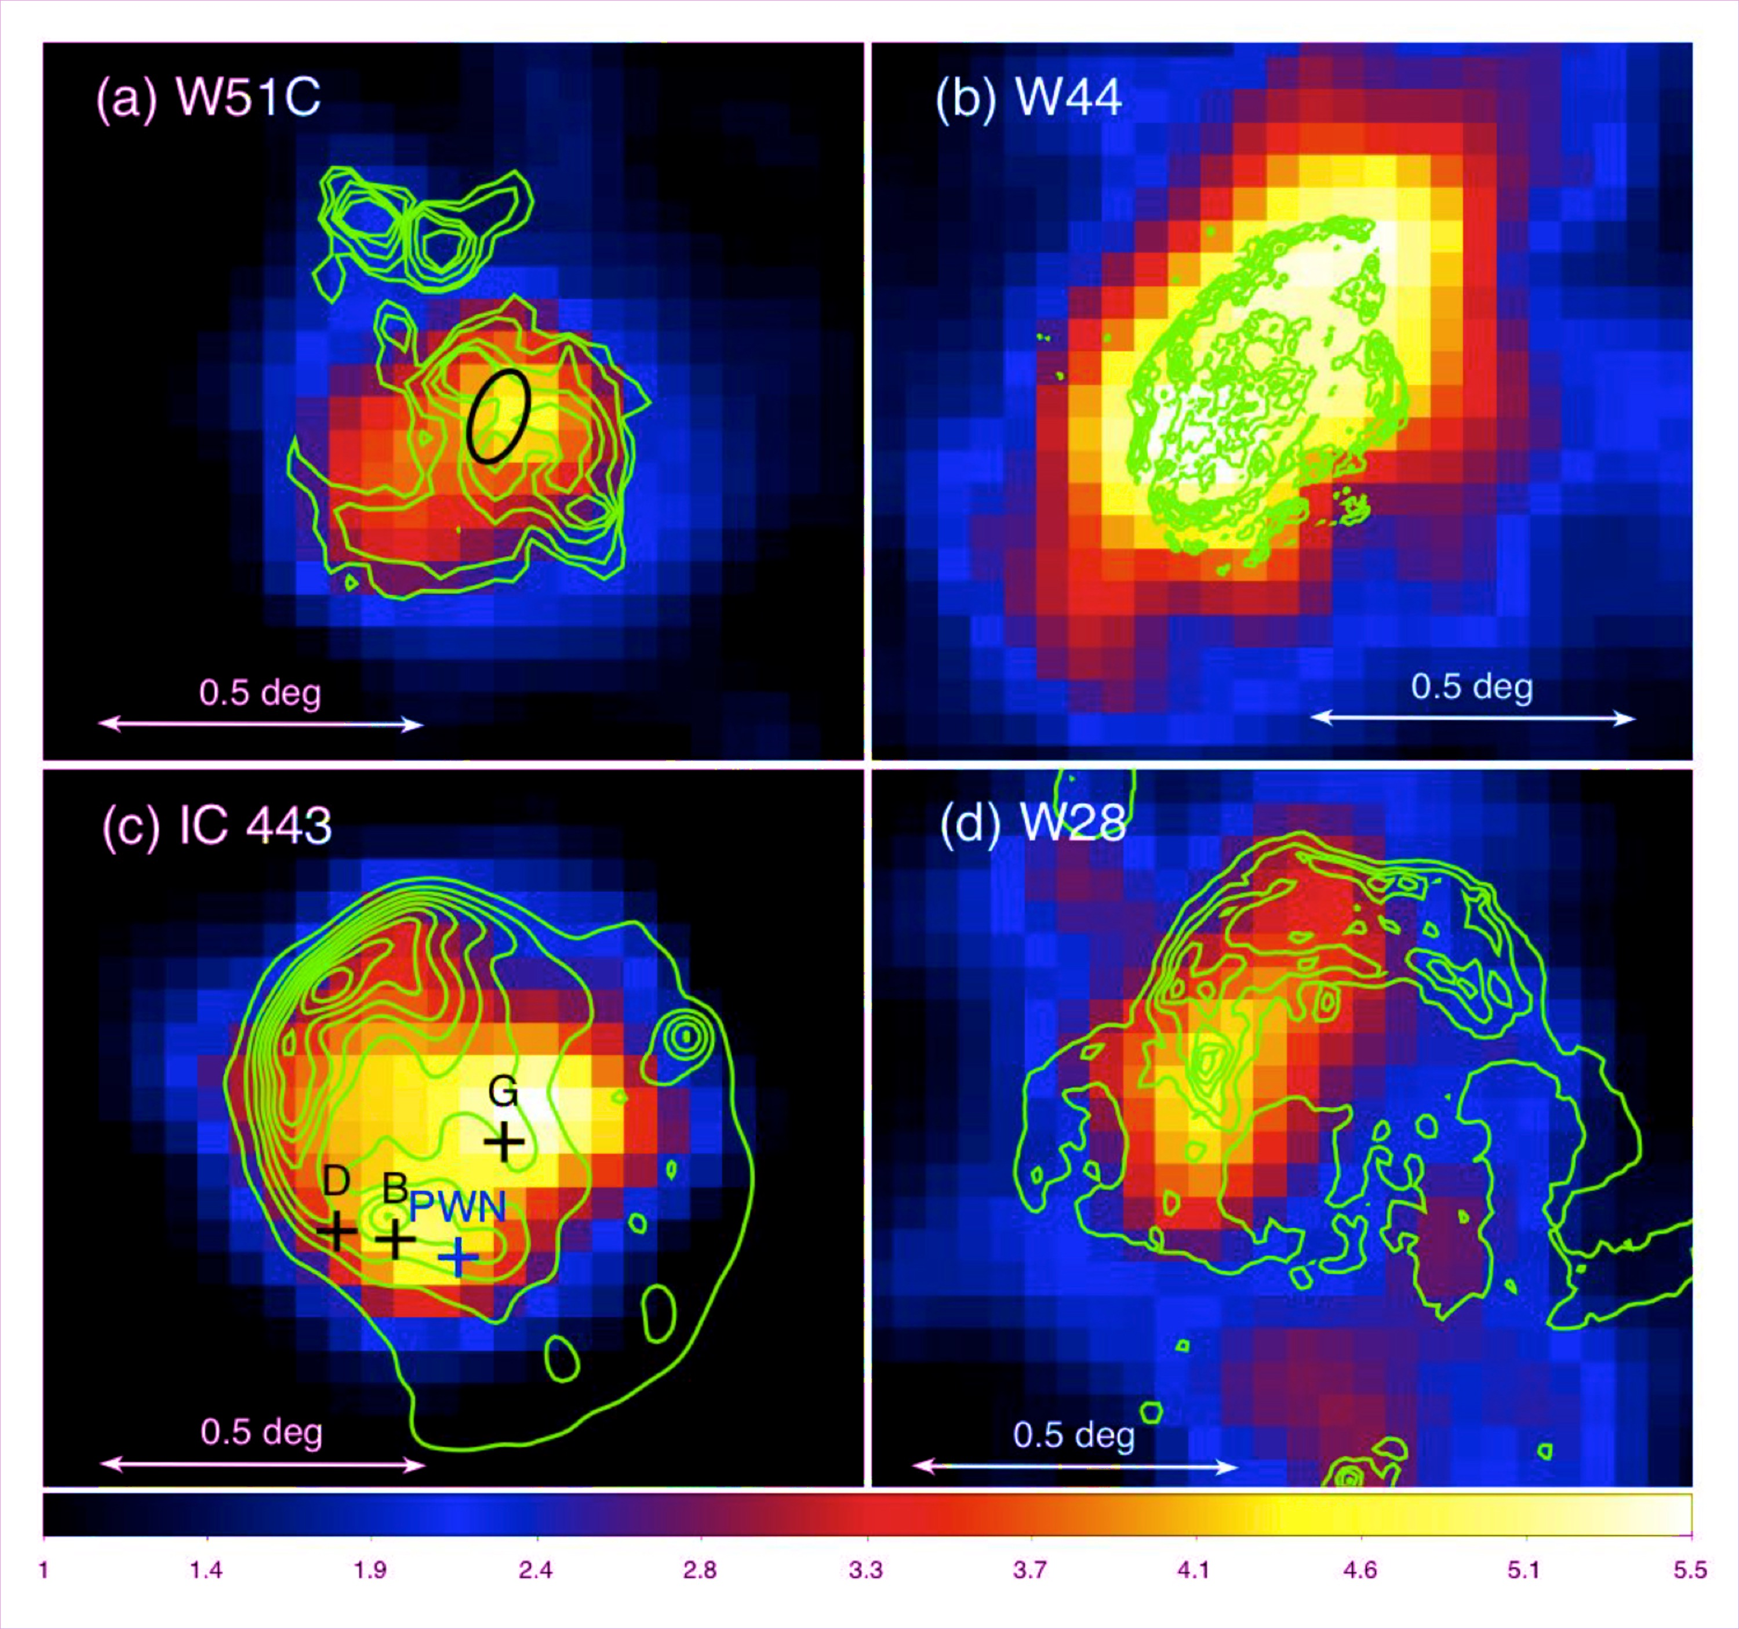
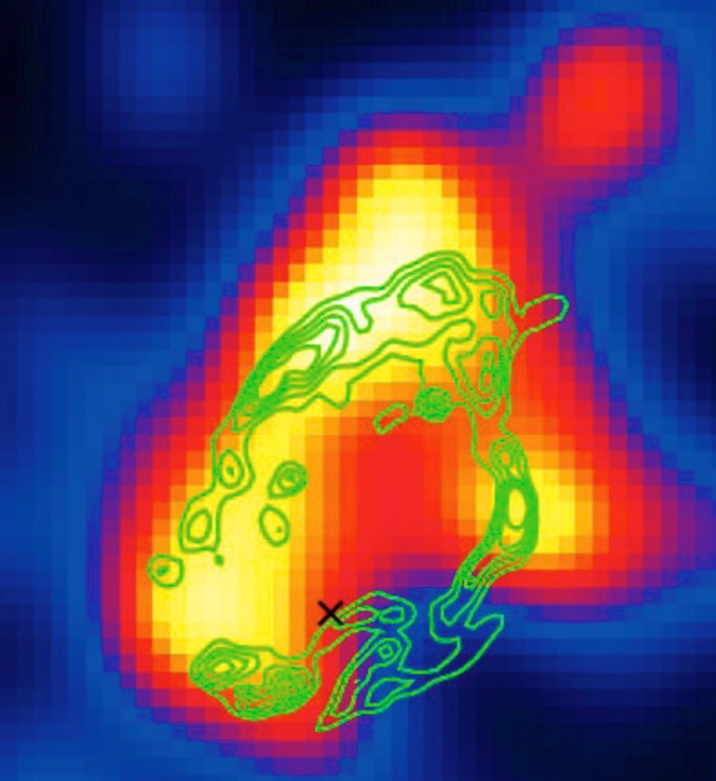
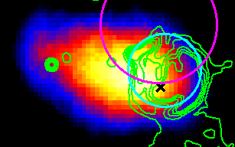
Sources of gamma-rays
Surprising as MM SNRs are thought to have too slow of shocks but a significant of these a interacting with MCs.
MSH 11-61A
IC443
W28
Auchettl et al. 2015
Castro & Slane 2010
Abdo et al. 2010
W51C
Kes 79
W44
Abdo et al. 2009
Auchettl et al. 2014
Abdo et al. 2010
Notes:
Well the first thing one notices is that, even though most MM SNRs are considered middle aged, these remnants are actually strong sources of GeV gamma-rays. Here is a small sample of these SNRs shown here as detected by the Fermi-LAT. This is surprising as these remnants are quite old and are thus thought to have shocks that are too slow to accelerate particles up to energies needed. In an attempt to understand the properties of these remnants

Slide 13
Individual studies
Molecular Cloud
~1/3-1/2 of all MM SNRs have been studied by the Fermi-LAT.
  E.g., Ackermann et al. 2010, Castro & Slane 2010, Auchettl et al. 2015….
Significant fraction (1/3) of the GeV emitting SNR population!
  But only ~13% of Galactic SNRs.
Emission dominated by pion decay.
Density required to produce observed γ-rays is much larger than that derived from X-ray studies.
  Shock interacting with cold dense material that does not radiate in X-rays.
Auchettl et al. 2015
Pion decay
MSH 11-61A
Non-thermal Brem
IC falls below axis
Notes:
A number of authors have undertaken individual gamma-ray studies of approximately 1/3 of all known MM SNRs using the Fermi, in fact these MM SNRs make up nearly 1/3 of the total GeV emitting SNR population detected by Fermi. Which is actually surprising because MM SNRs only make up 13% of all known Galactic SNRs, so there something special either about these objects themselves or their environments that lead these unique Galactic objects to be such a predominant class of GeV emitting SNRs.
From these individual studies it has become apparent that their emission arises predominantly from pion decay, which wouldn’t make sense if one considered the slow shock velocities of these remnants independent of the fact that that they are interacting with dense material. However, the fact molecular clouds are good sources of protons that are waiting to be accelerated by the shock front of a SNR leads to pion decay dominanting their emission.
Apart from characterizing the mechanism that produces the observed gamma-rays, these studies also provide us with a way to probe the density of the environment in which these SNRs are interacting with as well as trying to localised where this emission is coming from. Density estimates.

Slide 14
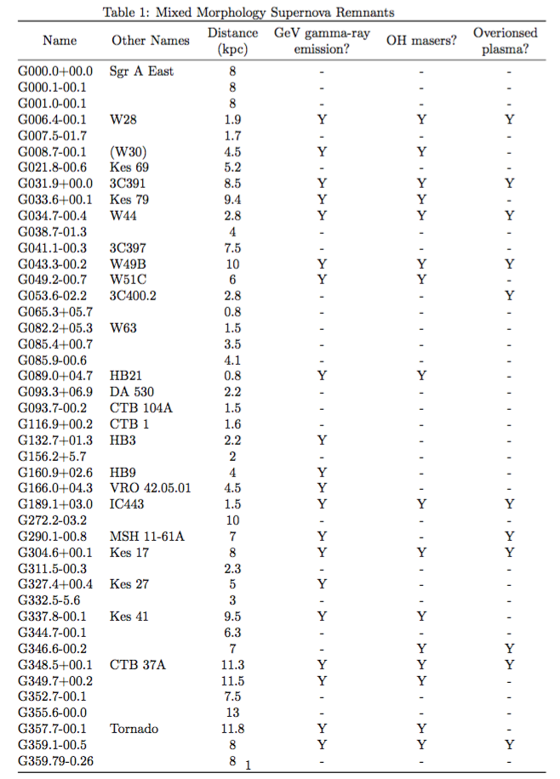
Global analysis
However, each SNR is analysed slightly differently.
  Different energies, data ranges and background models etc.
Difficult to determine whether:
  All MM SNRs emit in GeV γ-rays?
  Do all have the same γ-rays properties?
    i.e., are they all pion decay?
  How do their properties differ from those of other GeV emitting SNRs?
  How do these properties correlate with other wavelengths?
  Why are they so special?
Notes:
However, even though these studies have allowed us to characterise the properties of these sources individually, unfortunately as these studies have been completed at different times during the Fermi-LAT mission, with different PSFs, background models, data ranges, favourite methods to analyse this data. It is difficult to determine whether the properties we derive from these individual studies are common across the class of these remnants, or whether unique to these individual sources. As a consequence, it becomes difficult to understand the gamma-ray emitting properties of these remnants as a class, and answer important questions about whether do all MM SNRs emit in GeV? If not, why are they so different? Do they all produce pion emission of the same amount?, how do their properties differ from those of other GeV emitting SNRs? Or correlate with other wavelengths? Or generally why do these SNRs which only correspond to 10% of all Galactic SNRs, tend to be so special?

Slide 15
GeV properties of MM SNRs
Consistently analyse >8 yrs of Fermi-LAT data of all MM SNRs.
Generate: Spectra, detection signficance maps, count maps, etc.
Characterise: γ-ray emitting properties of these remnants.
Detection
Significance
maps
of some
MM SNRs.
PRELIMINARY
Auchettl et al (2017), In prep
Notes:
Well to better answer these questions, I have gone back and analysed over 8 years of Fermi-LAT data for all 41 known MM SNRs. For each remnant, I have produced detection significance maps of the gamma-ray emission arising from the position of each remnant. Here are a sample of some of these remnants and you can see that there is a wide range of gamma-ray morphologies, extensions and detection significiances of each remnant. In addition, I have produce count maps, as well as gamma-ray spectra for those which emit gamma-rays which I will use to quantify the gamma-ray properties of these remnants.

Slide 16
GeV properties of MM SNRs
Consistently analyse >8 yrs of Fermi-LAT data of all MM SNRs.
Generate: Spectra, detection signficance maps, count maps, etc.
Characterise: γ-ray emitting properties of these remnants.
Auchettl et al (2017), In prep
PRELIMINARY
Notes:
Here I have plotted some of the spectra that I have been able to extract from some of the MM SNRs shown on the previous slide. One thing you notice is that even in this subsample we get large variations in the emission of these sources themselves, with some sources showing what looks like a much flatter spectrum, while others show quite a significant cut off in the maximum energy, and some of these showing a variation between these two. So even within the population of these MM SNRs there is large variation in the emission properties of these sources, making it important to study these sources as a class to really understand why these are so special.

Slide 17
GeV properties of MM SNRs
Consistently analyse >8 yrs of Fermi-LAT data of all MM SNRs.
Generate: Spectra, detection signficance maps, count maps, etc.
Characterise: γ-ray emitting properties of these remnants.
PRELIMINARY
MM SNRs.
Auchettl et al (2017), In prep
SNRs interacting with MC but are NOT MM SNRs
SNRs NOT interacting with MCs.
Note indexes and luminosities in Green and pink taken from 3FGL catalogue.
Notes:
So for example, using these spectra we can determine correlations between different properties of these objects, as well as comparing the properties of these MM SNRs to those of other GeV emitting SNRs. For example, here we have plotted, very preliminarily, the best fit photon index of the gamma-ray emission as a function of luminosity for a handful of our MM SNRs as seen here in purple. Here we have also plotted the same parameters but from other GeV emitting SNRs that are not classified as MM SNRs in green and purple. First of all one can quickly see that these MM SNRs make up some of the brightest GeV SNRs in our sample, while interestingly they seem to have a much more narrower range for their photon index compared to other SNRs. As these remnants seem to have the same gamma-ray index, one might speculate that these objects have the same dominant particle acceleration mechanism. For example, it has been shown that W44 which is a well known MM SNR that its particle acceleration properties can be easily explained by radiative shocks re-accelerating preexisting cosmic rays boosted to GeV energies by the rapidly cooling shocks found in these remnants. So it is possible that all MM SNRs follow this, and something we can test quite using our global study.

Slide 18
X-ray properties of MM SNRs
Rho & Petre (1998) analysed ~10 MM SNRs using ROSAT:
  Uniform temperature ⎯ Emission arises from ISM
However more recent studies show they are more complicated.
We systematically analyse archival X-ray data of all MM SNRs.
PRELIMINARY
Auchettl et al (2017), In prep
Consistent with being in higher density regions of the Milky Way.
Notes:
So at the start of my talk I had touched on specifically the properties of these remnants that make these sources so unique. We have come a long way compared to the first study of these sources in the late 90s using ROSAT which thought that the emission from these sources was more simpler. However, a number of individual studies using high resolution X-ray instruments such as Chandra, Suzaku and XMM have shown that the properties of these sources are much more complicated and even different that originally presented by Rho and Petre . However, as only a fraction of these sources have been studied in X-rays, using various amount of data, different models, different analysis techniques with different abundance tables, atomic data bases, calibrations etc. So again, it is difficult to know whether these properties are unique to a few individual sources, or whether they are common across the class of remnants. So we went back and analysed archival X-ray data of a large fraction of the ~40 MM SNRs in a self consistent way, with proper background modeling, and common source model. Here we find that our MM SNR sample, the majority of them have enhanced column densities which is consistent with being found in higher density regions of the Milky Way.

Slide 19
X-ray properties of MM SNRs
Rho & Petre (1998) analysed ~10 MM SNRs using ROSAT:
  Uniform temperature ⎯ Emission arises from ISM
However more recent studies show they are more complicated.
We systematically analyse archival X-ray data of all MM SNRs.
Approximately ~50% MM SNRs show evidence of overionisation.
PRELIMINARY
Median electron temperature ~ 0.66 keV
Inner (~0.65 keV) > Outer (~0.60 keV)
Notes:
We find that mean temperature
These results suggest a plasma structure consisting of a central hot region surrounded by a cooler, denser shell, similar to the expected structure of a shell-like SNR.
Overionisation.

Slide 20
X-ray properties of MM SNRs
Rho & Petre (1998) analysed ~10 MM SNRs using ROSAT:
  Uniform temperature ⎯ Emission arises from ISM
However more recent studies show they are more complicated.
We systematically analyse archival X-ray data of all MM SNRs.
Median ionisation timescale ~2x10¹¹ s cm⁻³ :
Partial non-equilibration; all ions are equilibrated, but without electron-ion equilibration
PRELIMINARY
Most remnants show enhanced abundances of:
Mg, Si and S.
Most have abundances consistent w. CC SNRs?
Notes:
density-weighted timescale of the plasma: the degree of ionization in MM SNRs is systematically higher than in shell-like SNRs which are around 10^10. Differences in different parts of the remnant.
Look at elemental abundances, most of them enhanced in Mg, Si and S. Tie into Type Ia vs CC Sne…..

Slide 21
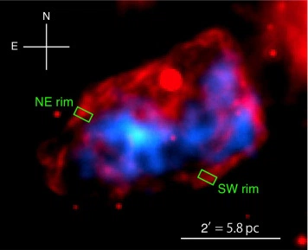
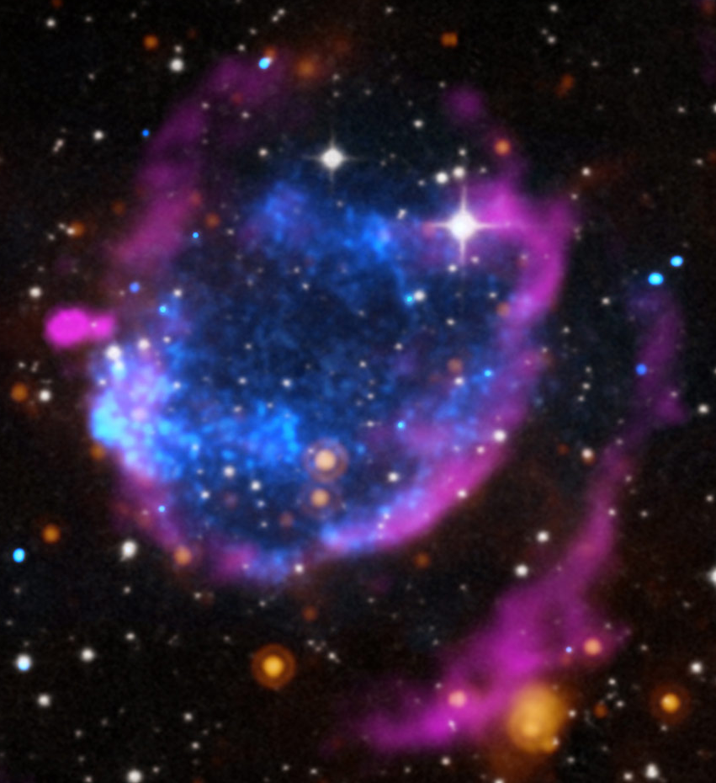
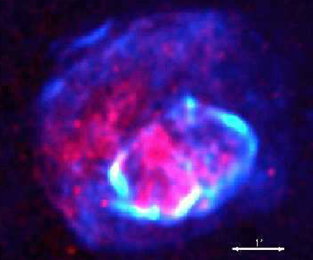
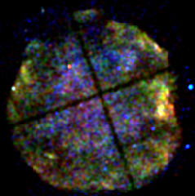
Type Ia MM SNRs interacting with molecular clouds.
3C397
G344.7-0.1
G352.7-0.1
G272.2-3.2
G337.2-0.7
Notes:
Another thing that can be quantified in this global study in the difference between the gamma-ray emission arising from MM SNRs arising from CC, and those arising from Type Ia.
Out of the 41 known MM SNRs, there are a handful of these that are thought to be interacting with molecular clouds and have been suggested to arise from a Type Ia SNe. Naively, one would expect that as these remnants are interacting with molecular clouds and are classified as mixed morphology due to their center filled X-ray emission and radio shell, that they would have similar properties to that of their core collapse siblings as I have highlighted before.

Slide 22
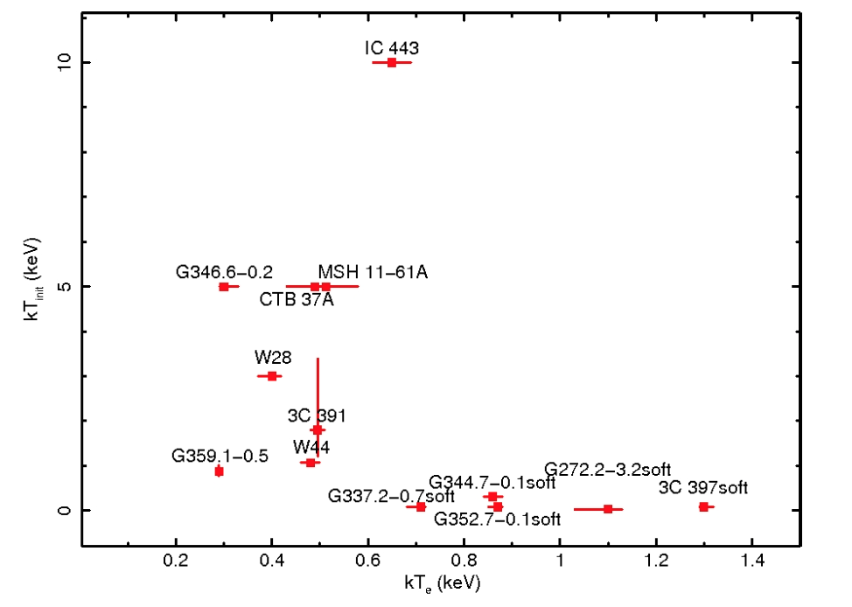
Type Ia vs. CC MM SNRs.
Sezer, Slane and Auchettl (2017), In prep.
Type II MM SNRs. Also have strong GeV γ-ray emission
PRELIMINARY
Initial Temperature kT_{init} (keV)
Type Ia MM SNRs.
No evidence of GeV γ-ray emission
Electron Temperature kT_{e} (keV)
Notes:
However, interestingly we find that Type Ia MM SNRs seem to have quite different properties. First of all Type Ia MM SNRs no evidence of GeV gamma-ray emission, unlike their CC siblings. In addition, their X-ray properties are very different from their CC MM SNRs as seen here on this plot, where here we have plotted the initial temperature of a X-ray emitting plasma before it became ionised, against its temperature measured now. One way to get this separation in both X-ray and gamma-ray properties is that they have different environments, leading to the differences in these properties, or the interaction of these remnants might not be as strong. If this is true, this has some complications associated with current models that try to produce the X-ray morphology of these SNRs. Thus, global studies of these SNRs in both gamma-rays and other wavelengths such as X-rays provides us with a very powerful way to better understand the properties of these SNRs and why they are so unique.

Slide 23
MM SNRs produce X-ray synch.?
G346.6-0.2
A single thermal model struggles to fit the data above > 3.5 keV
Auchettl et al. 2017; arXiv:1707.09370
Hard X-ray component consistent with:
Galactic Ridge Emission (located close to Galactic plane).
X-ray synchrotron emission (assuming upperlimit of B field derived from Zeeman).
Unidentified PWN.
Notes:
Another possibility is that this hard X-ray tail arises from a population of relativistic electrons that are being accelerated by the shock of the remnant, producing synchrotron X-ray emission. Usually this type of emission is only found in young SNRs with very fast shock velocities, with the population of electrons that cause the emission seen in these young remnant usually have a maximum energy of 1 TeV or greater. For older SNRs like Mm SNRs usually have shock velocities that are too slow to accelerate electrons to the energies needed to produced X-ray synchrotron emission, but G346 is a unique case. It has one of the fastest shock velocities derived of MM SNRs, and in addition it also has a significantly higher magnetic field than those seen in young shell type remnants. It is on the order of milliGauss instead of microgauss, thus the shock front of the remnant does not need to be as fast as those seen in young remnant to accelerate particles up to the energies needed to produce X-ray synchrotron. Thus it is not unlikely that this powerlaw component implies X-ray synchrotron emission making it the first SNRs known to be interacting with molecular clouds to emission X-ray synchrotron radiation that arises from particle acceleration. This discovery has interesting implications for studying the conditions that may potentially lead to X-ray synchrotron emission in older remnants.

Slide 24
Summary
SNRs given an insight into the star we did not see.
Dense environments dramatically affect the properties of SNRs.
  In both X-ray and gamma-ray energy bands.
Global studies can provide us with a wealth of knowledge about both the acceleration and plasma properties of MM SNRs.
  Pion decay dominated? • Re-acceleration?
  Type Ia vs. CC MM SNRs. • All overionised plasmas?
  Enhanced abundances? • Flat temperature profile?
  Any have non-thermal X-ray components consistent with particle acceleration?

