Slide 1
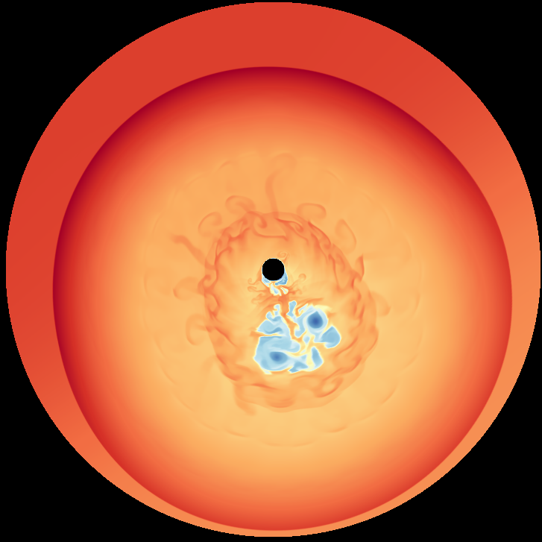
Complexities of a Mid-Life Crush:
A Study of the Pulsar Wind Nebula Vela X
Collaborators:
J. Blondin
C. Kolb
T. Temim
and many others…

Slide 2
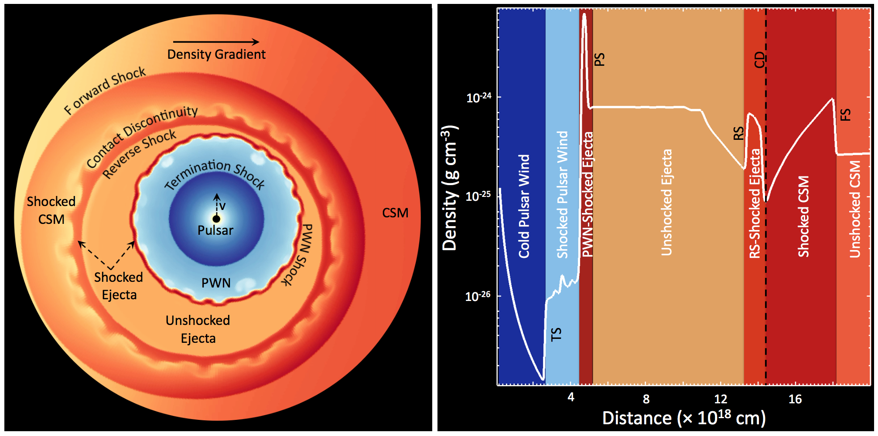
Composite SNRs: Shock Structure
Slane 2016
See, also, Kolb et al. 2017

Slide 3
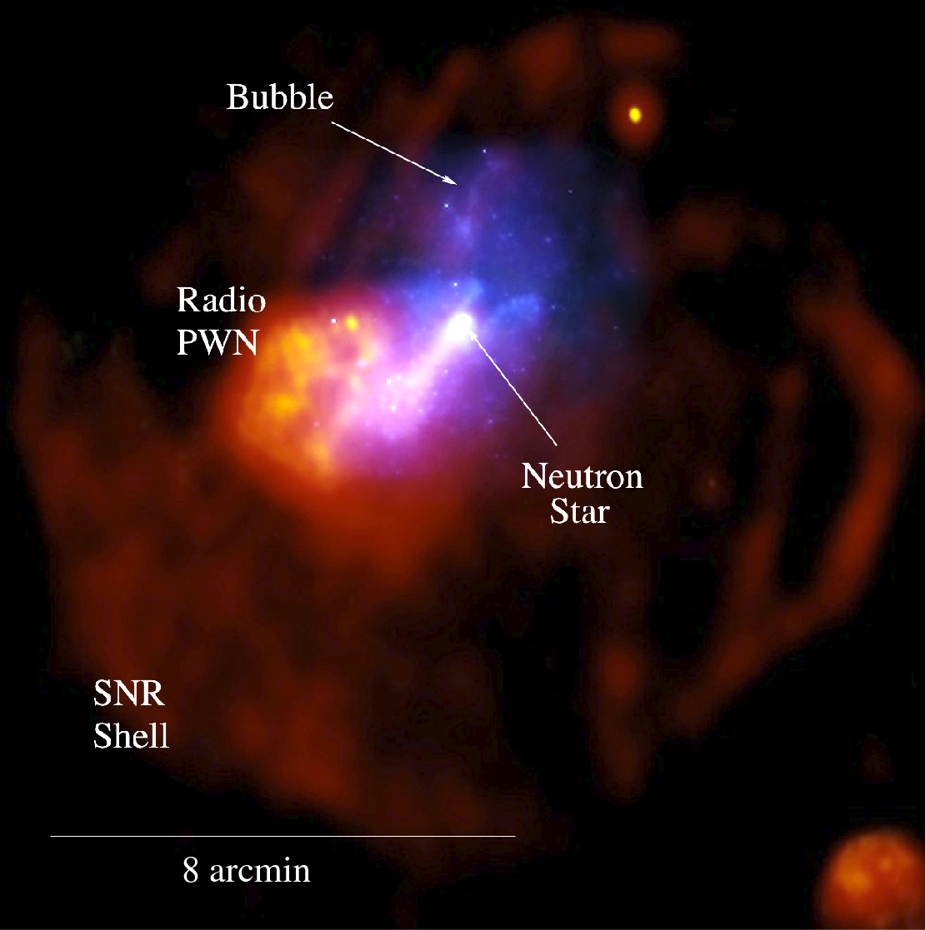
G327.1-1.1: SNR RS Interaction
(X-ray)
Radio morphology
suggests PWN interaction
with SNR reverse shock.
Chandra observations
show offset compact
source w/ trail of
nonthermal emission
extending to radio PWN.
- Compact source shows
extent and is embedded
in bow shock structure
(radio)
Temim et al. 2009

Slide 4
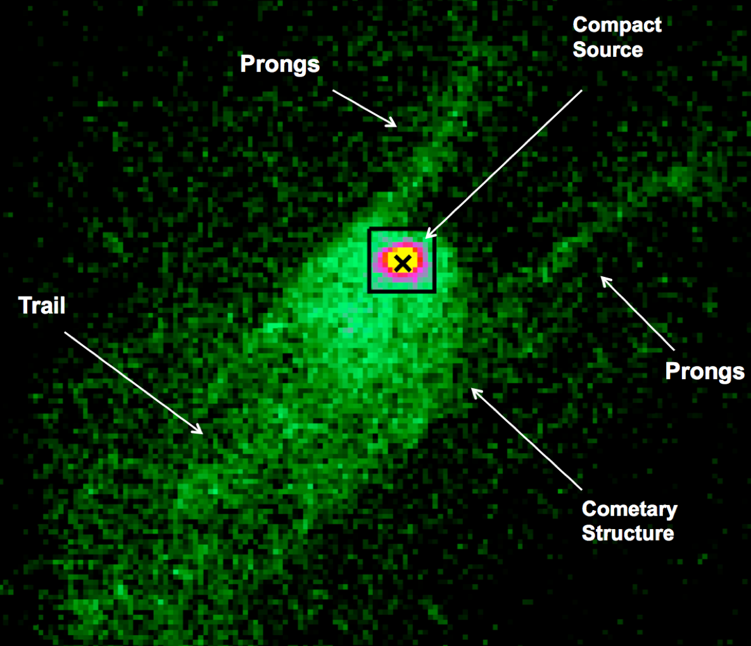
G327.1-1.1: SNR RS Interaction
(X-ray)
Radio morphology
suggests PWN interaction
with SNR reverse shock.
Chandra observations
show offset compact
source w/ trail of
nonthermal emission
extending to radio PWN.
- Compact source shows
extent and is embedded
in bow shock structure
(radio)
Temim et al. 2009

Slide 5
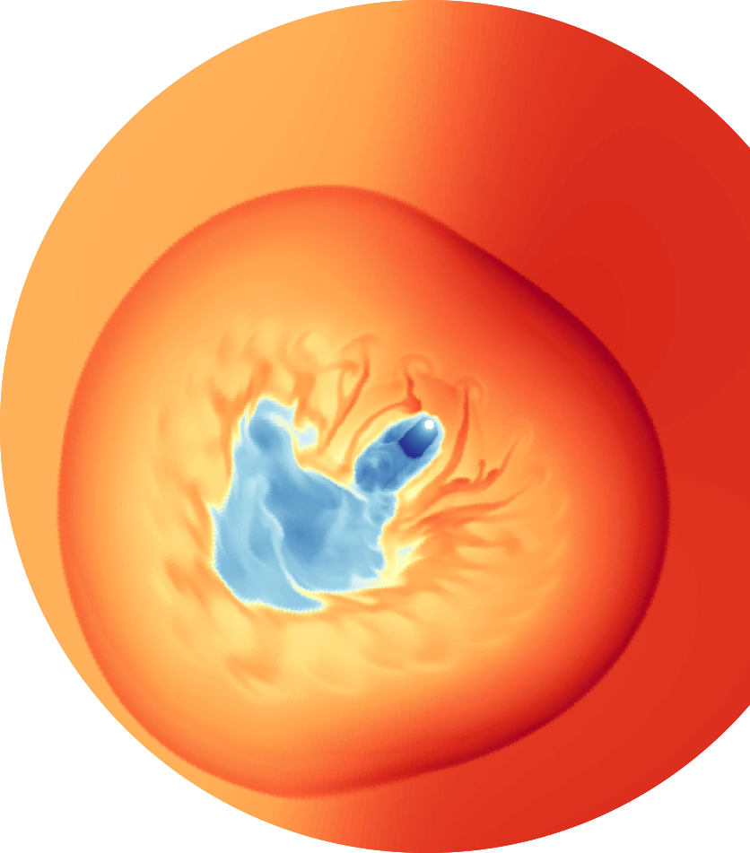
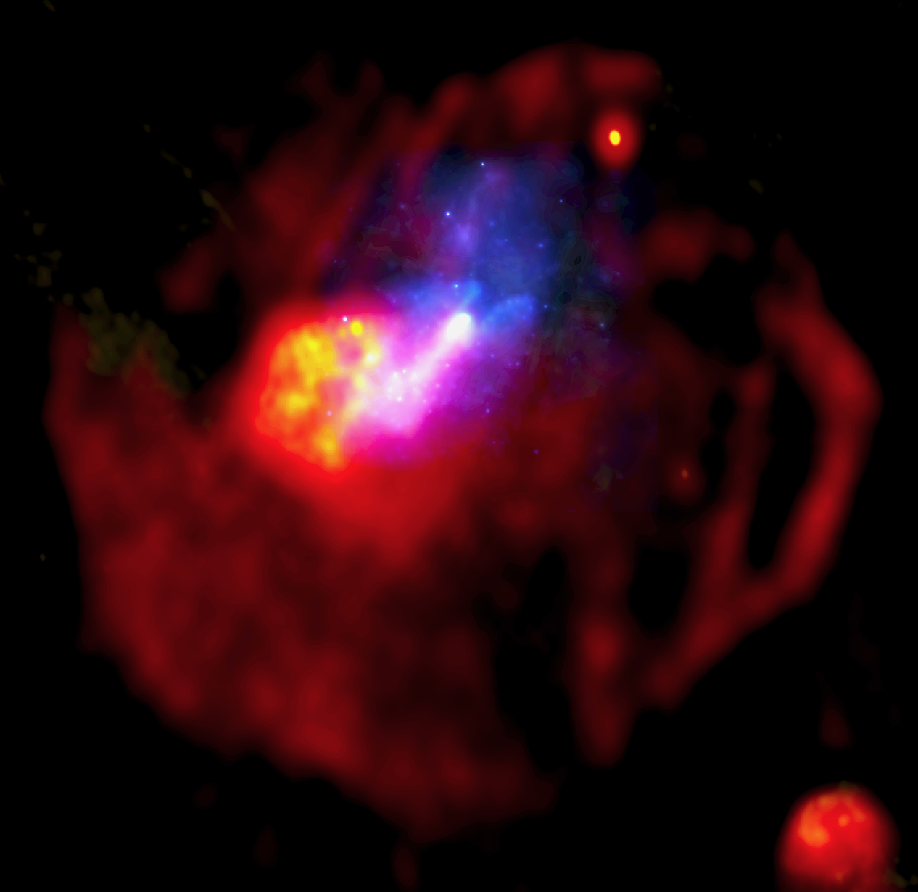
Morphology Comparison
Trail thickness→ pulsar’s spin- down luminosity
ISM density gradient
Pulsar velocity
Temim et al. 2015
Displacement of “relic” PWN → orientation of density gradient
Orientation of trail → combination of gradient and pulsar motion direction

Slide 6
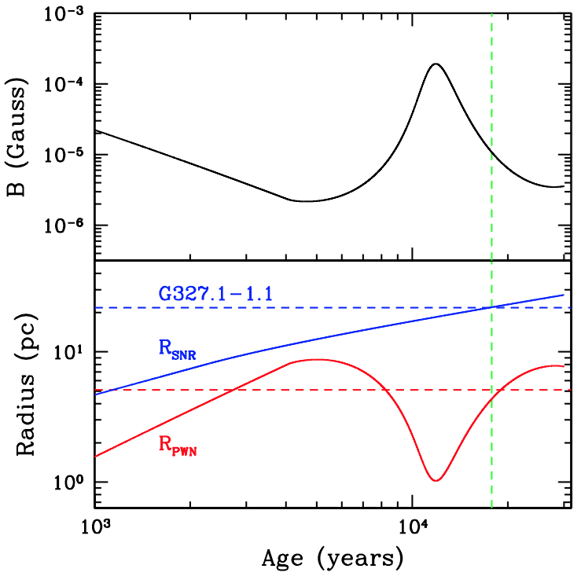
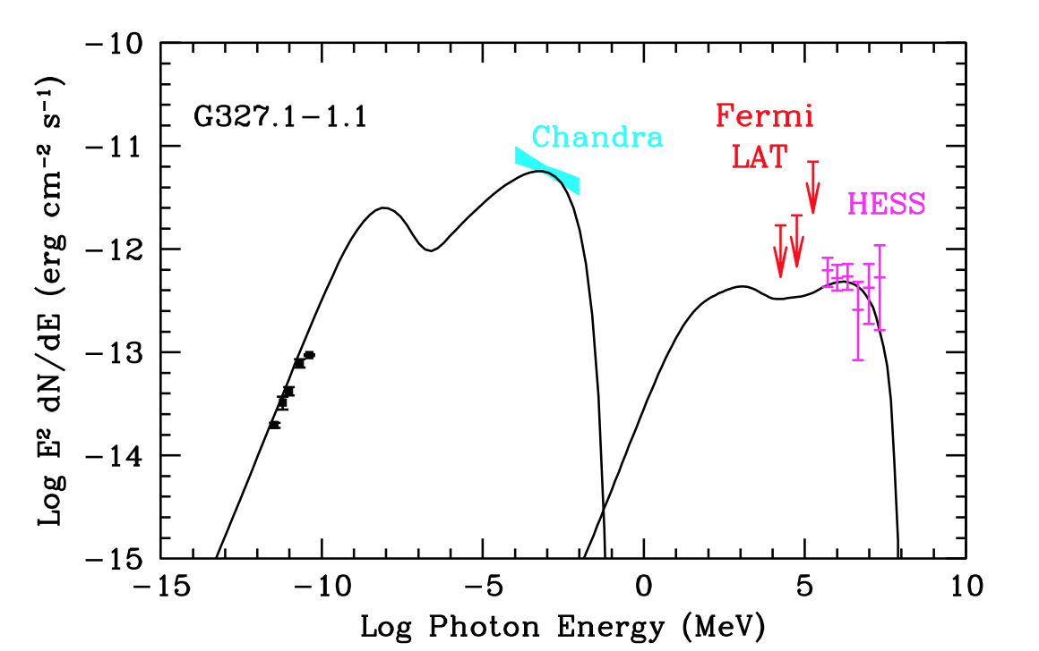
Broadband Spectrum at 17,000 yrs
Temim et al. 2015
Semi-analytic model for radiative evolution of the PWN (Gelfand et al. 2009)
Input parameters from observational constraints and HD model
→ B = 11 μG and an electron energy break at 300 GeV

Slide 7
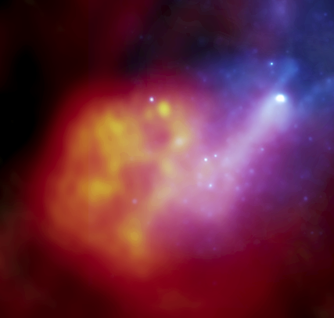

Age of Injected Particles at 17,000 yrs
Radio
X-ray
1700
Temim et al. 2015
$$τ_{syn}≈820 E_{e,100}^{−1}B_{10}^{−2} \text{yr}$$
Photon index in the trail steepens from 1.76 to 2.28:
∴ Expect spectral steepening
ΔΓ = 0.5
over a synchrotron lifetime
ΔΓ = 0.52 + 0.17

Slide 8
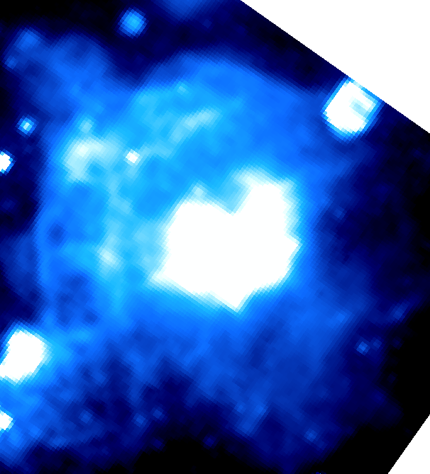
Vela SNR and its PWN
Vela SNR
Vela X
Parkes
Nearby SNR evolving in density gradient
Middle-aged pulsar with disrupted PWN
(Vela X)

Slide 9
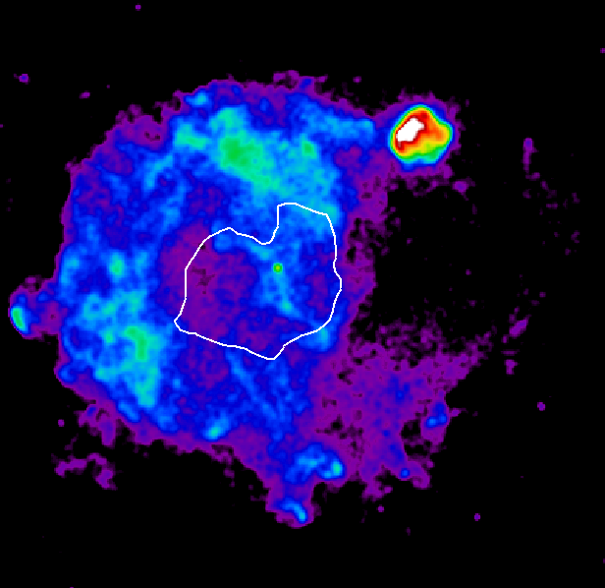
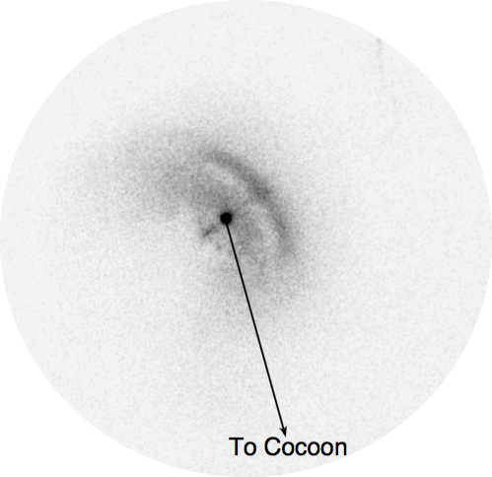
Vela SNR and its PWN
~1.5 arcmin
Pulsar
“Cocoon”
Vela X
R ~ 4°
ROSAT
Nearby SNR evolving in density gradient
Middle-aged pulsar with disrupted PWN
(Vela X)
“Cocoon”-like structure extending
southward from pulsar (Markwardt &
Ögelman 1995)

Slide 10
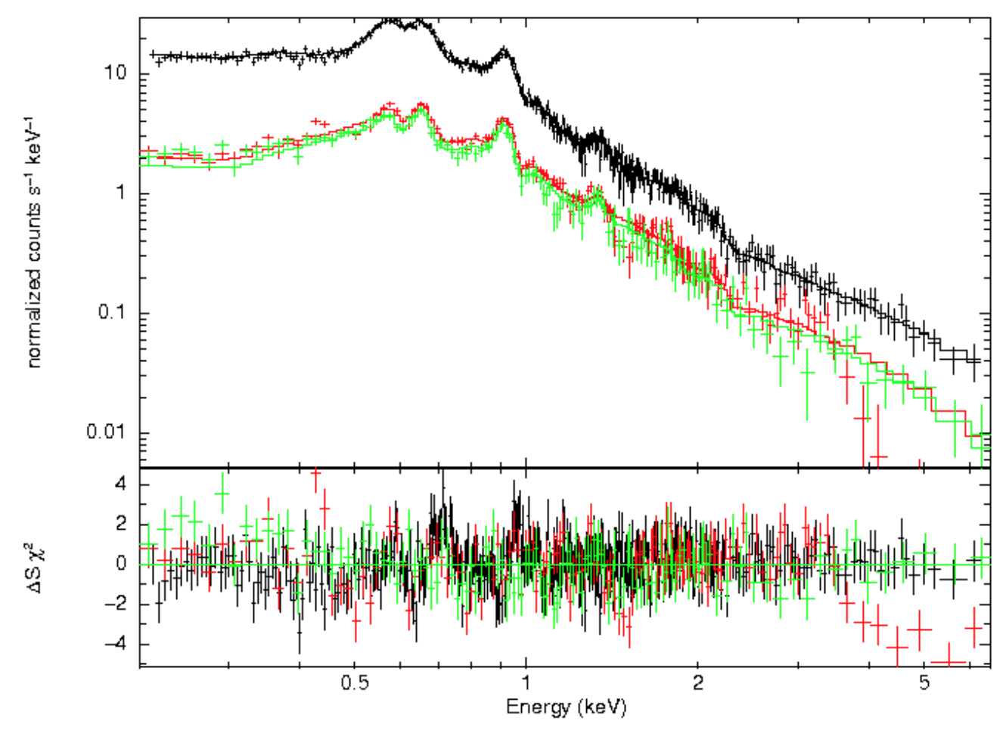
Vela SNR and its PWN
Vela X Cocoon
(section)
Pulsar
“Cocoon”
LaMassa et al. 2008
Vela X
ROSAT
Nearby SNR evolving in density gradient
Middle-aged pulsar with disrupted PWN
(Vela X)
“Cocoon”-like structure extending
southward from pulsar (Markwardt &
Ögelman 1995)
Radio/X-ray/γ-ray emission suggests
complex particle spectrum
Possible breaks or particle escape

Slide 11
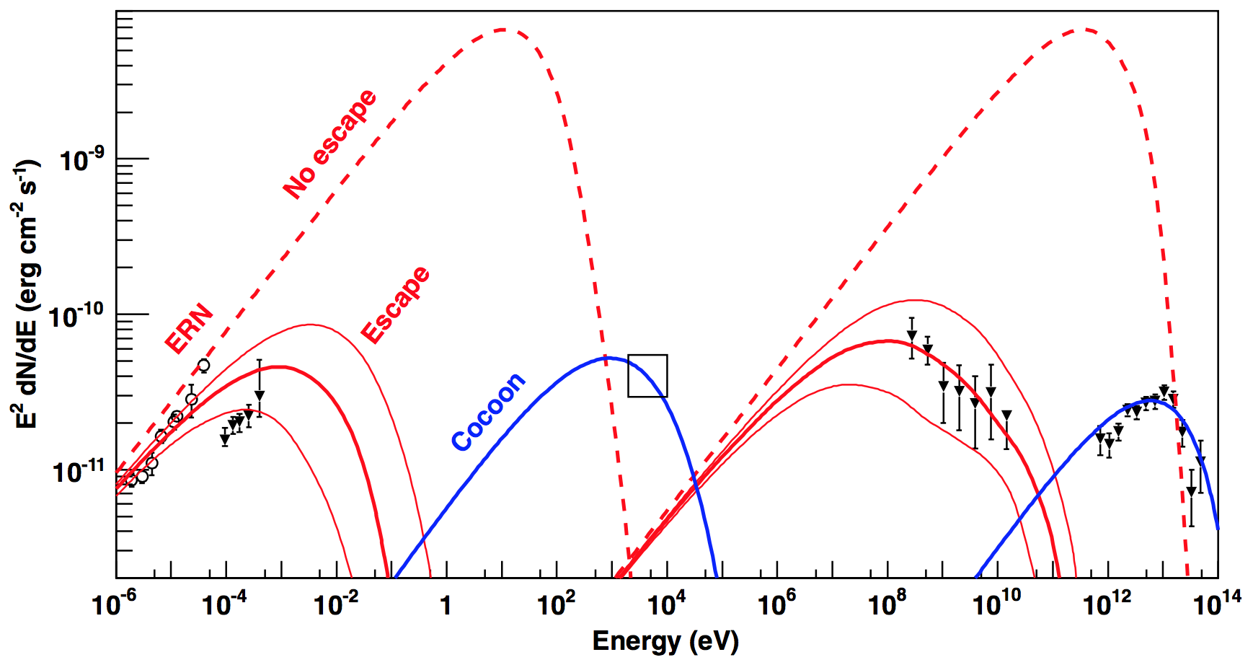
Vela SNR and its PWN
Hinton et al. 2011
Pulsar
“Cocoon”
Vela X
ROSAT
Nearby SNR evolving in density gradient
Middle-aged pulsar with disrupted PWN
(Vela X)
“Cocoon”-like structure extending
southward from pulsar (Markwardt &
Ögelman 1995)
Radio/X-ray/γ-ray emission suggests
complex particle spectrum
Possible breaks or particle escape
- Possibly more rapid diffusion from
radio nebula than from cocoon

Slide 12

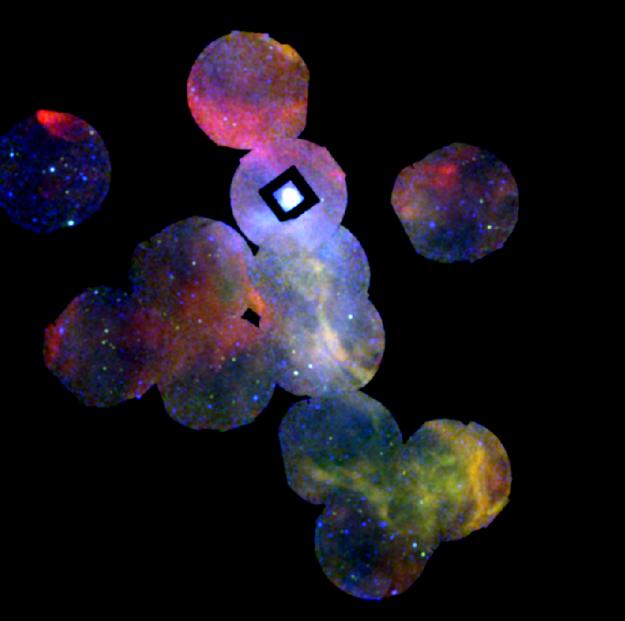
Vela X: XMM Observations
XMM observations reveal filamentary
structure along cocoon
- both nonthermal emission and thermal
emission from ejecta observed

Slide 13
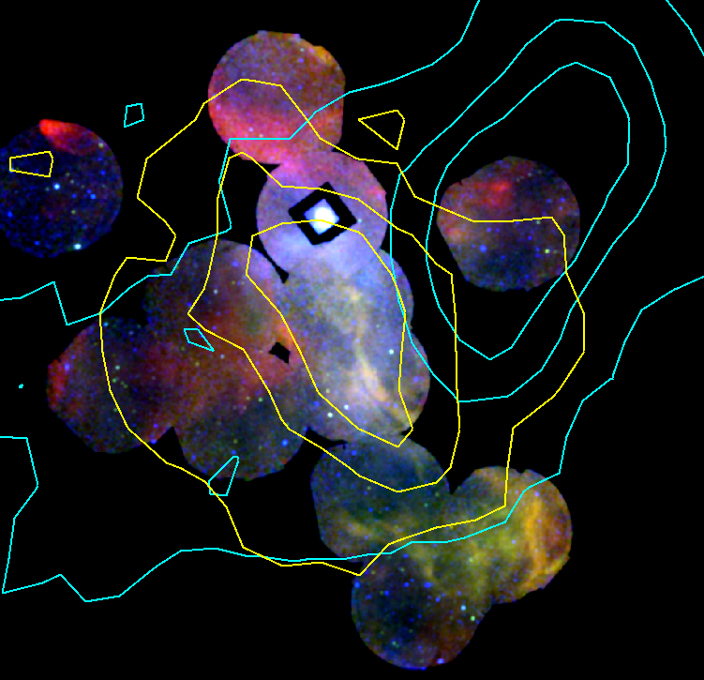
Vela X: XMM Observations
Fermi LAT
(Grondin et al. 2013)
H.E.S.S.
(Abramowski
et al. 2012)
XMM observations reveal filamentary
structure along cocoon
- both nonthermal emission and thermal
emission from ejecta observed
TeV and GeV γ-rays seen from Vela X
- emission centroids appear offset

Slide 14
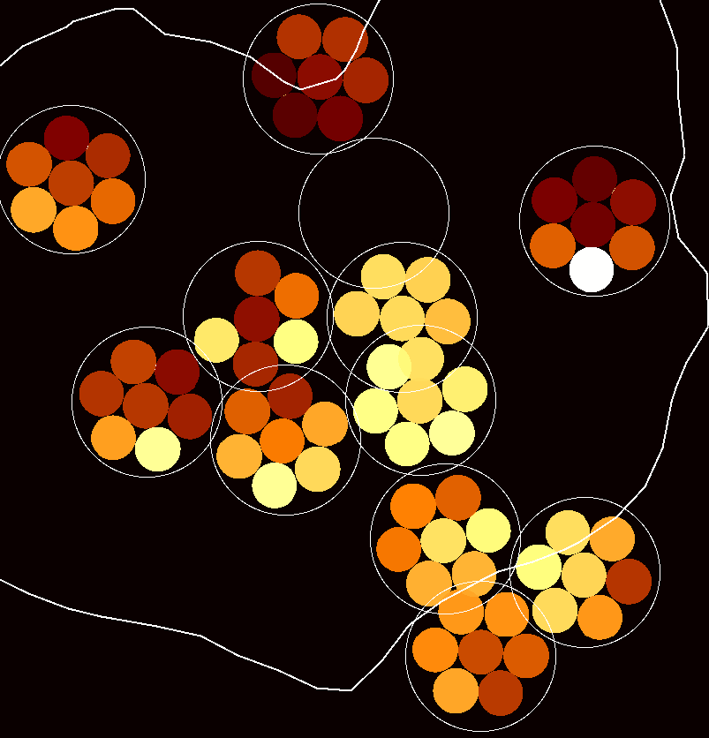
Vela X: XMM Observations
kT
XMM observations reveal filamentary
structure along cocoon
- both nonthermal emission and thermal
emission from ejecta observed
TeV and GeV γ-rays seen from Vela X
- emission centroids appear offset
Spectra show ejecta component within
Vela X has higher kT along cocoon

Slide 15
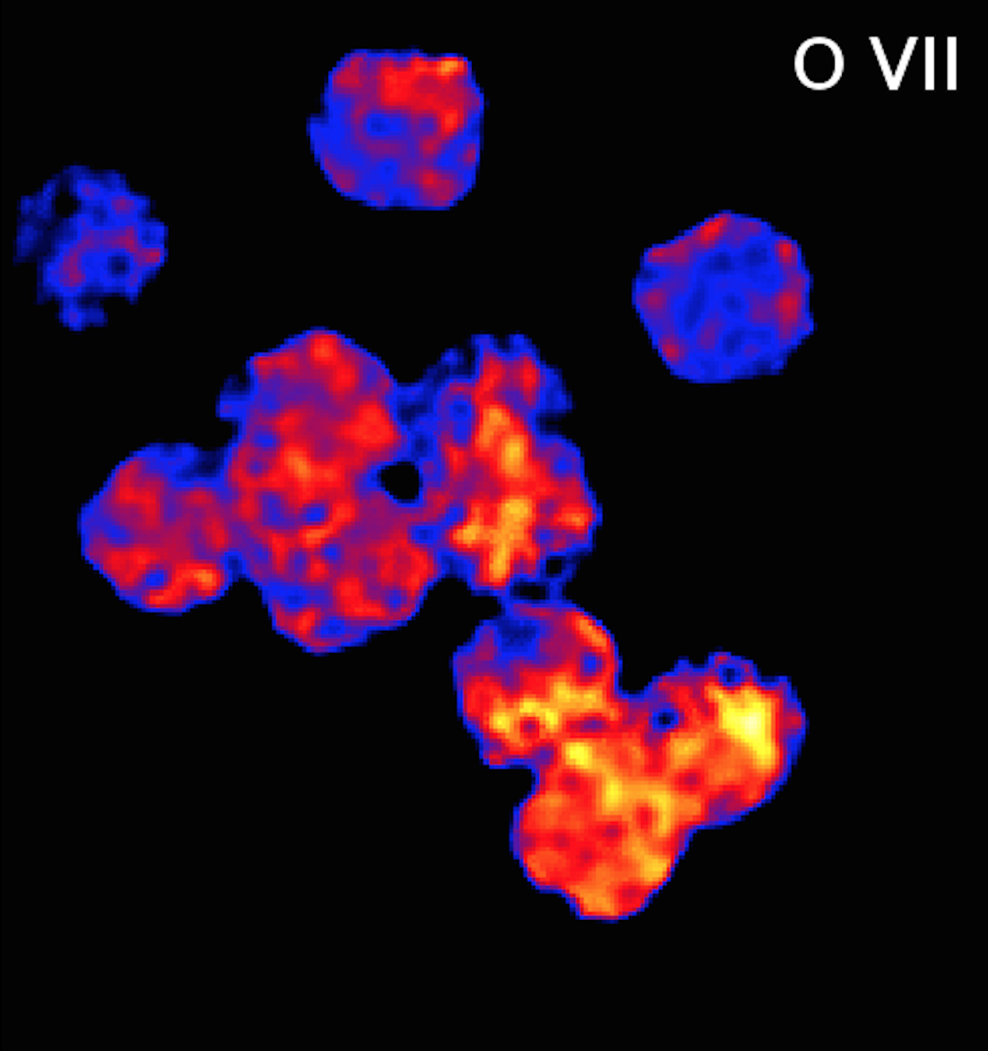
Vela X: XMM Observations
XMM observations reveal filamentary
structure along cocoon
- both nonthermal emission and thermal
emission from ejecta observed
TeV and GeV γ-rays seen from Vela X
- emission centroids appear offset
Spectra show ejecta component within
Vela X has higher kT along cocoon
- distribution of O VII and O VIII is
consistent with this picture

Slide 16
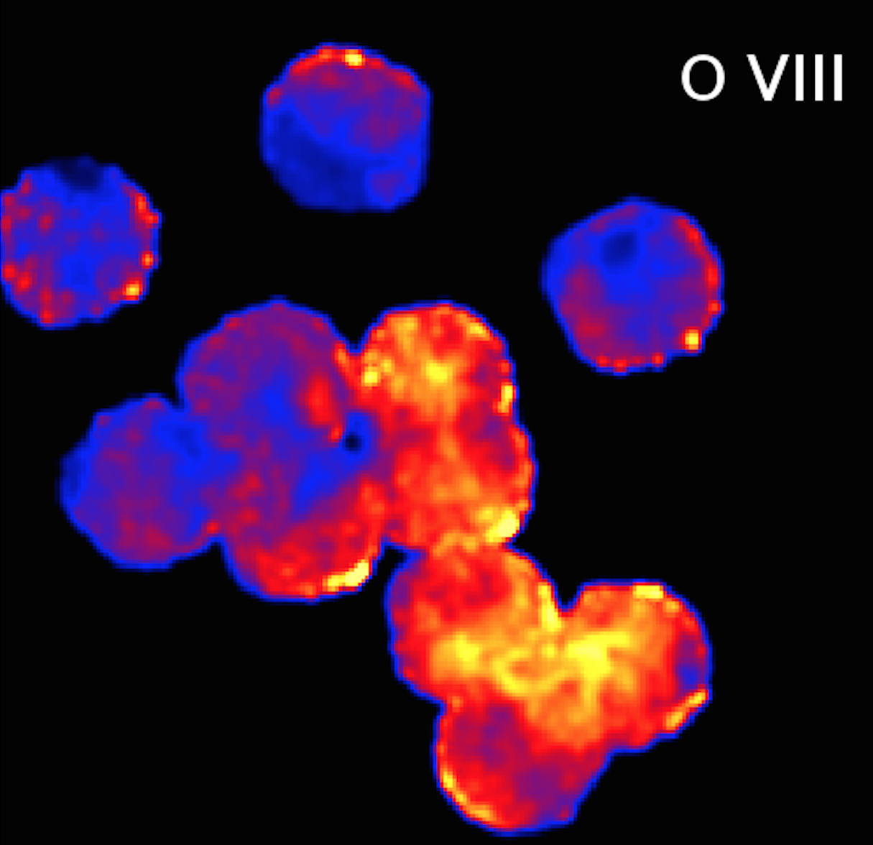
Vela X: XMM Observations
XMM observations reveal filamentary
structure along cocoon
- both nonthermal emission and thermal
emission from ejecta observed
TeV and GeV γ-rays seen from Vela X
- emission centroids appear offset
Spectra show ejecta component within
Vela X has higher kT along cocoon
- distribution of O VII and O VIII is
consistent with this picture

Slide 17
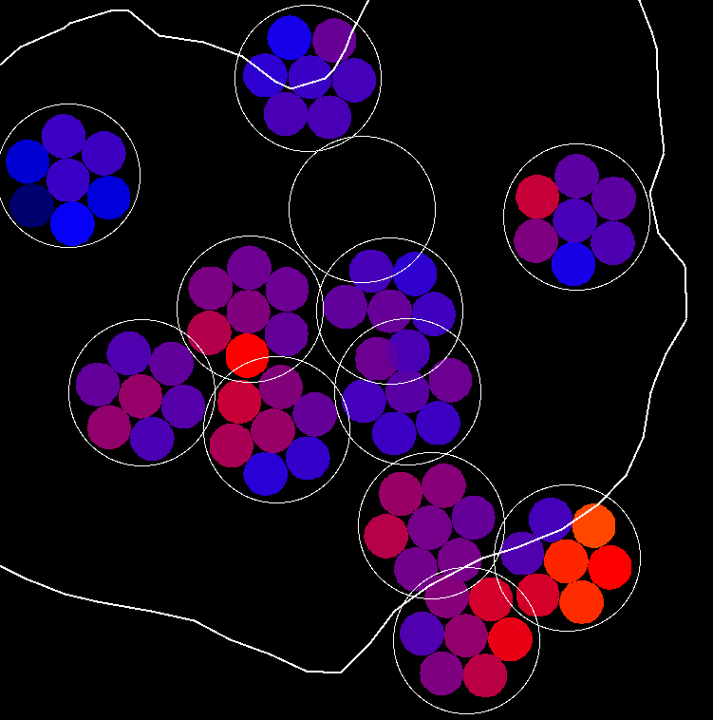
Vela X: XMM Observations
Γ
XMM observations reveal filamentary
structure along cocoon
- both nonthermal emission and thermal
emission from ejecta observed
TeV and GeV γ-rays seen from Vela X
- emission centroids appear offset
Spectra show ejecta component within
Vela X has higher kT along cocoon
- distribution of O VII and O VIII is
consistent with this picture
Power law index steepens with distance
from pulsar, though slowly along cocoon
- emission at Fermi peak somewhat harder

Slide 18
Progression of FS/RS
• Solutions by Truelove &
McKee (1999) show evolution
of FS/RS radius for different
values of explosion energy,
ambient density, and ejecta
mass/profile.
• Explore parameter space to
arrive at scenario for Vela SNR
E₅₁ = 1, M_{ej} = 8 M⦿, n = 12
n_{0,SW} = 0.05 cm⁻³
n_{0,NE} = 0.15 cm⁻³
Note: actually, evidence of
engulfed clouds suggests a
higher mean density.

Slide 19
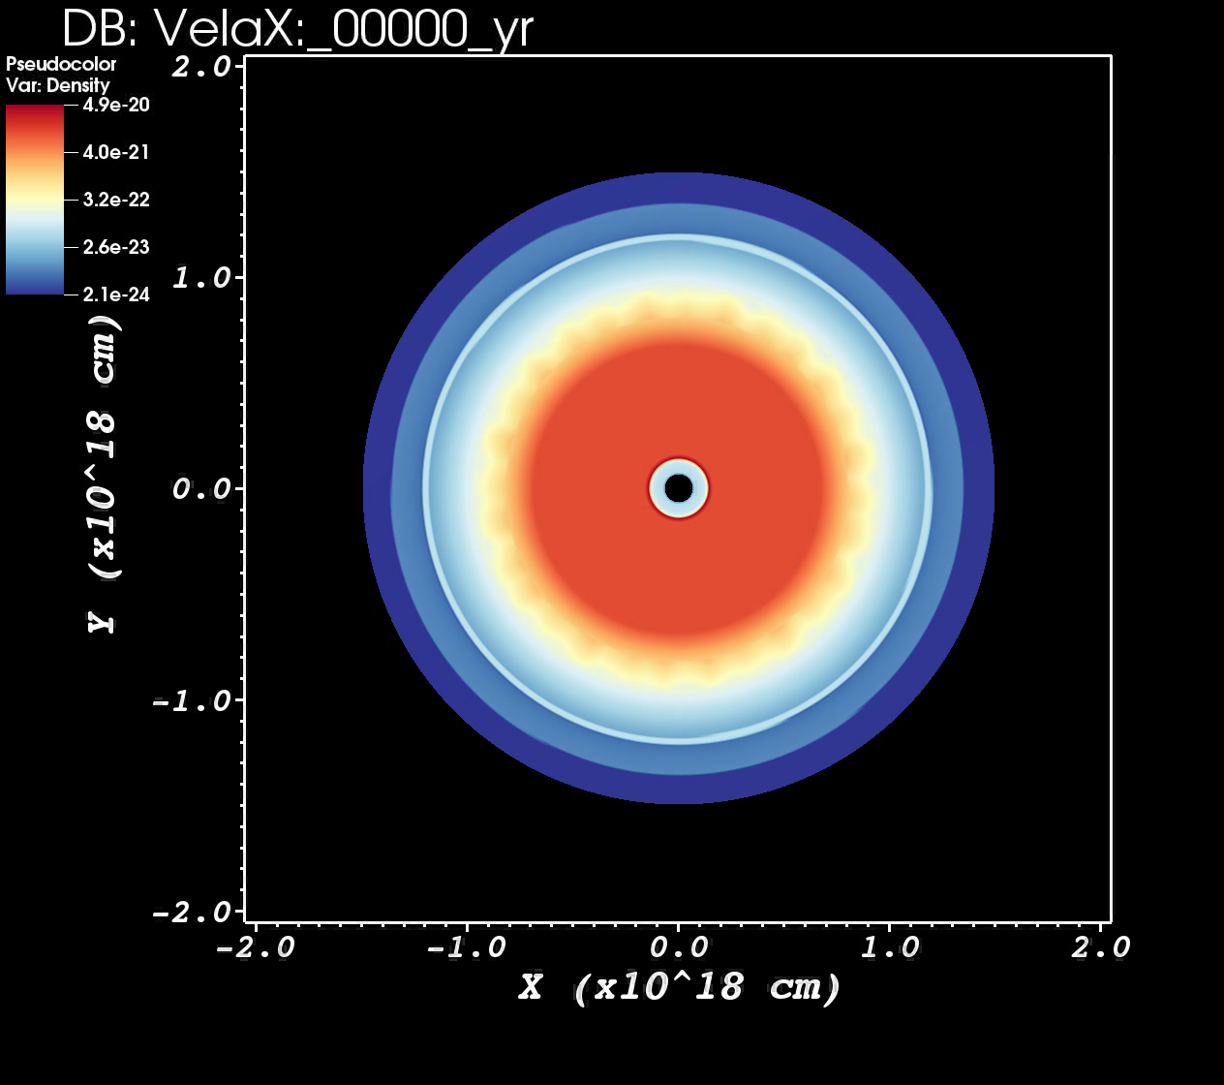
Hydrodynamical Simulations
Kolb et al. 2016
• Evolution of SNR into
density gradient with
contrast of ~4 results
in asymmetric crushing
similar to that observed
in Vela X.
- As RS sweeps over
pulsar, a channel of
ejecta-rich material
is formed, similar in
structure to cocoon.
- Rapid advection may
explain hard spectrum
in cocoon.

Slide 20

Vela SNR and its PWN
n₀^{N} = 1 cm⁻³
ISM density gradient
P = 89 ms
Ė = 10^{36.8} erg/s
τ_{c} = 10^{4.05} yr
Pulsar:
Pulsar velocity
“Cocoon”
Vela X
ROSAT
n₀^{S} = 0.06 cm⁻³
Log ρ
(cm⁻³)
-27.5
-26.3
-25.2
-24.0
-22.9
Hydro simulations reproduce overall
structure
“Cocoon” created by RS interaction
- RS sweeps ejecta into PWN,
creating channel of mixed gas
PWN gas still fills much of nebula,
but ejecta mixing occurs throughout
- consistent w/ observations, though
fast diffision may be required
3D modeling and study of broadband
emission in progress

Slide 21
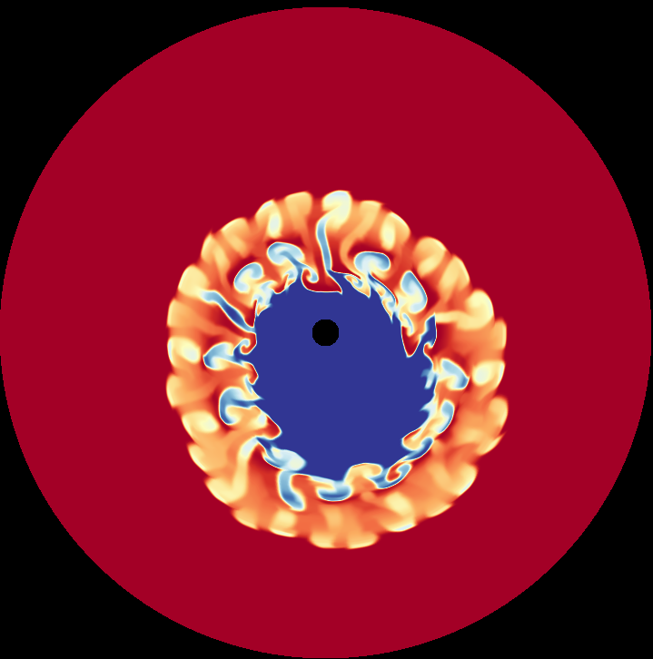

Vela SNR and its PWN
n₀^{N} = 1 cm⁻³
P = 89 ms
Ė = 10^{36.8} erg/s
τ_{c} = 10^{4.05} yr
Pulsar:
“Cocoon”
Vela X
ROSAT
n₀^{S} = 0.06 cm⁻³
ISM
0
1
Hydro simulations reproduce overall
structure
“Cocoon” created by RS interaction
- RS sweeps ejecta into PWN,
creating channel of mixed gas
PWN gas still fills much of nebula,
but ejecta mixing occurs throughout
- consistent w/ observations, though
fast diffision may be required
3D modeling and study of broadband
emission in progress

Slide 22

Vela SNR and its PWN
n₀^{N} = 1 cm⁻³
P = 89 ms
Ė = 10^{36.8} erg/s
τ_{c} = 10^{4.05} yr
Pulsar:
“Cocoon”
Vela X
ROSAT
n₀^{S} = 0.06 cm⁻³
γ
Hydro simulations reproduce overall
structure
“Cocoon” created by RS interaction
- RS sweeps ejecta into PWN,
creating channel of mixed gas
- lower ρ in cocoon ⇒ higher kT
1.30
1.40
1.50
1.60
1.70
PWN gas still fills much of nebula,
but ejecta mixing occurs throughout
- consistent w/ observations, though
fast diffision may be required
3D modeling and study of broadband
emission in progress

Slide 23
Summary
Multiwavelength studies of PWNe reveal unique information on the
conversion of spin-down power into relativistic outflows, providing
views of shocks and interactions with supernova ejecta.
- Hydrodynamical simulations, constrained by observations, provide
important tool for unfolding the evolution and properties of PWNe
within SNRs.
Vela SNR shows distinct signatures of evolution into a non-uniform CSM,
resulting in disruption of its PWN by an asymmetric reverse shock.
X-ray studies of Vela X reveal ejecta mixed into disrupted PWN.
- Hard nonthermal X-rays observed along cocoon, and also near GeV peak.
- Enhanced ejecta observed along cocoon.
- HD modeling suggests cocoon may result from instabilities dragging ejecta
into disrupted PWN.
- Higher advection speed may reduce synchrotron losses in cocoon region.
Ongoing efforts include 3D simulations with post-processed emission
characteristics, applied to these and other evolving systems.

Slide 24
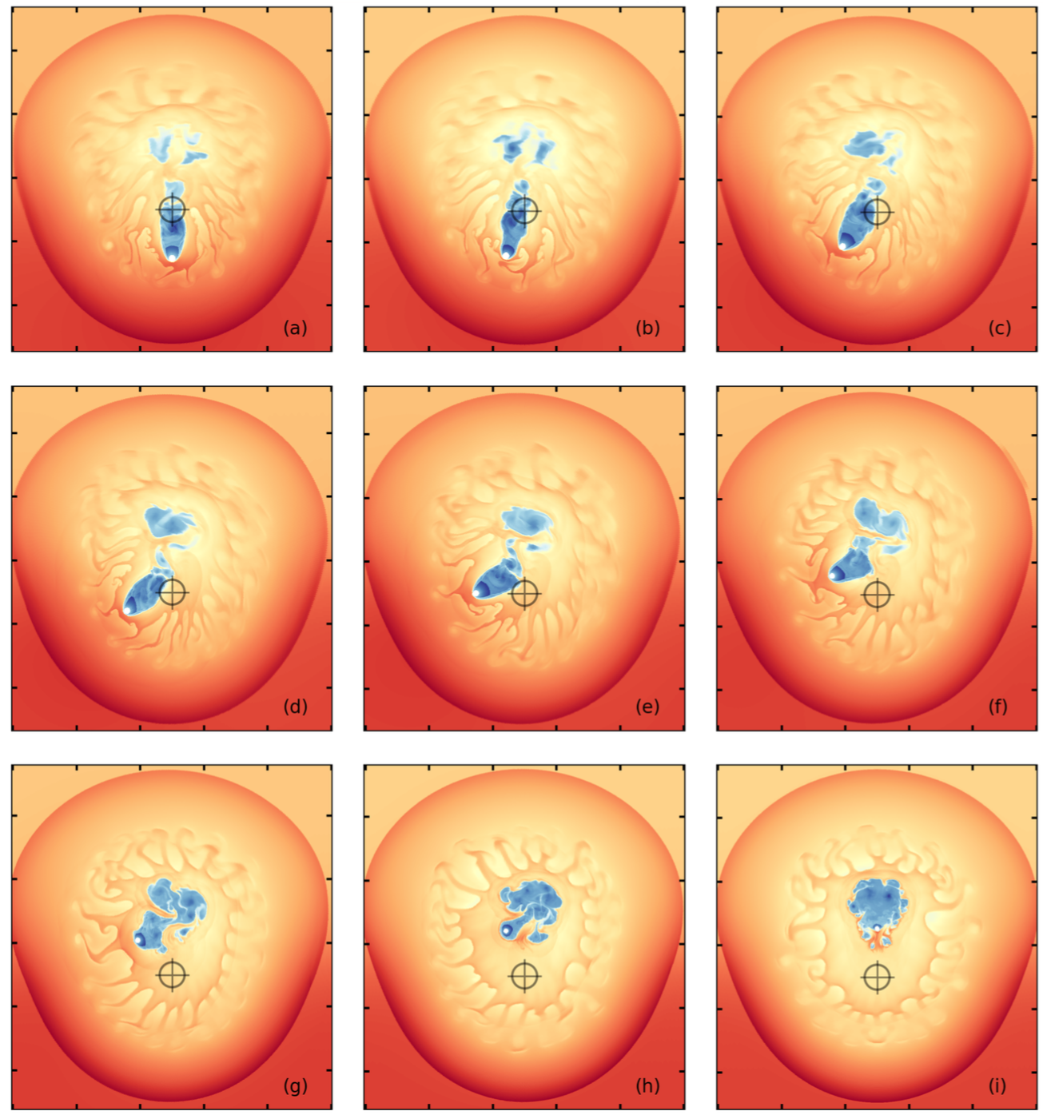
Inferring Pulsar Kicks
Kolb et al. 2016
• Cross-hair
indicates
original pulsar
position.
• Interpreting
pulsar motion
based on
tail geometry
and distance
from apparent
SNR center
is misleading.

Slide 25
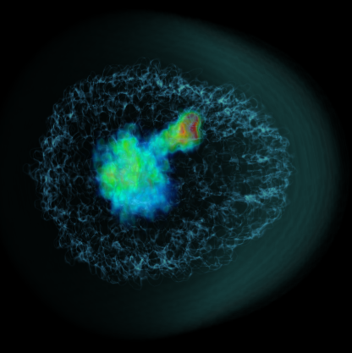
Morphology Comparison
Kolb et al. 2016

