Slide 1
Radio and Gamma-Ray Constraints along the minor axis of starburst M82
Benjamin J. Buckman
Tim Linden
Todd A. Thompson
buckman.12@osu.edu

Slide 2
Google BING

Slide 3
Why M82?
One of the few galaxies with significant detection in gamma-rays
Well studied
Gamma-ray observations – Fermi-LAT & VERITAS
Radio halo observations
Edge-on View
Exemplar of galactic winds
Cosmic-ray driven?

Slide 4
Modeling CR’s in M82 Important Ingredients
Injection
Primary Spectrum
SNR
Source Distribution
Diffusion
Wind
$$D_{xx}$$
𝐷_𝑥𝑥
Energy Losses
$$B$$
𝐵
$$n_{HI}{, n}_{HII}$$
𝑛_𝐻𝐼 〖, 𝑛〗_𝐻𝐼𝐼
ISRF

Slide 5
Distributions
Magnetic Field – Constant in core + power law
Gas Density – Constant in core + power law + wind
ISRF – MW with scaling
Sources – Constant distribution in core
Source Spectra ${∝E}^{−2.2}$

Slide 6
What we want to Constrain
Magnetic Field and Gas Densities – $B_{0}, n_{0}$ + power laws
Wind
Diffusion Coefficient
Free-free emission + absorption

Slide 7
GALPROP
GALPROP ►injection ►propagation ►energy losses ►secondaries
Injection
Diffusion
Energy Losses
Cosmic ray Distribution
Gamma-ray Emission
Inverse Compton
Pion-decay Emission
Radio Emission
Synchrotron
Free-Free
Bremsstrahlung

Slide 8
Results I
Create images of M82 in gamma-rays and radio

Slide 9
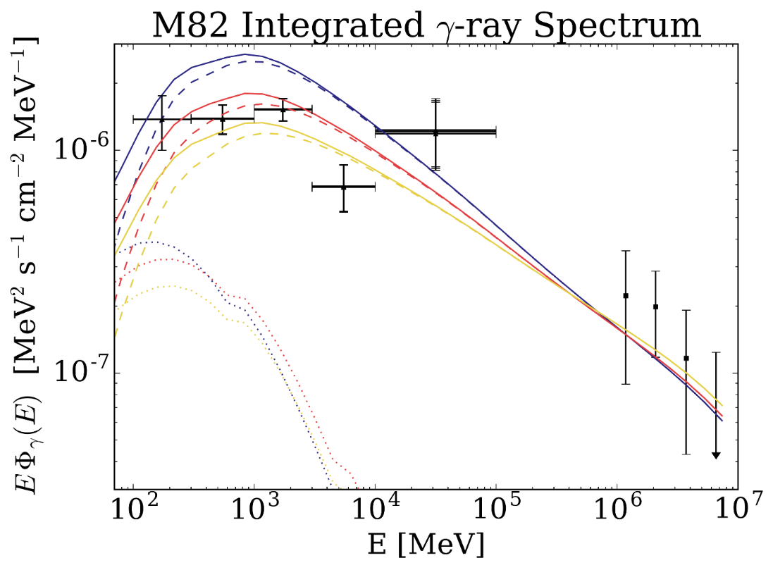
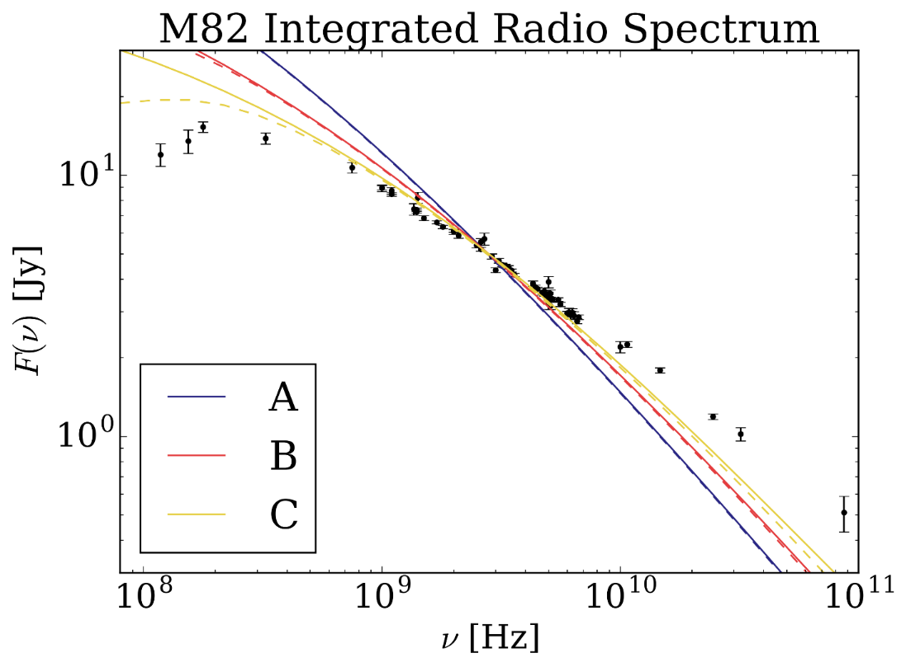
Results II
Finding possible $B_{0}$ and $n_{0}$
From overall normalization of integrated radio and gamma-ray spectra
[$B_{0} \left(μG\right),n_{0} (cm^{−3})$] ► A – [200, 200] B – [400,800] C – [800,2000]

Slide 10
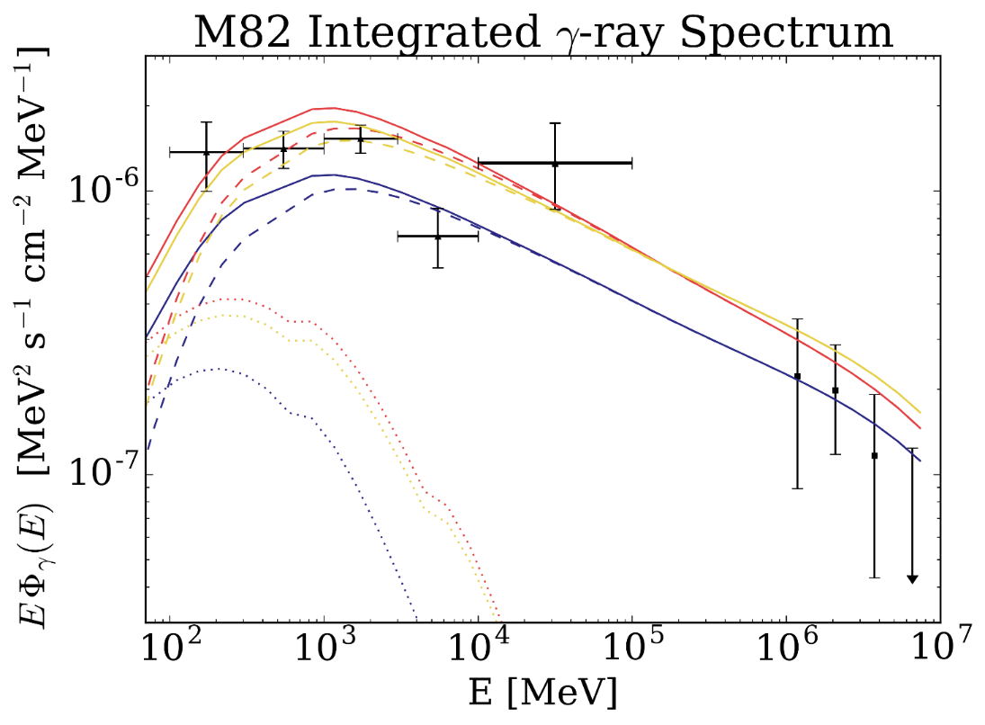
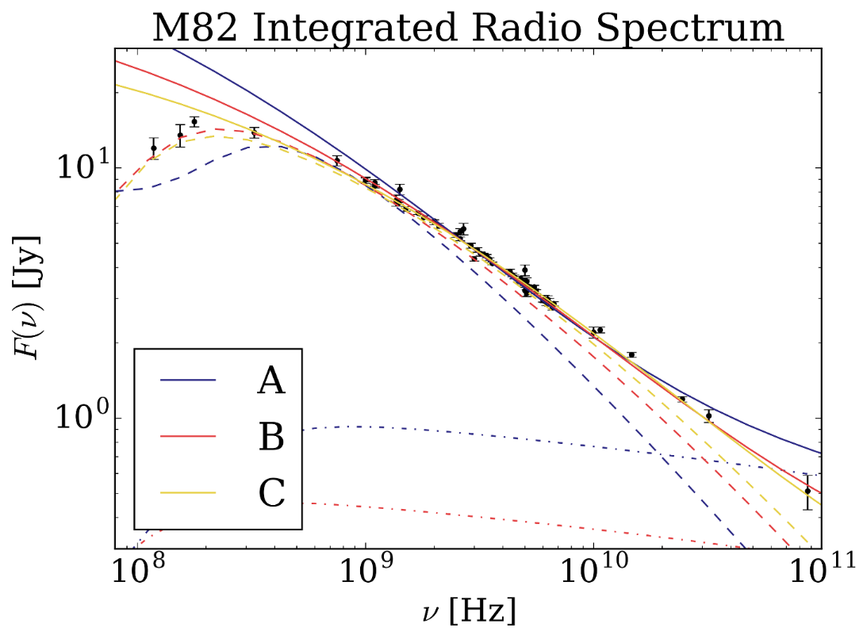
Results III
Possible Solutions
Decrease $D_{xx}$
More free-free emission & absorption
free-free solution
[$B_{0} \left(μG\right),n_{0} (cm^{−3})$] ► A – [200, 200] B – [400,800] C – [800,2000]

Slide 11
Results IV
Hardest points to fit are [0.5,1.0] kpc
Hard to get 92cm and 22cm without overproducing 6cm and 3cm

Slide 12
Results V
$$\left(\frac{E}{1 GeV}\right)={\left(\frac{ν_{crit}}{1 GHz}\right)}^{\frac{1}{2}}{\left(\frac{B}{100 μG}\right)}^{−\frac{1}{2}}$$
Possible solution – synchrotron or IC cooling
$τ_{bremss}\sim 3×{10}^{5}{\left(\frac{n}{100 cm^{−3}}\right)}^{−1}$ yr
$τ_{IC}\sim 3×{10}^{5} {\left(\frac{ν_{crit}}{1 GHz}\right)}^{−\frac{1}{2}}{\left(\frac{B}{100 μG}\right)}^{\frac{1}{2}}{\left(\frac{U_{rad}}{1000 eV cm^{−3}}\right)}^{−1}$ yr
$τ_{synch}\sim {10}^{6} {\left(\frac{ν_{crit}}{1 GHz}\right)}^{−\frac{1}{2}}{\left(\frac{B}{100 μG}\right)}^{−\frac{3}{2}}$ yr
steepen spectrum

Slide 13
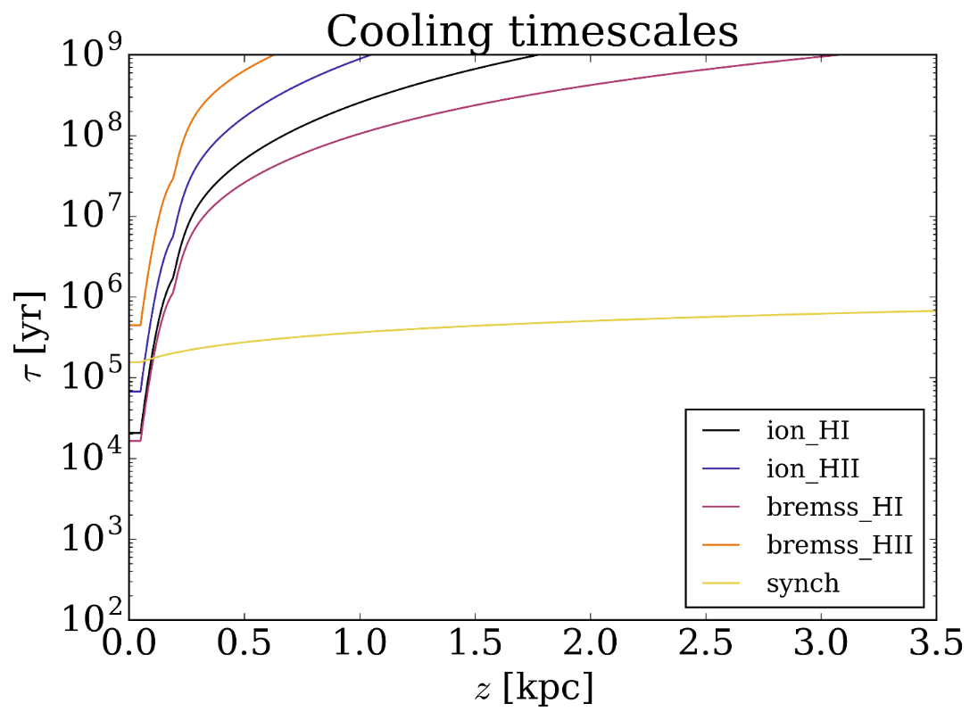
Results VI

Slide 14
Results VI
Allowing the gas density to decrease much faster than magnetic field gives better fits

Slide 15
Summary
Using GALPROP, able to model starburst galaxy M82 radio and gamma ray emission
We can put constraints on magnetic fields, gas densities, and cosmic ray propagation properties
Spectral hardening along minor axis can be due to synchrotron cooling
Gamma-rays are important for the modeling of cosmic rays

Slide 16
Pressure

