Slide 1
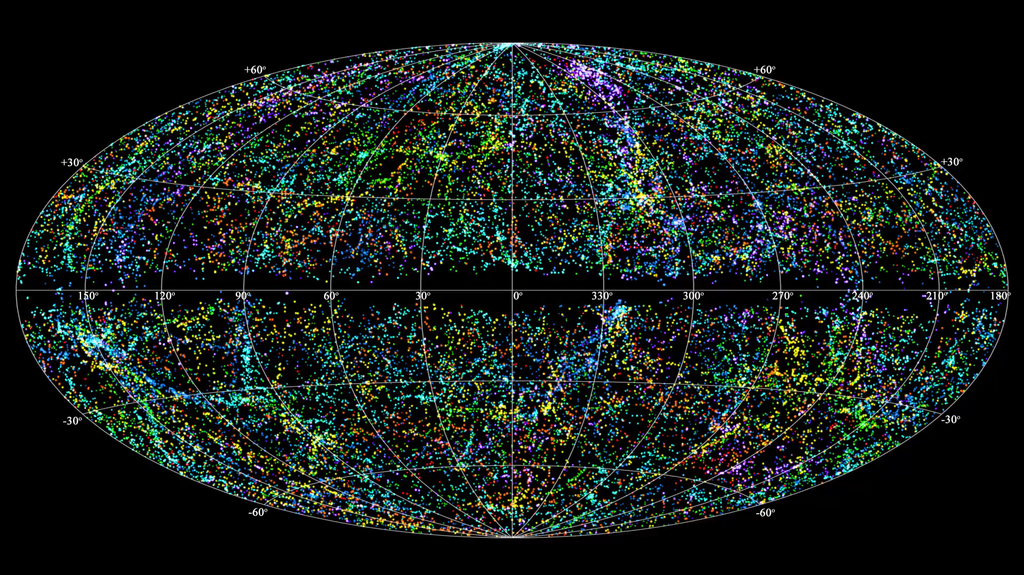
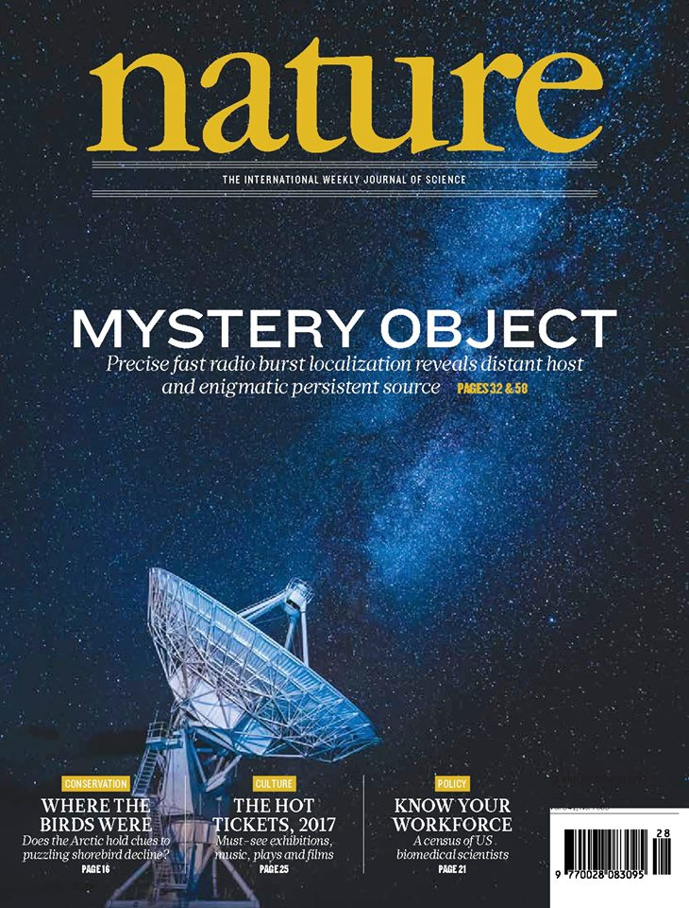
Fast Radio Bursts
Vicky Kaspi
Dept of Physics & McGill Space Institute
McGill University, Montreal, Canada
TeVPA Ohio State University Aug 8, 2017

Slide 2
Fast Radio Bursts
Brief (~ms) radio bursts
Likely cosmological
1st : Lorimer et al. 2007
using Parkes @ 1.4 GHz
Today: ~23 known
Estimated rate:
~1,000 /sky/day @ 1.4 GHz
ORIGIN UNKNOWN!
Parkes
Telescope,
Australia

Slide 3
Dispersion of Radio Waves
t₂ - t₁ = DM ( 1/f₂² – 1/f₁²)

Slide 4
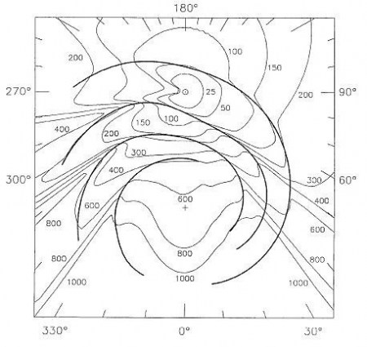
Free Electron Distribution
Milky Way
Model:
Contours
of constant
free electron
column density
Cordes & Lazio 2002

Slide 5
“The Lorimer Burst”
DM_{max} = 25 pc/cm³
DM_{burst} = 375 pc/cm³
!!!!!
Lorimer et al. 2007, Science

Slide 6
Cosmological Distance?
IGM Models: DM = 1200 z pc/cm³
Implies z=0.3 for Lorimer burst
Corresponds to ~1 Gpc… really far!
BUT: likely upper limit
  some DM may be in host galaxy:
  DM_{tot} = DM_{MW} + DM_{IGM} + DM_{host}
For d=500 Mpc radio energy ~ 10⁴⁰ erg Corresponds to 10³⁶ Watts = 10¹⁰ Suns!

Slide 7
Cosmological Distances to FRBs?
Roughly isotropic sky distribution
Dispersion of radio waves strongly
suggests extragalactic
Standard models of intergalactic medium
suggest cosmological distances
FRBs could make excellent cosmological probes! (e.g. Ravi et al. 2016)
Courtesy Ziggy Pleunis

Slide 8
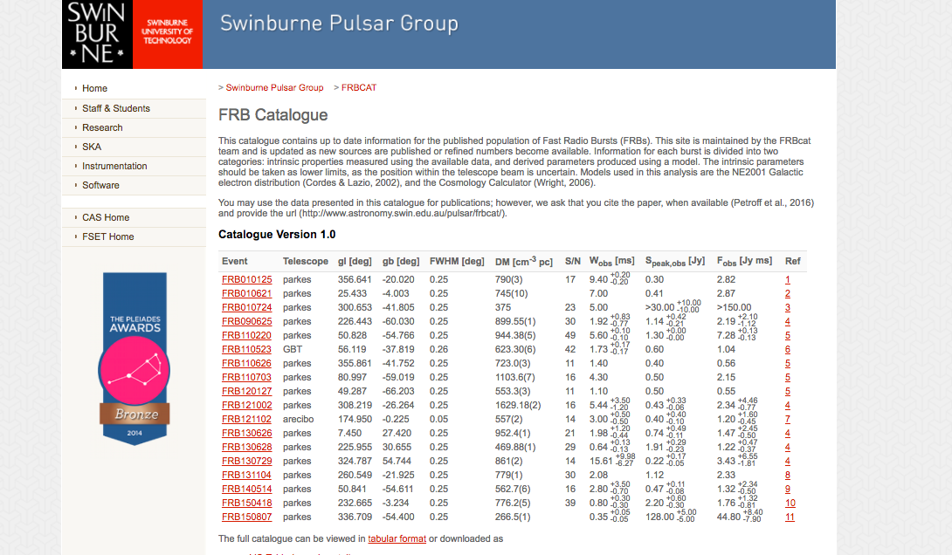

Slide 9
FRB Models
More models than events!
Energy not that constraining…gamma-ray bursts can have isotropic E ~ 10⁵³ erg
  No GRB/FRB coincidences (Tendulkar, VK, Patel 2016)
For FRBs, easily enough energy in cataclysmic events
  Supernovae
    Need free-free opacity low...difficult!
  Neutron star/black hole or neutron star/neutron star
  mergers...but rate too low!
Radiation mechanism must be coherent:
  Brightness temperature T_{b} = I_{v} c²/2kv²= 10³⁴ K!
    Same as in radio pulsars
    Strong magnetic field?
  Source size < ct = 300 km
    Compact object?

Slide 10
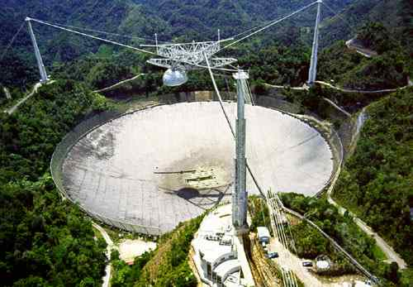
Searching for FRBs: PALFA
Pulsar Arecibo L-Band Feed Array (PALFA)
  305-m telescope in
  Arecibo, PR
  Survey of Galactic Plane with 7-beam PALFA receiver
  Center freq 1.4 GHz, BW 300 MHz,
  ~1 Petabyte
  HPC job!

Slide 12
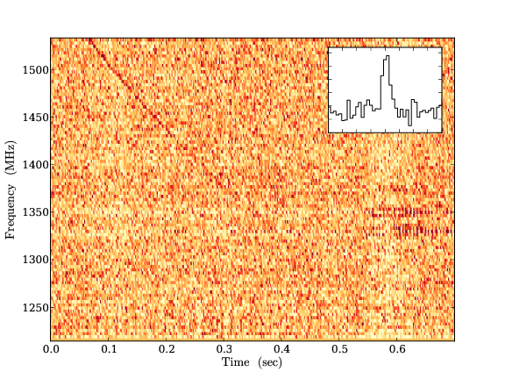
FRB 121102
Found at Arecibo
First non-Parkes
FRB
DM = 558 pc/cm³
= 3DM_{max}
Note unusual
spectrum
  Spectral index ~+9!
Assumed due to
offset from beam
centre
Spitler et al. 2014

Slide 13
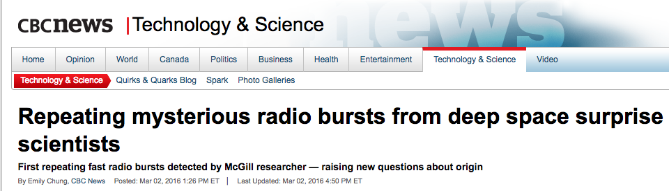
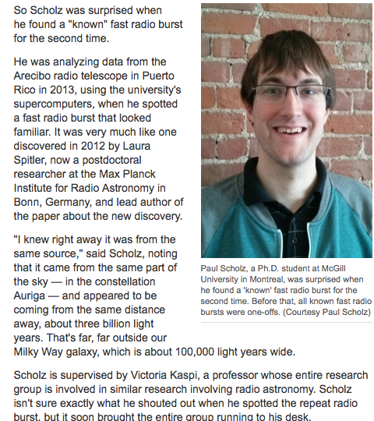
Arecibo FRB Repeats!
>10 more bursts detected
Spitler et al. 2016 Nature;
Scholz et al. 2016 ApJ
Hugely varying spectra
Bursts come in clusters

Slide 14
Repeats Highly Clustered!
Plot courtesy:
S. Ocker,
K. Gourdjii
L. Spitler
J. Hessels
Others…
Hessels et al. in prep.

Slide 15
Why Only 1 Repeater?
Different classes of FRBs?
  Some cataclysmic, some not?
BUT coincidence that of 23 known, only
repeater is also only Arecibo FRB??
  Maybe no, as repeat bursts generally too faint
  for Parkes
What could repeater be? We don’t know.
  Rotation-powered pulsar giant pulses?
  Magnetar giant flares?

Slide 16
Crab-like Giant Pulses?
Max L~10³⁵ erg/s
Hankins & Eilek 2007

Slide 17
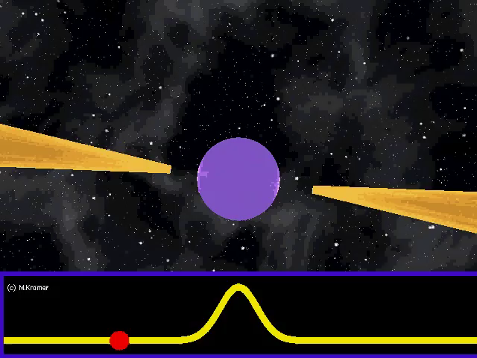
Radio Pulsar
Energetics:
Spin-down
Crab pulsar: P = 33 ms, dP/dt = 4x10⁻¹³, E=5x10³⁸ erg/s
See Lyutikov (2017)

Slide 18
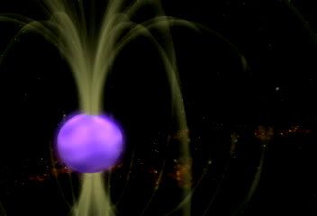
Pros of FRBs as Magnetars
Magnetar Giant Flares have
few ms peaks in X-rays
3 since 1979 → ~0.1 /MW/yr
but FRBs ~10⁻³ /galaxy/yr
  We must be sensitivity limited for FRBs
Magnetars have sufficient energy: ~10⁴⁷-⁴⁹ erg
  Even for repeating FRB? Depends on activity life time
  Cannot be for more than ~100 yr

Slide 19
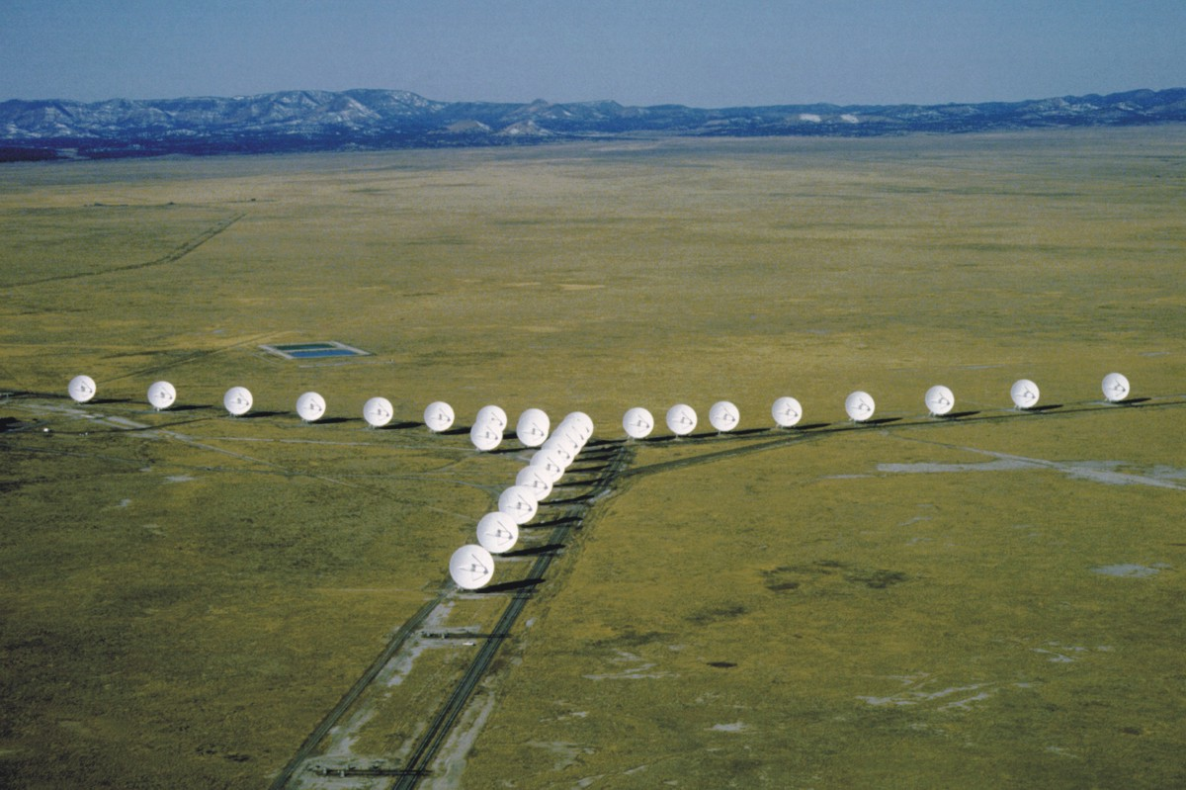

JVLA observes FRB 121102
Computationally
demanding!
(Law et al 2015)
Fast imaging of FRB 121102:
  Fall 2015, 10 hours: no detection
  Spring 2016, 40 hours: no detection
  Fall 2016, 40 hours
    In the first hour of a test observation…

Slide 20
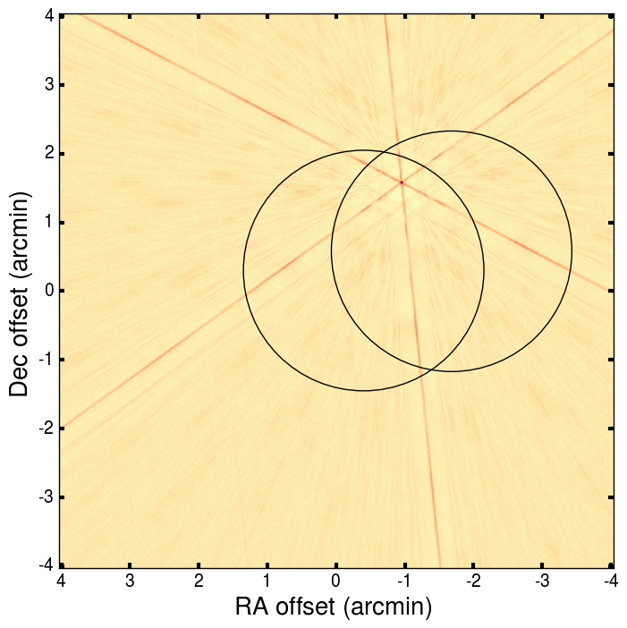
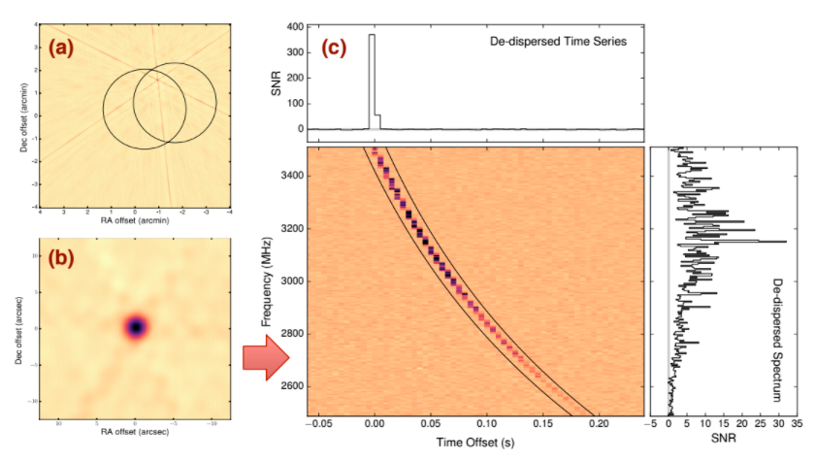
Chatterjee et al 2017, Nature

Slide 21
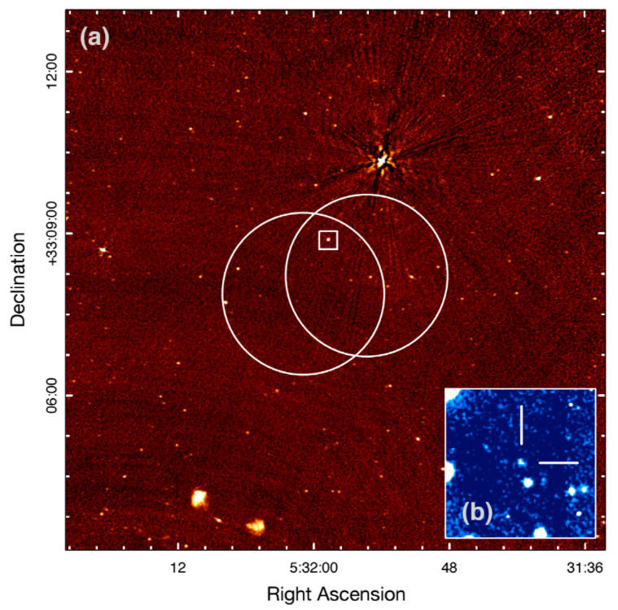
JVLA Detections
9 bursts in Fall 2016
Location to 0.1 arcsecond
Persistent radio source – 200 𝜇Jy!
  30% variability
Optical counterpart 25th mag
Chatterjee et al (2017)
Deep VLA 3 GHz image and Gemini r-band image

Slide 22
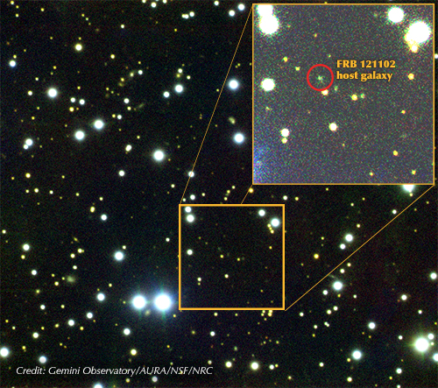
Optical counterpart: a Dwarf Galaxy
z=0.19273(8)
Distance 972 Mpc
Mass 5 × 10⁷ M_{sun}
  MW is 10¹² M_{sun}
Star forming
  0.5 M_{sun} / year
Low metallicity
  Affects stellar characteristics
Milky Way
Tendulkar et al (2017)

Slide 23
FRBs: Where do we stand?
At least one FRB repeats and is definitely cosmological!
Open questions
  Is this representative?
  What is the burst source?
  What is the persistent source?
  Is it related to SLSNe?

Slide 24
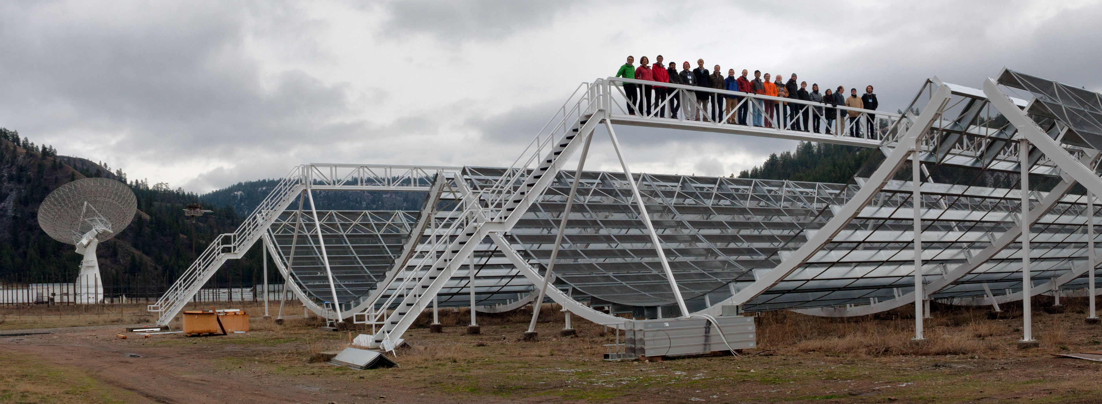
CHIME: Canadian Hydrogen Intensity Mapping Experiment
🇨🇦
Penticton, BC at DRAO
4 20 m x 100 m cylinders
Transit telescope
256 dual-pol feeds per axis,
2048 input signals
400-800 MHz
FOV: E-W 2.5º-1.3º,
N-S ~120º
Beam size 0.5º-0.3º
CFI-funded $16M CDN: McGill, UofT, UBC
10 Terabits/s!

Slide 28
CHIME & FRBs
CHIME’s
* 220 sq deg
field-of-view
* wide
400-800 MHz
Bandwidth
* Large
collecting Area
mean it will
detect several
FRBs per day!
Chawla et al. 2017

Slide 29
Conclusions
FRBs are here to stay
Origin remains unknown
Perhaps all repeat?
First localization accomplished
  Cosmological distance confirmed!
CHIME will be a great FRB machine!

Slide 30
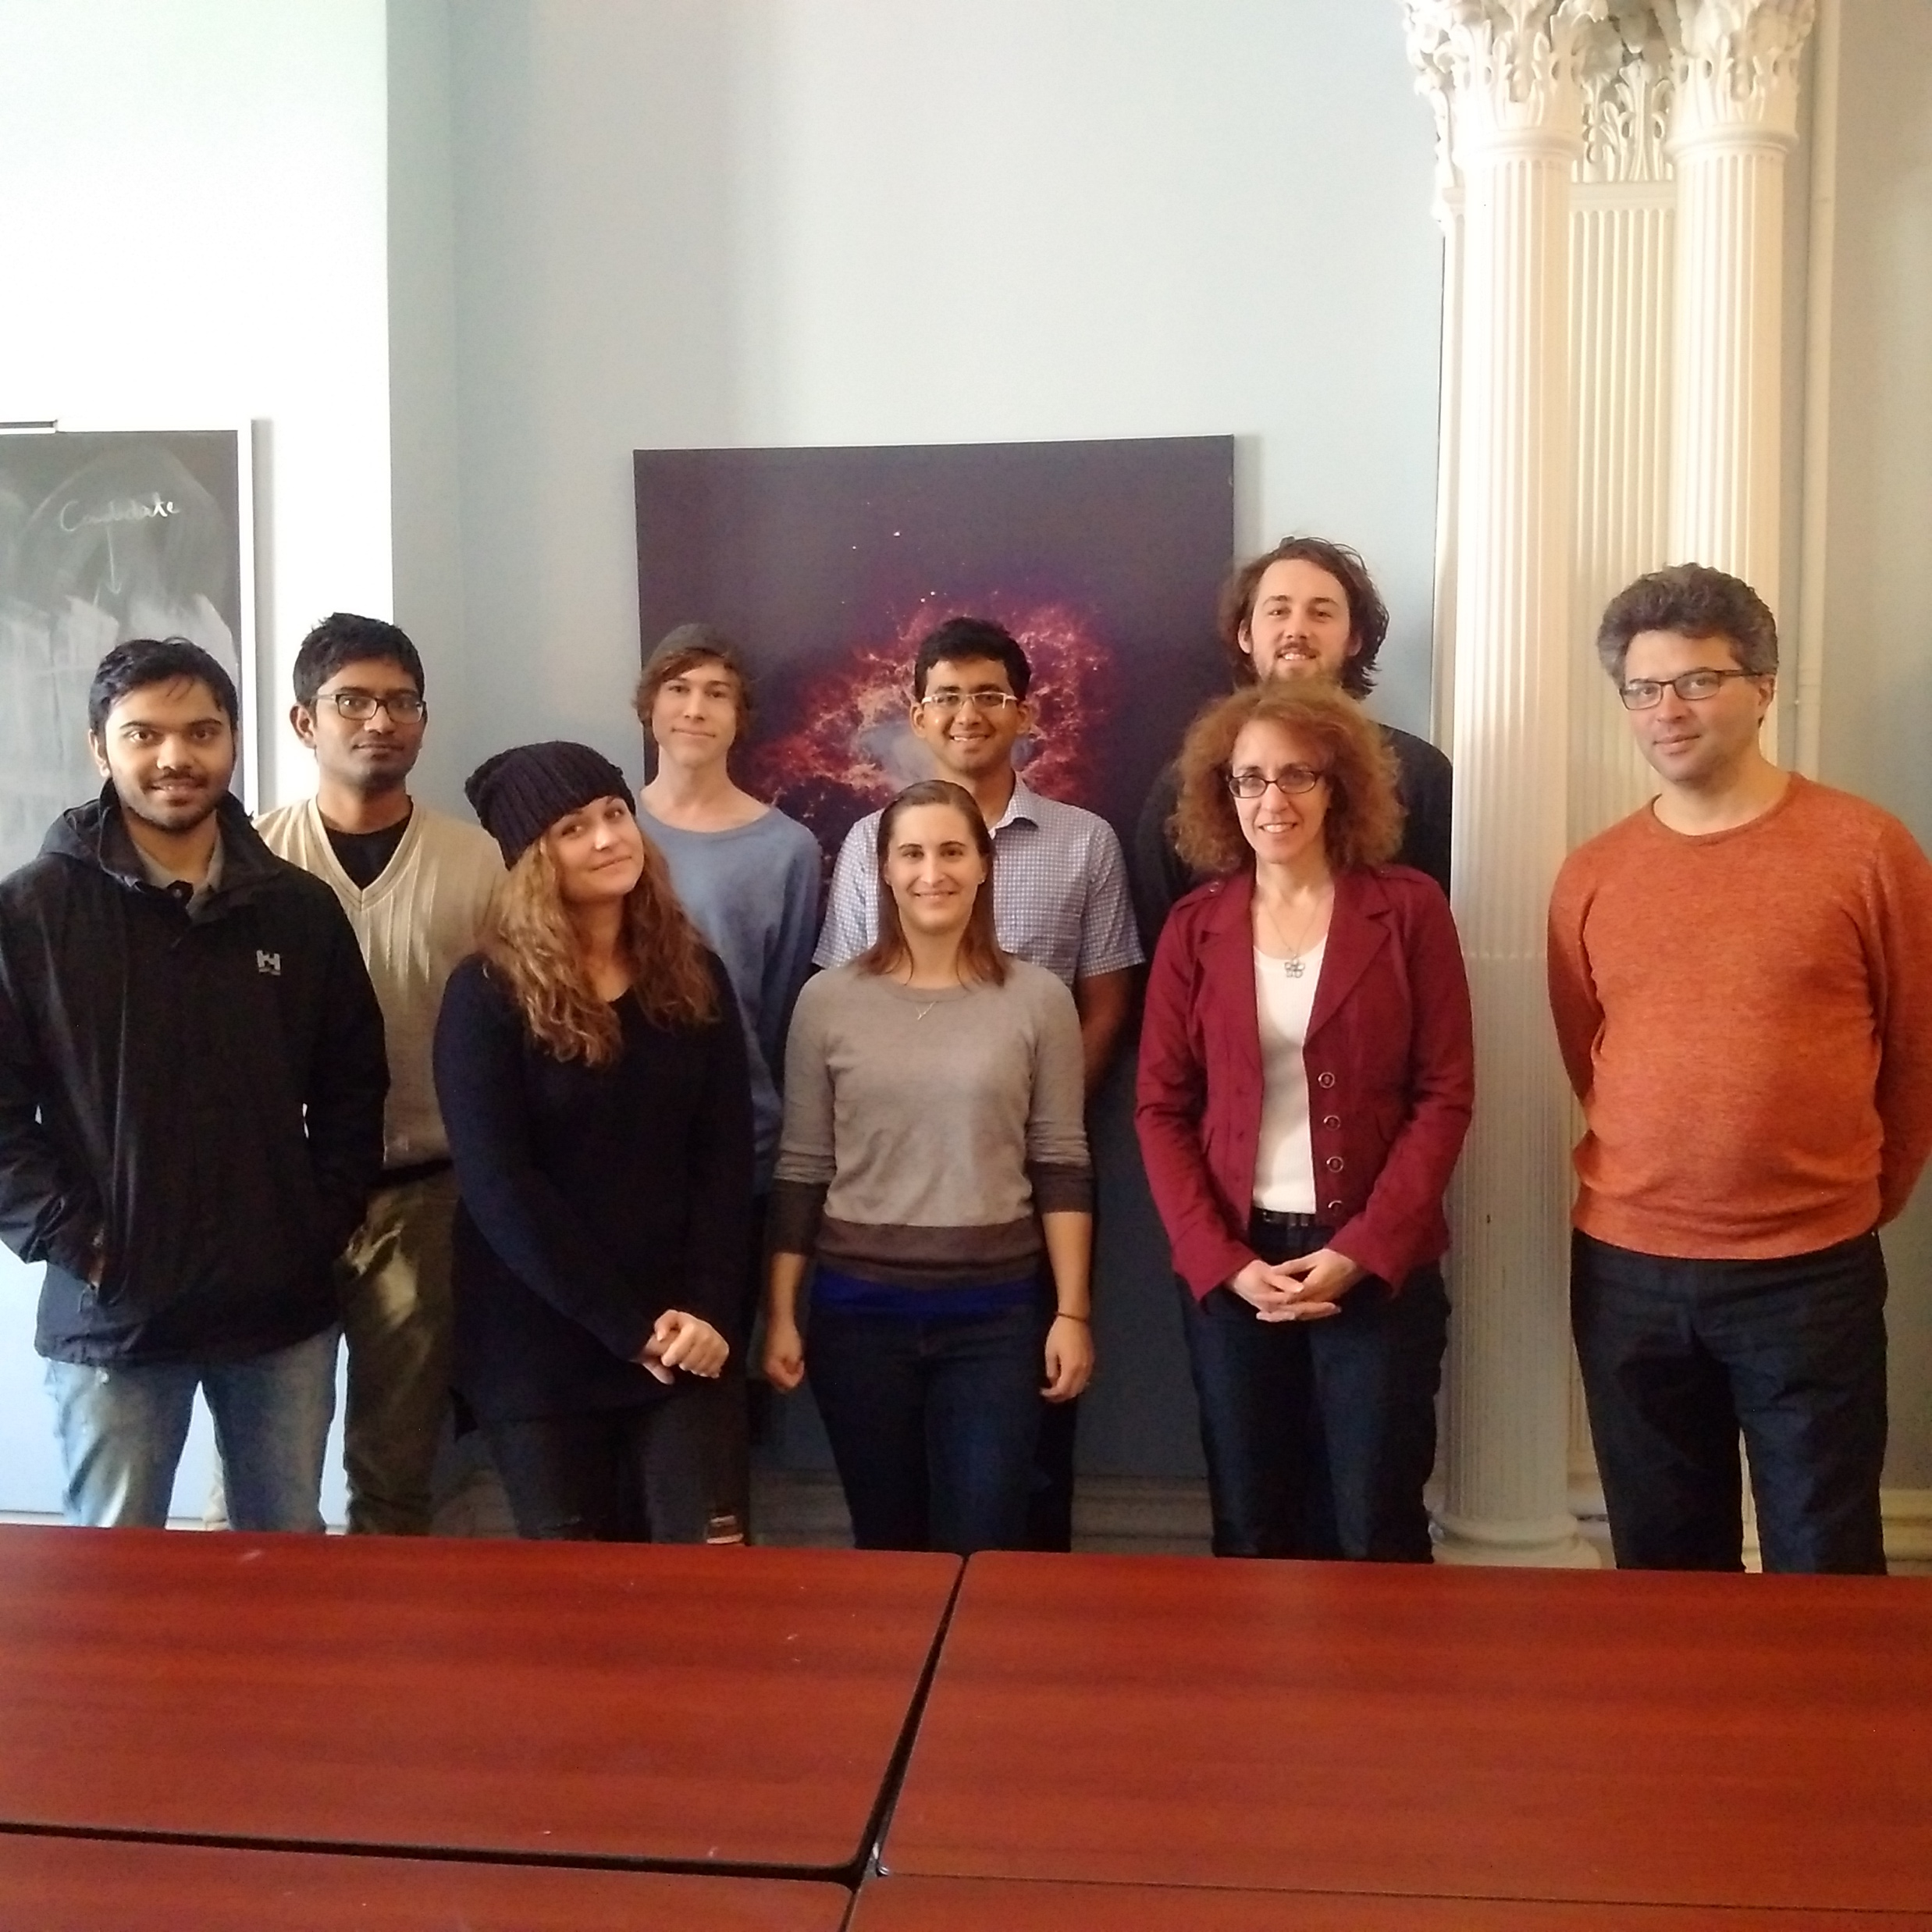






Thanks to…
CHIME
Team
Lorne Trottier Chair
in Astrophysics &
Cosmology

