Slide 1
Gamma-rays and Neutrinos from Efficient Cosmic-Ray Acceleration in Young Supernovae
Vikram Dwarkadas (U Chicago)
Matthieu Renaud, Alexandre Marcowith (LUPM, U Montpellier)
Vincent Tatischeff (Univ Paris-Sud)
We acknowledge support from the FACCTS program at Univ of Chicago

Slide 2
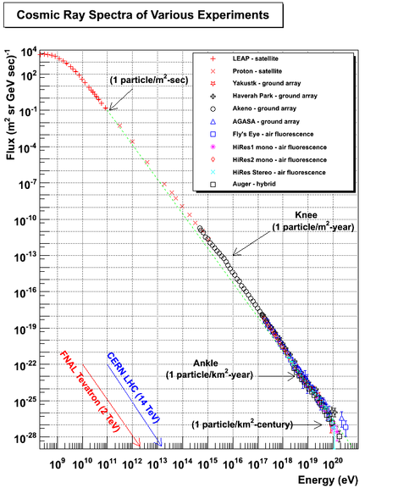
SNRs - Galactic Pevatrons?
Can SNe accelerate particles up to the knee of the cosmic-ray spectrum – i.e. are they Galactic Pevatrons?
When are the PeV energy particles emitted?

Slide 3
Gamma-rays from SNe
We have started a large project to study various aspects of gamma-ray emission from SNe.
We look at the amplification of the magnetic field, maximum energy via various processes, and absorption of the emission in young SNe.
The goal is to understand particle acceleration in young SNe, and help to set the observing agenda for the Cerenkov Telescope Array (CTA) with regards to young SNe.
In this talk I will consider the various arguments, using SN 1993J as an example.

Slide 4
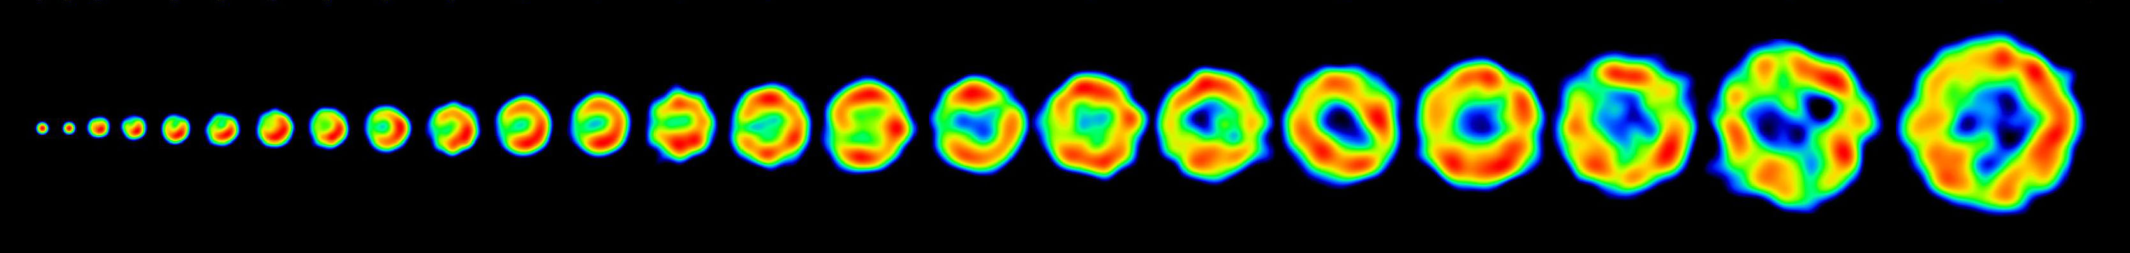
SN 1993J
Type IIb SN with possible RSG progenitor (Chevalier & Oishi 2003)
VLBI observations provide information on expansion, radius and velocity
Tatischeff (2009):
Compare with equipartition magnetic field:
Magnetic field amplified almost 1000 times
Chandra et al 2004: B_{eq} ~ 38 mG around day 3200

Slide 5
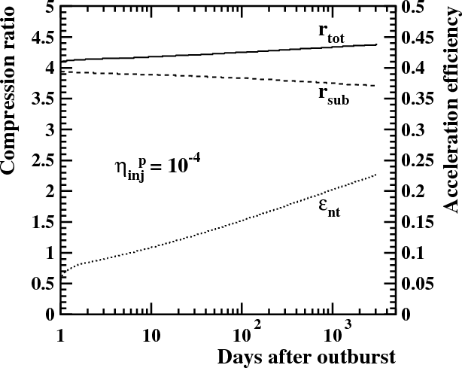
SN 1993J (Contd)
Shock itself not highly modified
Compression ratio close to 4
Strong magnetic field amplification, driven by diffusive shock acceleration, at work at forward shock.
Efficiency of accelerated particles increases with time to ~25%

Slide 6
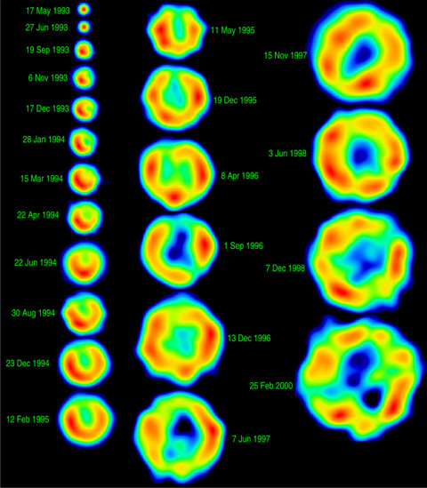
SN 1993J (Contd)
Shocks are not highly affected – assume Chevalier (1982) self-similar solution.
Circumstellar medium formed by pre-SN RSG wind mass-loss. Wind fully ionized over 30 days of SN evolution.
Mass-loss rate 3.8 x 10⁻⁵ M yr⁻¹.
Circumstellar density decreases as r⁻².

Slide 7
Streaming Instabilities
Streaming of cosmic rays ahead of shock front produces magnetic fluctuations.
Streaming modes can be in resonance with energetic particles (k ~ r_{L}⁻¹), or they can be non-resonant (k > r_{L}⁻¹). NR modes grow fastest in case of fast shocks, such as in young SNe:
Where φ=ln(p_{max}/p_{inj})≅15, and ξ_{CR}≅0.05, i.e 5% of the kinetic energy goes into accelerated particles.

Slide 8
NR Modes (Contd)
The growth timescale must be shorter than the advection timescale towards the shock τ_{ADV}=κ/v_{sh}², where κ=ηκ_{B,}
κ_{B}=cr_{L}/3, r_{L} is the Larmor radius, and κ is calculated with the background magnetic field. We find:
The condition τ_{NR-st} < τ_{ADV} is necessary for the instability to develop and cosmic rays to be confined around the shock, but not sufficient.

Slide 9
Other Modes
R instability has growth rate (Amato & Blasi 2009, MNRAS, 392, 1591):
τ_{R-st}≅(πσ/8)^{0.5}/r_{Lmax,} with σ ~ 3×10¹⁶ cm² s^{2.} Thus τ_{R-st} ≅ 16 τ_{NR-st} at 1 PeV.
Bykov et al (MNRAS, 410, 39) proposed a ponderomotive instability, that builds up magnetic fluctuations by the NR instability, with growth rate:
Where A₁₀ = B_{NR}²/B₀² refers to increase in magnetic energy over background energy, (normalized to 10). Timescale is shorter than τ_{ADV} for kr_{L,max}≅ 1.

Slide 10
Maximum Energies
At early times, maximum energy limited by SN age, and obtained by equating acceleration timescale with the age:
t_{age} = τ_{acc} = g(r) κ_{u}/u_{sh}²
where g(r) =3r/(r-1)×(κ_{d}/κ_{u}r + 1).

Slide 11
Maximum Energies (Contd)
If NR streaming instability is active:
If long wavelength fluctuations due to ponderomotive instability (Maund et al 2004)
Caveat: Highest Energy particles may not experience maximum B field.

Slide 12
Particle Acceleration Modelling
Procedure: [Renaud et al. (2017) in prep]
  Using 1D solutions at the shock front:
    Calculate E_{max}(t) for protons and electrons (radiative losses) taking various instabilities into account
    Inject a modified non-linear spectrum at the shock.
  Downstream evolution (One-zone model):
    Radiative + adiabatic losses
    Pion production: Secondaries production (electron/positron, neutrinos)
  Compute time dependent multi-wavelength spectra from primaries and secondaries.
    GeV-TeV signal accounting from gamma-gamma absorption.

Slide 13
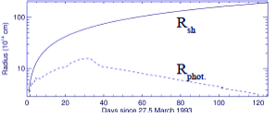
Gamma-ray Absorption
Anisotropic Gamma-Gamma absorption over soft photons produced at the SN photosphere (UV,optical)
Rear-on
R_{phot}
R_{sh}
produces much less absorption than in isotropic calculations (eg Tatischeff, Kirk)
Head-on
Opacity ↑
Opacity ↓

Slide 14
Gamma-Ray Absorption (Preliminary)
Gamma- rays can be absorbed by soft photon fields to produce electron-positron pairs (gamma-gamma absorption).
Photon source - SN photosphere. Full calculation of γ-γ opacity including geometrical effects due to anisotropic interaction.
Dashed line – unabsorbed flux
Solid line - Absorbed Flux
Above 0.1 TeV
Above 1 TeV

Slide 15
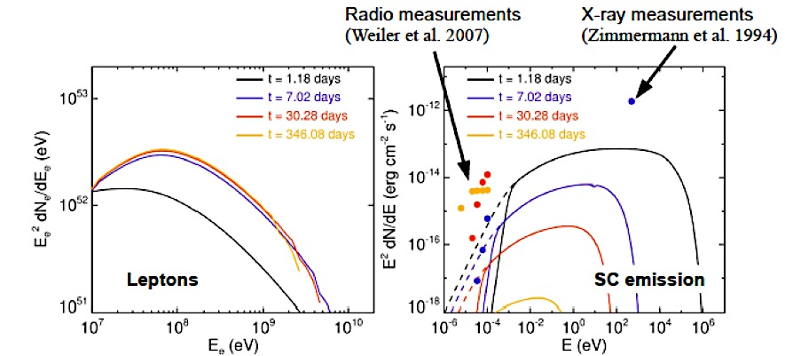
Emission from secondary leptons
Time dependent spectra from electron-positron secondaries at four different times after outburst. Radio data (Weiler et al., 2007, ApJ). X-ray data (Zimmerman et al., 1994, Nature), at about 7 days after outburst. Dotted lines represent unabsorbed synchrotron spectra while continuous lines include synchrotron self-absorption. The plot shows that the emission from the secondaries lies below the observed radio and X-ray levels.

Slide 16
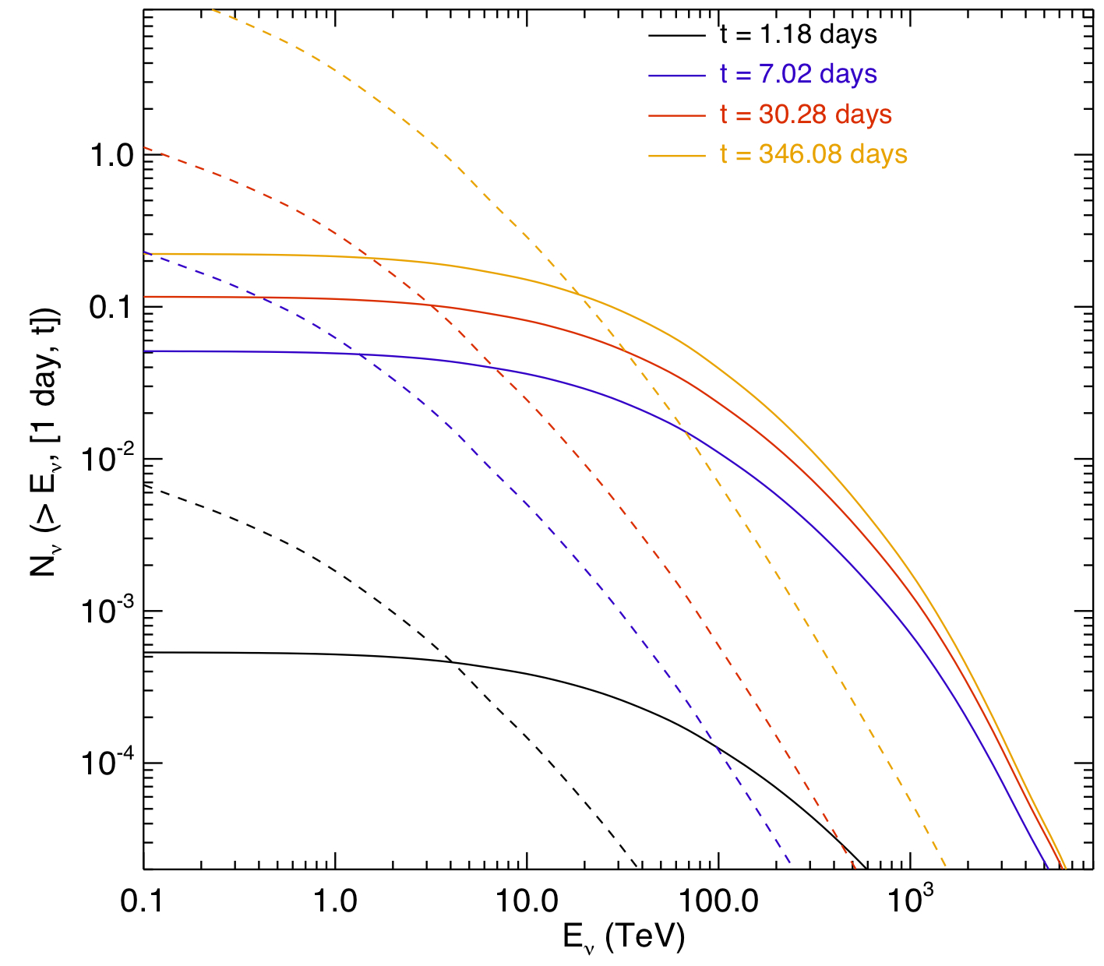
Neutrinos
Neutrinos are by-products of pion production. Time dependent neutrino flux of SN 1993J above an energy E expected by an instrument equivalent to KM3NeT (solid lines) at four different times after the outburst. Dotted lines show the atmospheric neutrino backgrounds. In order to detect at least one neutrino from such a source, it must be at a distance < 1 Mpc, or the gamma-ray signal has to be ten times stronger.

Slide 17
Analysis of various effects
key parameters | main effects
Mass loss rate/wind velocity | CSM density and instability growth rate Target material and gamma-ray luminosity
Shock velocity | Instability growth rate and acceleration timescale
Local ionization degree | Composition, instability growth
Background magnetic field | Magnetization and obliquity
SN luminosity (peak and light curve) | Gamma-gamma absorption

Slide 18
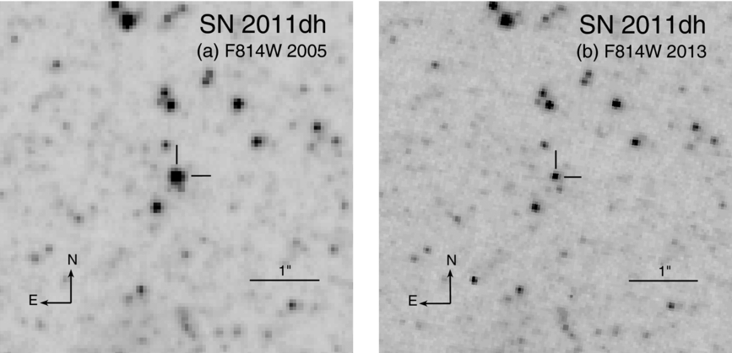
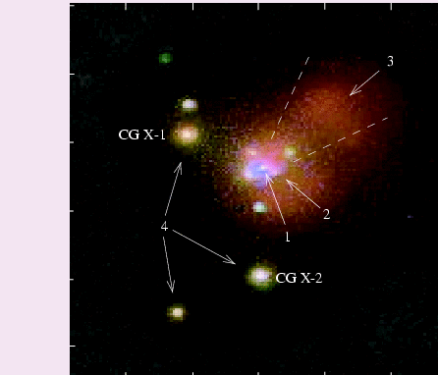
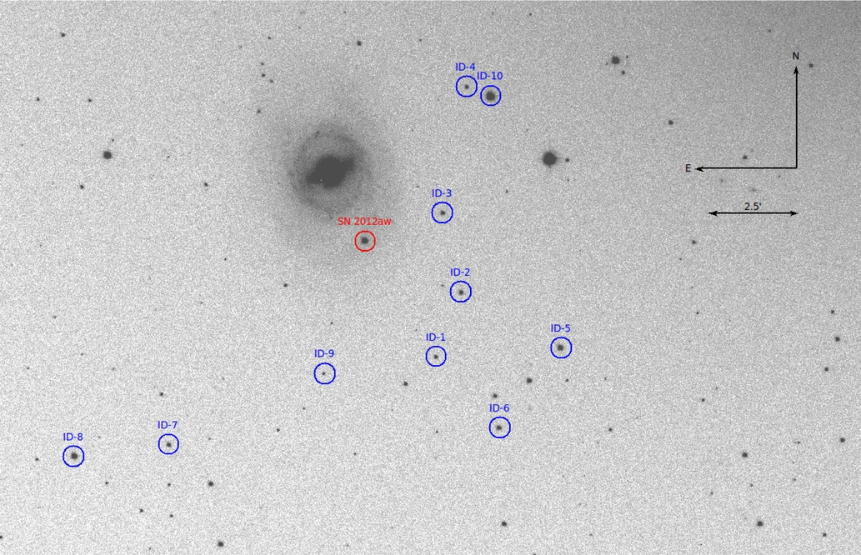
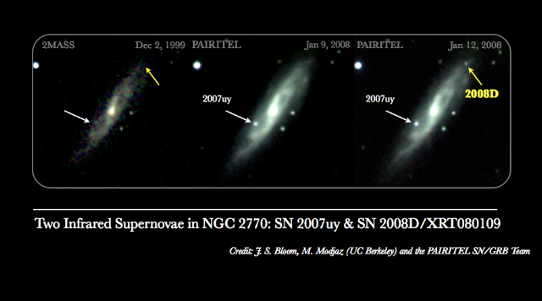
Analysis of SN Types
SN IIb
  Interesting but rare events ~4-6% of core collapse
  SNe (Smartt+09). Some (IIb(e) - 93J) have higher ambient densities, other sub-types (IIb(c)) may have much lower densities.
SN IIn
  ~1-4% of Core-collapse SNe : more luminous, higher density.
  But not necessarily wind interaction; perhaps dense shell. Somewhat different hydrodynamical model required – cannot use self-similar solutions.
SN IIP
  around 50-55% of Core-Collapse SNe - less luminous, particularly in X-rays; suggests lower mass loss/wind velocity ratio than observed for RSG stars.
SN Ib/Ic
  mildly relativistic shocks. Associated with a WR phase, so low density ambient medium. X-rays presumably due to Inverse Compton, thus show evidence of particle acceleration already.

Slide 19
Conclusions
Highest GCR energies are reached for fast shocks. Current driven instabilities grow the fastest in dense environments.
Explore particle acceleration in very young SNe.
Test case 93J:
  Maximum energies: Up to few PeV for protons,
  Gamma-gamma absorption reduces flux considerably, up to several orders of magnitude.
  Gamma-ray detection of 93J-like SNe possible above 0.1TeV for CTA. Much higher ambient densities required for HESS, VERITAS and MAGIC.
  High-energy neutrinos expected however the flux is low (depends on p-p interaction and surrounding density).
  Our neutrino fluxes lower than some others (Murase et al., Zirakashvili etc) because these authors use much higher ambient densities.
Other SN classes:
  Type IIn seem obvious targets – high density in surrounding medium.

Slide 20
Questions and Discussions

Slide 21
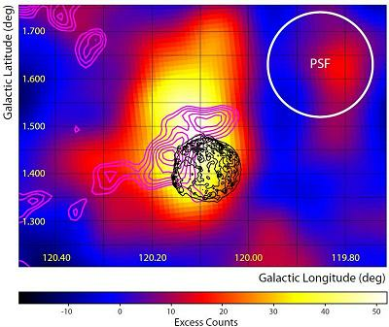
SNRs as Particle Accelerators
E_{max} ~ B R_{sh} v_{sh}
In general, not high enough to give Pevatrons using interstellar B values.
Magnetic field must be amplified if high values of E_{max} are to be reached (Bell & Lucek 2001; Bell 2004)
Bell instability – Resonant and Non-resonant modes

