Slide 1
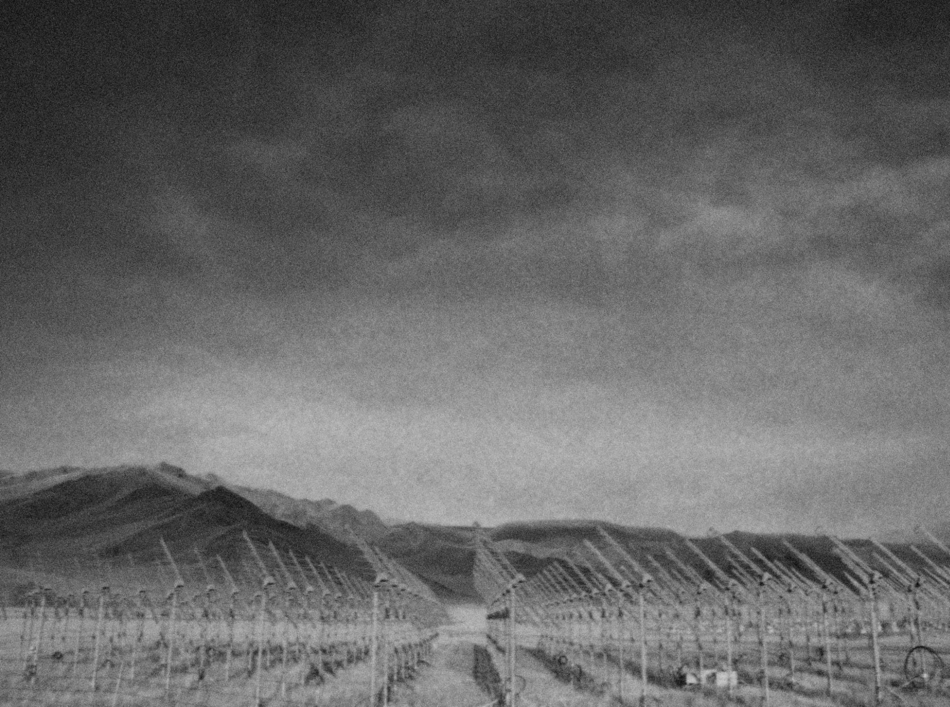
Autonomous detection of air showers with the TREND radio-array
Olivier Martineau-Huynh
TeVPA2017, Columbus
Aug. 10, 2017

Slide 2
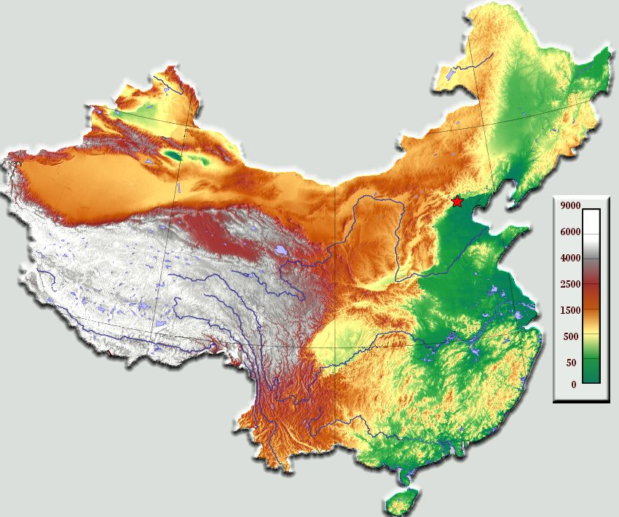
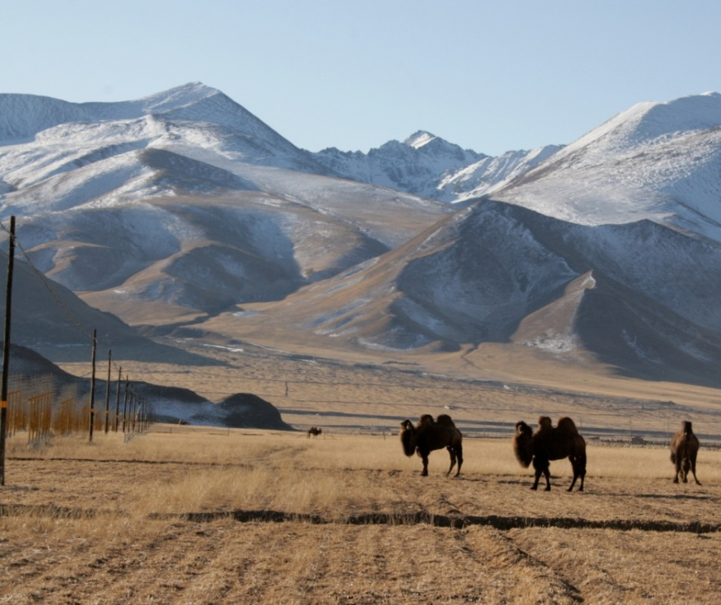
Autonomous radio-detection
Urumqi
Ulastai
Beijing
Cheap, light & robust: radio is an
appealing technique for giant detectors
of HE air showers.
Background sources are a major challenge for ground-based radio experiments.
TREND proposal (2008): tiny group from China (Wu XiangPing NAOC, Hu HongBo IHEP) & France (P. Lautridou Nantes, V. Niess Clermont-Ferrand, OM Paris/NAOC/IHEP) aiming at demonstrating that self-triggered radio trigger + identification of air shower is possible.
Site: 21CMA radio interferometer, XinJiang Province, China
Short waves
Simulated
galactic bckgd
Measured bckgd noise

Slide 3
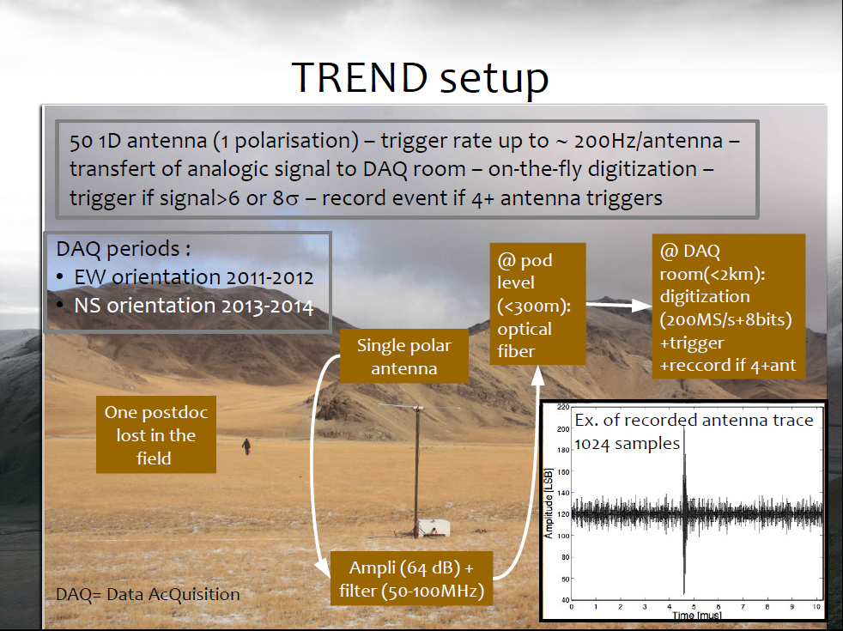

Slide 4
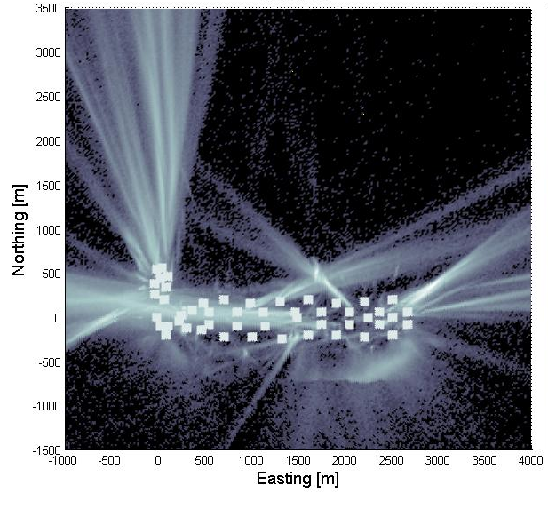
Radio background
TREND-50 antennas
radio array:
2011-2012 data
(E-W polarization)
316 DAQ days analyzed
8 10⁹ triggers recorded ⬄ 8TBy
7 10⁸ coincidences
~25Hz event rate
over whole array (physical origin)
Expected EAS trigger rate:
~40/day
TREND antenna
Reconstructed source position
Background rejection is a key issue for EAS radio-detection.
Background sources: HV lines, radio emiters, train, cars, planes, thunderstorms…

Slide 5
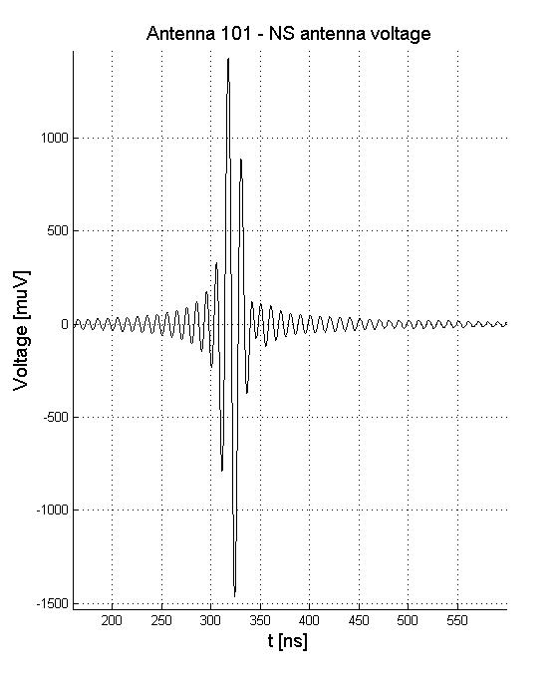
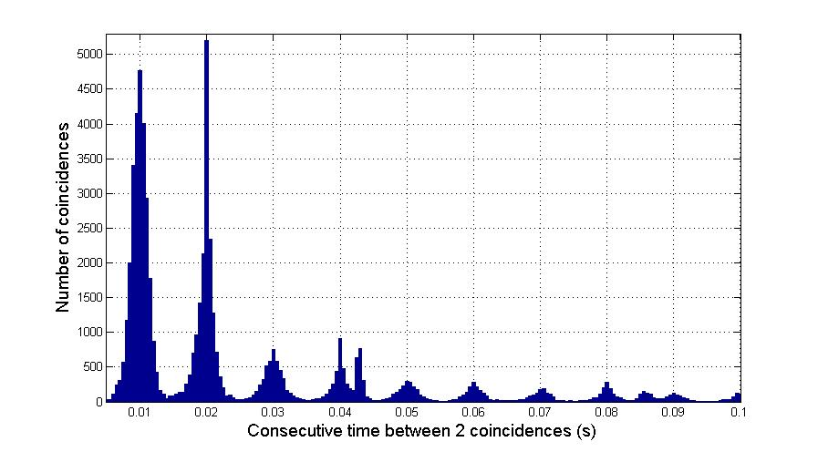
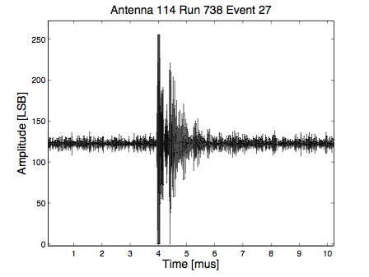
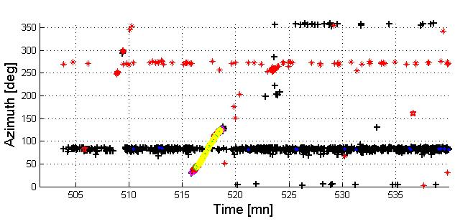
Discriminating parameters
10 ms ⬄ 50Hz
power line
200ns
Simulated EAS trace
2000ns
Data trace

Slide 6
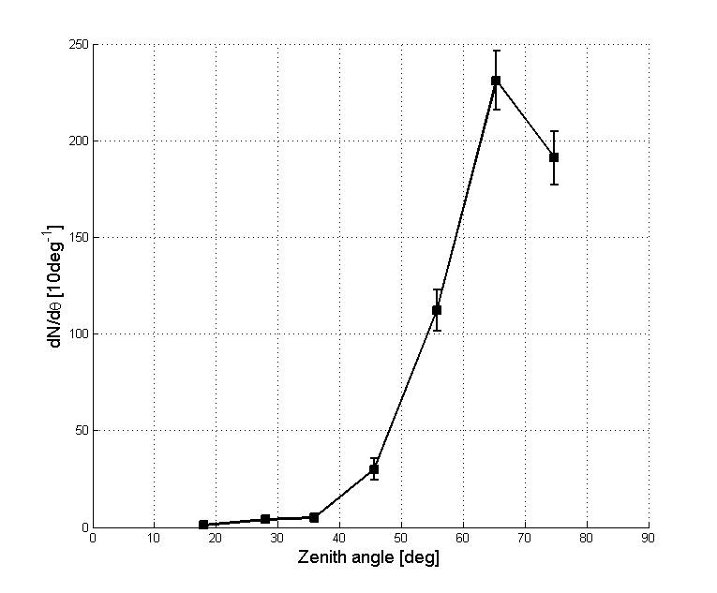
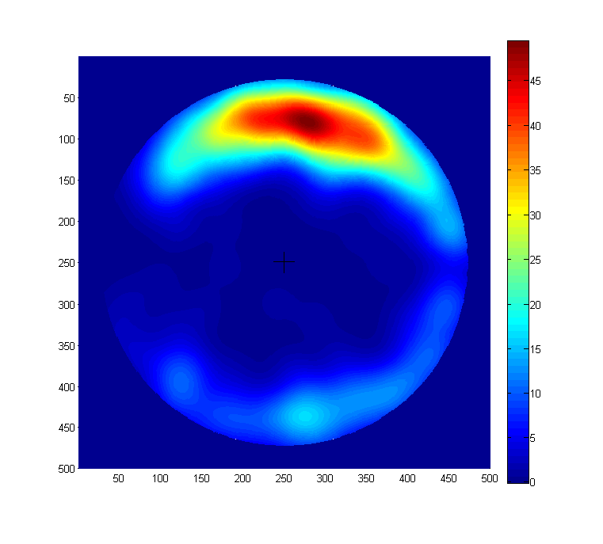
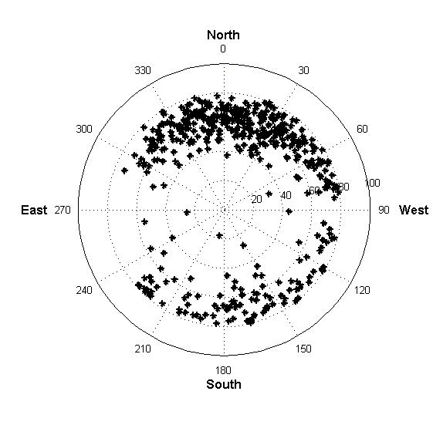
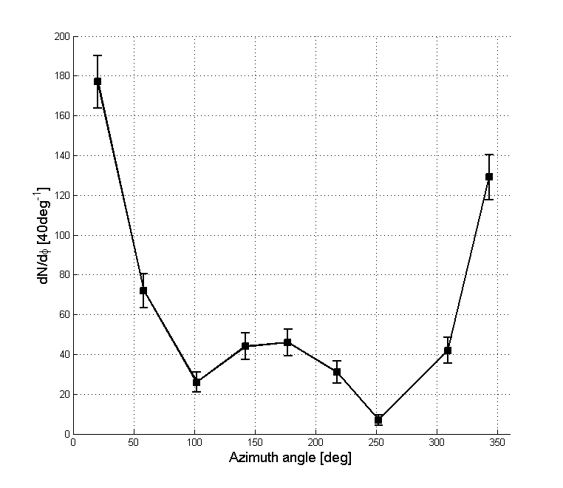
TREND EAS candidates
90°
60°
30°
Excess to North
(α~90°)
Deficit to
East & West
(α~0°)
2011-2012 data - 316 DAQ days
EW polar
574 EAS candidates

Slide 7
TREND real-time event simulation
Primary
(A, E, θ,ϕ, x_{core})
p or Fe, 11 fixed energies in [5 10¹⁶, 5 10¹⁸eV], random sky distribution & random core position (<1km of detector)
Air shower + radio simulation
ZHAireS or Conex+EVA. ~8 10⁶ simulation so far (and running)
E [V/m] @
antenna positions
Antenna response simulation
NEC2 code
Voltage [V] @
antenna foot
Propagation through DAQ chain at fixed random time
Signal @ ADC
Calibration: g(t)
Voltage [LSB]
@ DAQ
Selected simulated events inserted in data set.
Perform blind analysis. Completed on 80 days subset so far.
signal
@ disk
Retrieve noise & computer status at fixed random time. Evaluate trigger and select event if 4+ antennas are OK.

Slide 8
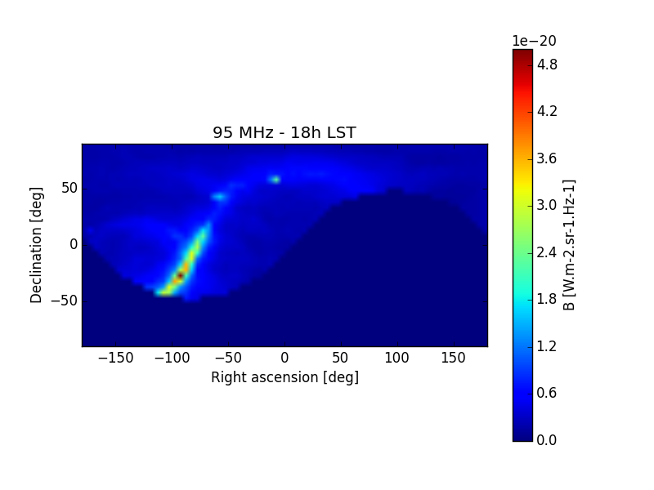
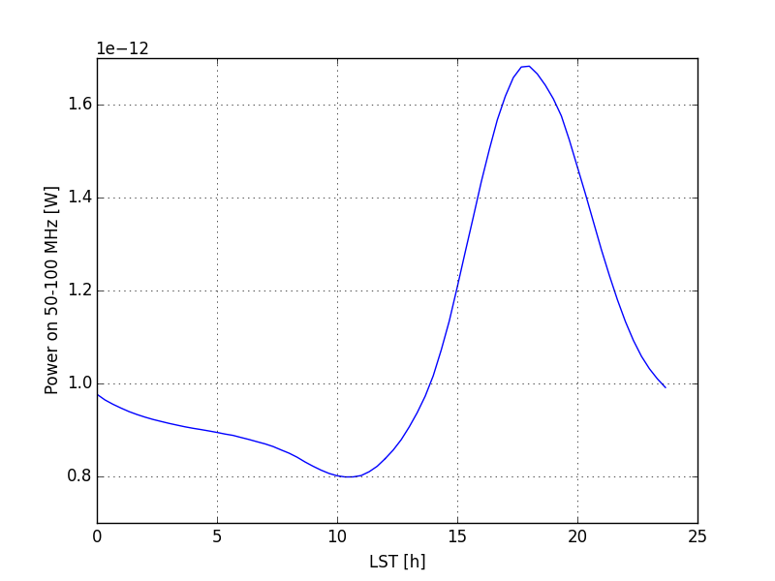
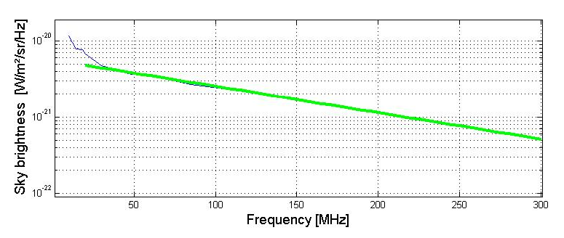
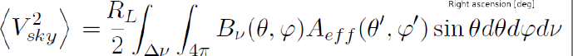
TREND calibration
[S. Le Coz, V. Niess]
In TREND frequency range, sky emission highly dominated by Galactic plane radiation.
Very well known ➔ provides a stable & periodic source for calibration & monitoring.
95MHz sky in TREND antenna FoV @ 18h LST
TREND antenna
Galactic simulation
EW polarisation

Slide 9
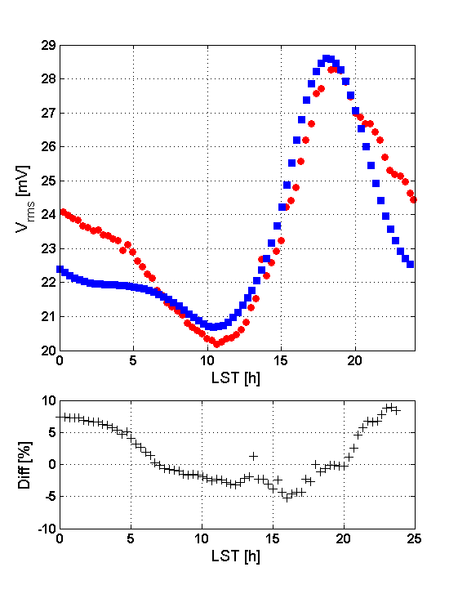
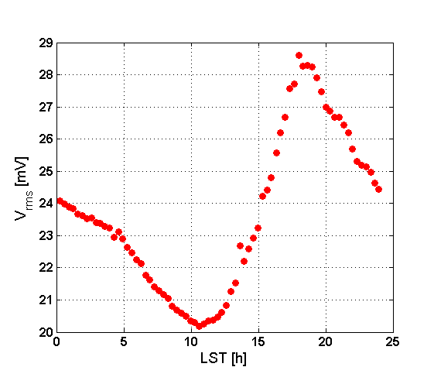
TREND calibration
TREND antenna
Galactic simulation
@ antenna foot
TREND monitoring data
Galactic sim signal x g
x gain
TREND monitoring
data @ DAQ
Antenna 105
March 19-20, 2012

Slide 10
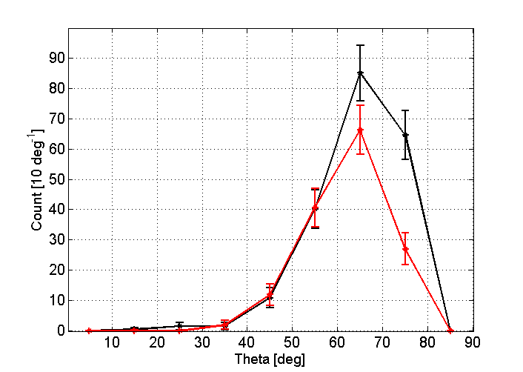
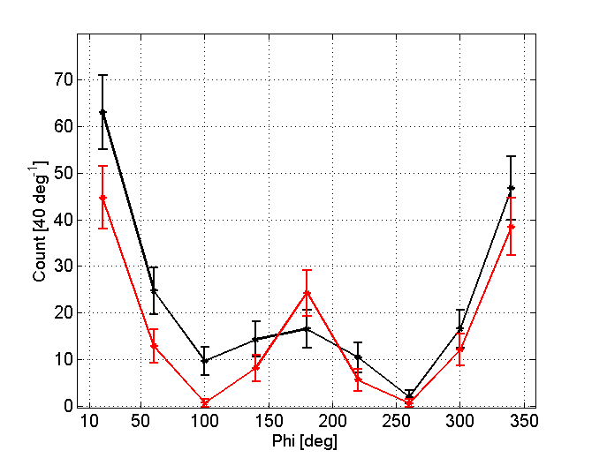
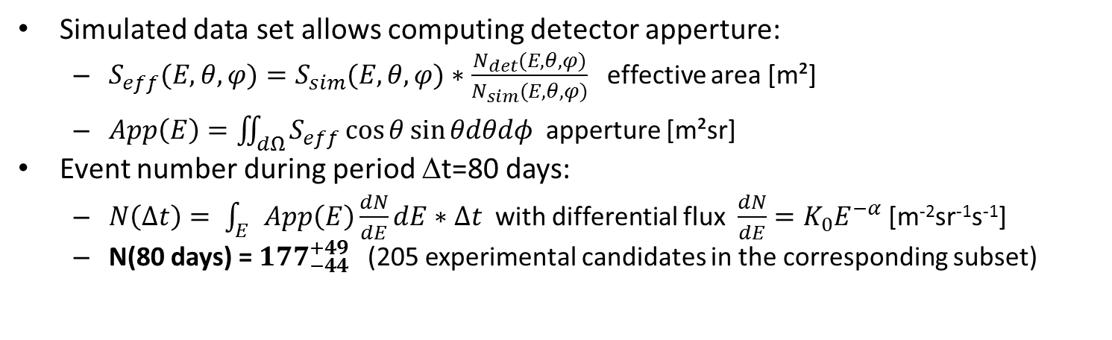
Results
Simulated data set allows computing detector apperture:
  $S_{eff}(E,θ,φ)=S_{sim}(E,θ,φ)∗\frac{N_{det}(E,θ,φ)}{N_{sim}(E,θ,φ)}$ effective area [m²]
  $App\left(E\right)=\iint_{dΩ}{S_{eff}\cos{θ}sin{θdθdφ} }$apperture [m²sr]
Event number during period Δt=80 days:
  $N\left(Δt\right)= \int_{E}{App\left(E\right)\frac{dN}{dE}dE}∗Δt$ with differential flux $\frac{dN}{dE}=K_{0}E^{−α}$ [m⁻²sr⁻¹s⁻¹]
  N(80 days) = ${177}_{−44}^{+49}$(205 experimental candidates in the corresponding subset)
Zenith distribution
Azimuth distribution
Data
Simulated TREND events
S. Le Coz
S. Le Coz
TREND has performed autonomous detection of air showers from ultra-dominant background with limited background contamination (<30%)

Slide 11
Simulated events
Random (θ,ϕ)
Random core position
Random t
DAQ time: 80 days (02-06/2012)
Preliminary results
To be confirmed with full TREND dataset (317 days)
5+ antenna triggers
«ideal» detector: Antenna+DAQ live time = 100%
Expected
nb of events:
2192
Instantaneous antenna + DAQ status
ε_{det}~20%
«ideal» selection: 100% EAS pass cuts
Expected
nb of events:
381
ε_{tot}~8%
Offline EAS selection
Expected
nb of events:
177
ε_{sel}~50%
TREND EAS selection

Slide 12
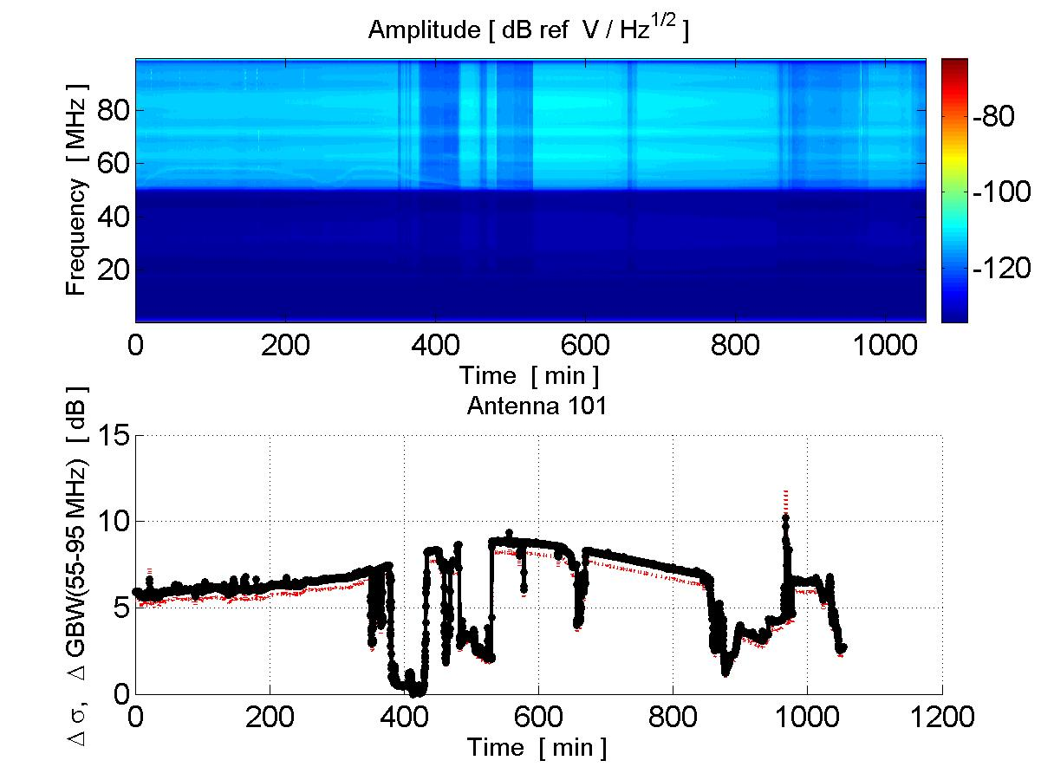
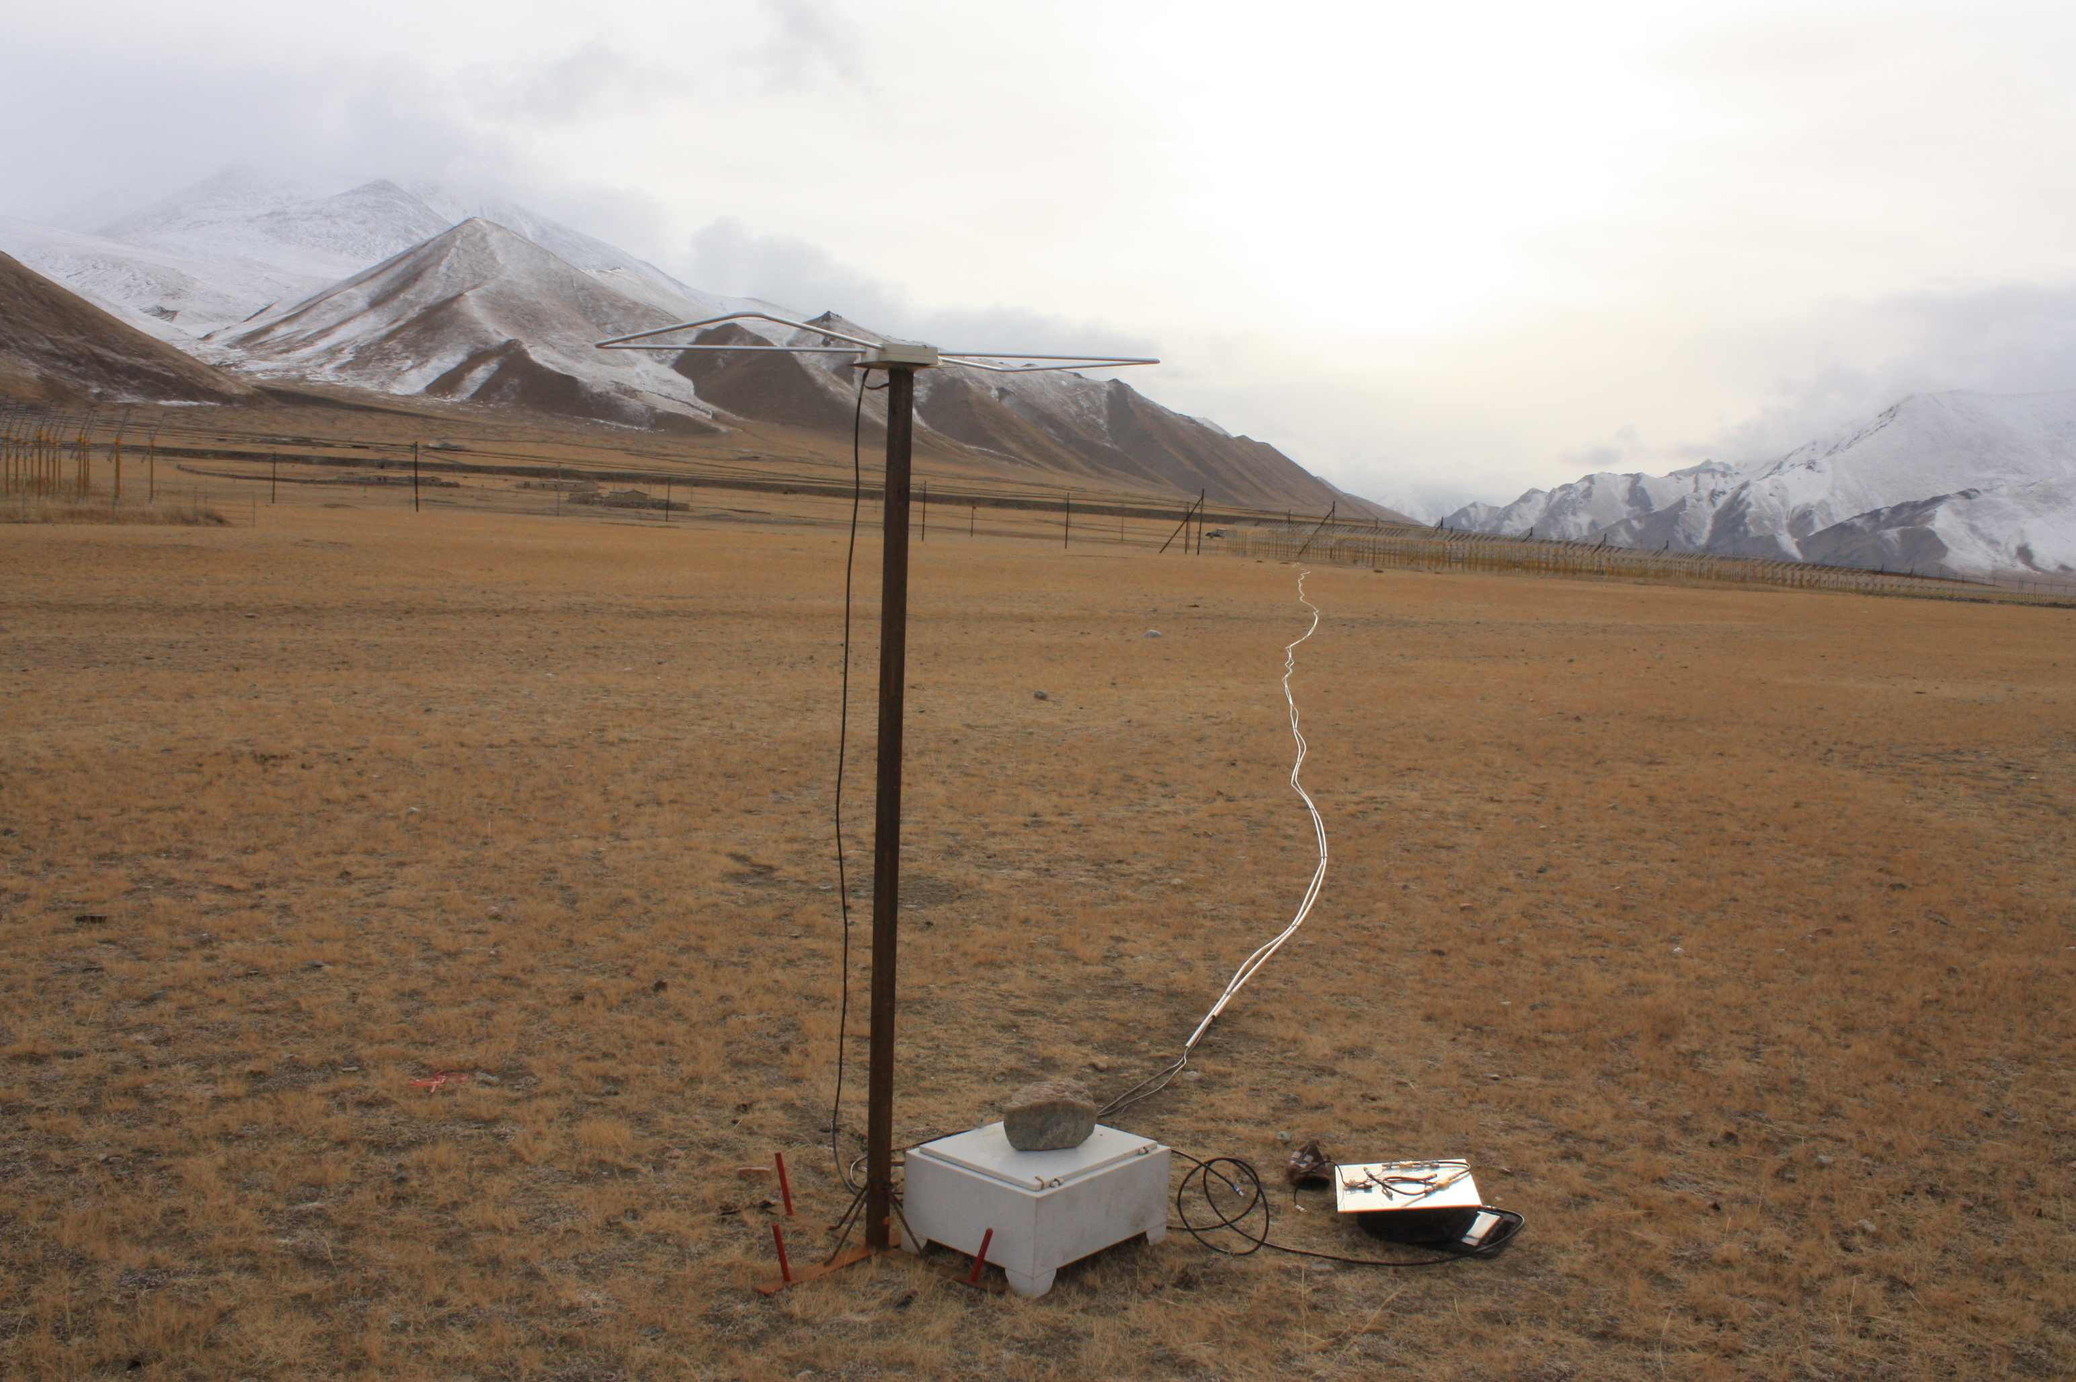
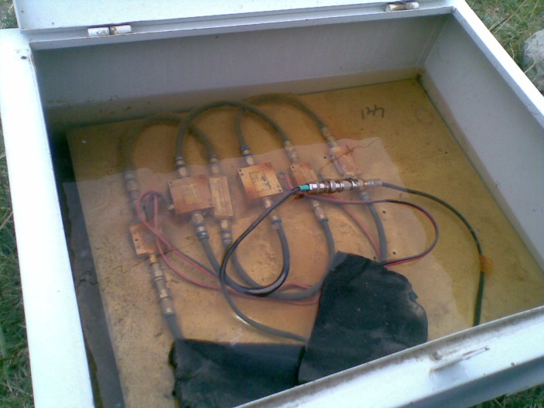
TREND issues
«You get what you pay for»: system reliability questionnable
  Sudden drops in gain
  Aging (antennas, amplifiers, optical system, computers…)
50-100MHz noise level (dB)

Slide 13
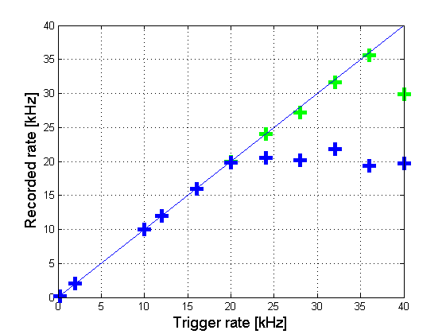
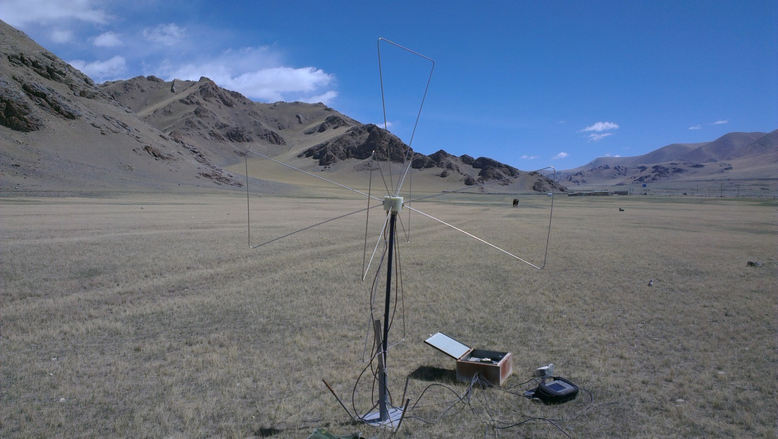
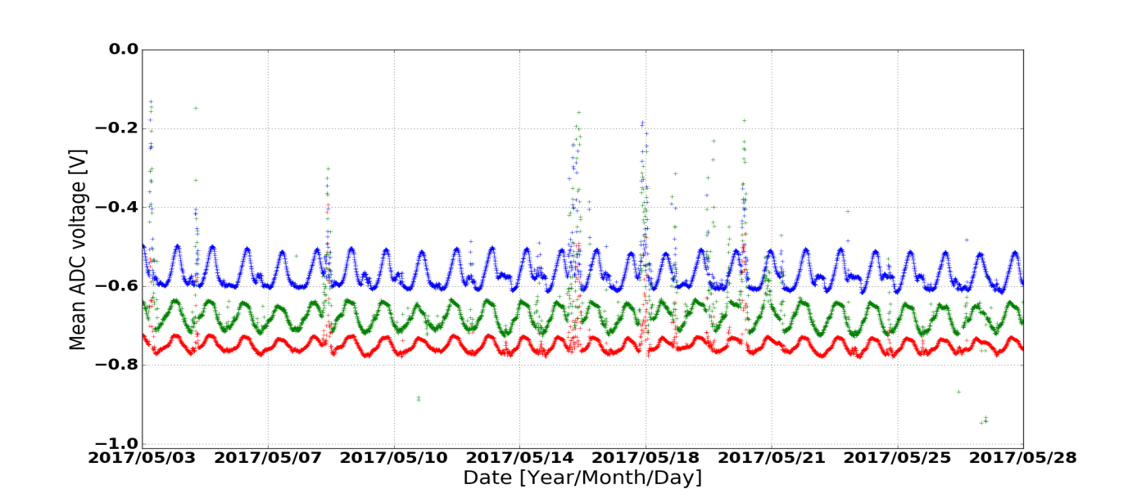
Next steps
Recorded trace duration = 3µs
Recorded trace duration = 1.5µs
GRANDproto35: dedicated setup of 35 antennas deployed on the TREND site. Goal: optimized detection efficiency & air shower purity
  Polarization measurement (3 arms antenna) brings additionnal tools for background rejection
  Dedicated electronics & DAQ (developped at LPNHE) should allow ~100% live time.
  ➔ Expecting improved detection efficiency & background rejection compared to TREND.
X arm Y arm Z arm
26 days

Slide 14
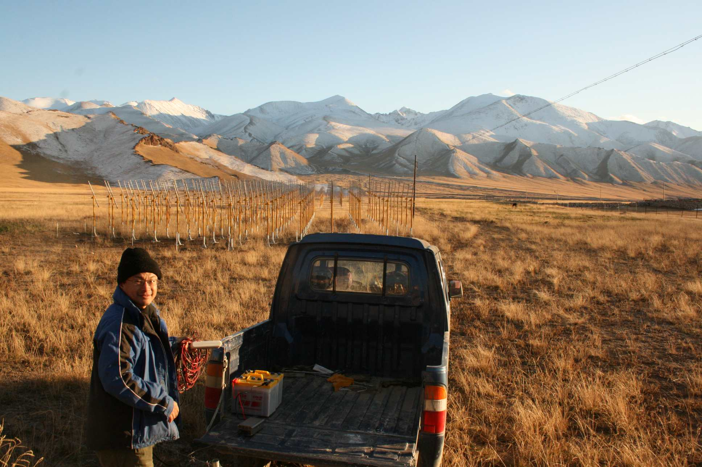
Conclusion
TREND accomplished its initial goal: performing succesfull detection & identification of air shower with an autonomous radio array. Paper in preparation.
Limited detection efficiency & sample purity due to flows in TREND setup. Should be fixed on GRANDproto35 (starting early 2018), a first step towards GRAND [Zilles, Friday PM].
谢谢

Slide 16
Cut efficiency
Cut | % survival | N_{coincs} final | % survival [simu] | N_{coins} [simu] (not E weighted)
« 50Hz » cut | 8% | 6.3 10⁷ | 82% | 1526
Pulse duration | 46% | 2.9 10⁷ | 86% | 1312
Multiplicity > 4 | 51% | 1.4 10⁷ | 80% | 1050
Valid reconstruction | 67% | 1.0 10⁷ | 99% | 1040
Radius > 3000m | 35% | 3.4 10⁶ | 95% | 988
Θ < 80° | 30% | 1.0 10⁶ | 98% | 968
Trigger pattern/ Extension | 32% | 3.3 10 ⁵ | 88% | 855
Neighbourgs (direction) | 0.3% | 1440 | 85% | 725
Neighbourgs (time) | 40% | 574 | 92% | 668
Simulated EAS selection cuts survival rate: 37% (46% if multiplicity cut excluded)

Slide 17
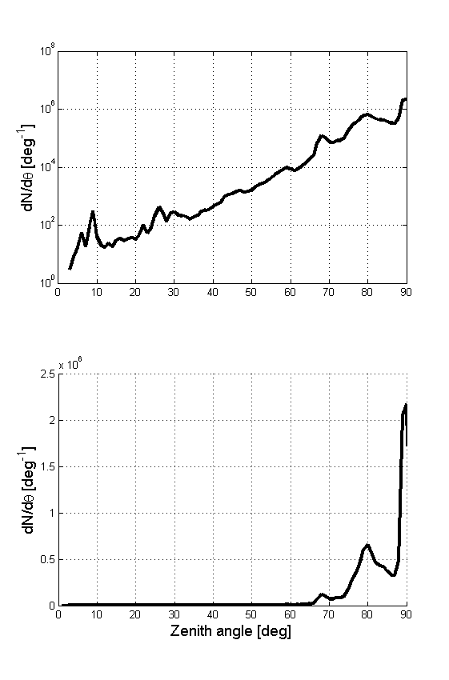
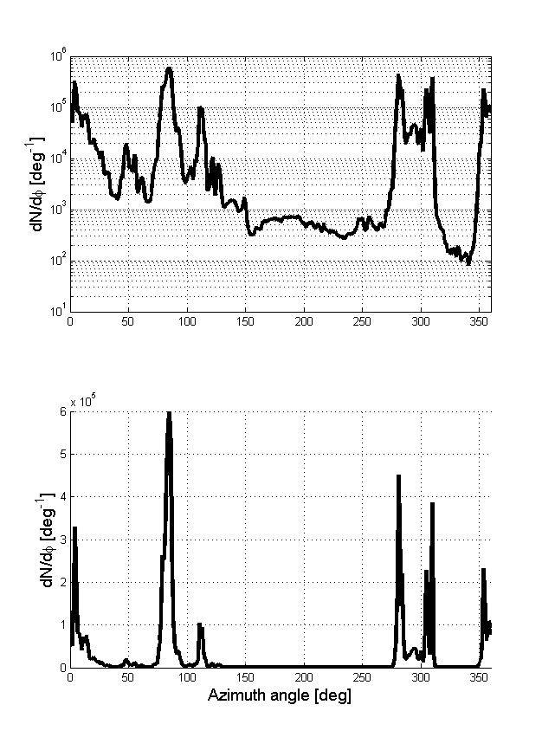
Radio background
Zenith distribution
Azimuth distribution
Log scale
Here selecting plane wavefronts only (curvature radius>500m)
Most events coming from specific directions (N,E,W) along horizon (static noise sources)
North
West
South
East
Lin scale

Slide 18
Direction distribution
Shapes of zenith and azimuth distributions of experimental radio candidates and simulated EAS are compatible.
Excess of experimental data at large zenith angles & towards North & West (⬄ standard background sources)
Excess most likely corresponds to background events passing cuts.
Still to be refined, but already TREND has performed autonomous detection & identification of EAS, sample purity ~ 70%.
Azimuth distribution
All data
Zenith distribution
Azimuth distribution
Experimental EAS candidates
[normalized to 205 events]
Simulated EAS events (f=0.8)
Experimental EAS candidates
[normalized to 205 events]
Simulated EAS events (f=0.8)
PRELIMINARY
PRELIMINARY

